Slide 1

What is a digital signature?
Online Cryptography Course Dan Boneh
Digital Signatures

Slide 2
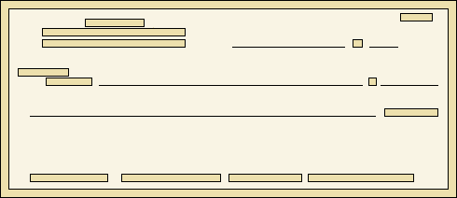

Physical signatures
Goal: bind document to author
Bob agrees to pay Alice 1$
Bob agrees to pay Alice 100$
Problem in the digital world:
anyone can copy Bob’s signature from one doc to another
Notes:
Bad example: will see why on the last slide of this segment.

Slide 3
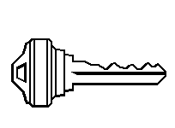

Digital signatures
Solution: make signature depend on document
Signer
Verifier
‘accept’
or
‘reject’
Bob agrees to pay Alice 1$
verifier
signature
signing
algorithm
secret signing
key (sk)
public verification
key (pk)

Slide 4


A more realistic example
Software vendor
clients
pk
software update
sig
untrusted
hosting
site
pk
secret signing
key (sk)
signing
algorithm
verify sig,
install if valid
Notes:
Could be millions of clients. All can verify signature. Same software update sent to everyone.
Much harder to do with MACs. Generally, signatures are needed when many verifiers need to verify signature.

Slide 5
Digital signatures: syntax
Def: a signature scheme (Gen,S,V) is a triple of algorithms:
  Gen(): randomized alg. outputs a key pair (pk, sk)
  S(sk, m∈M) outputs sig. σ
  V(pk, m, σ) outputs ‘accept’ or ‘reject’
Consistency: for all (pk, sk) output by Gen :
∀m∈M: V(pk, m, S(sk, m) ) = ‘accept’

Slide 6
Digital signatures: security
Attacker’s power: chosen message attack
for m₁,m₂,…,m_{q} attacker is given σ_{i} ← S(sk, m_{i})
Attacker’s goal: existential forgery
produce some new valid message/sig pair (m, σ).
  m ∉ { m₁ , … , m_{q} }
⇒ attacker cannot produce a valid sig. for a new message

Slide 7
Secure signatures
For a sig. scheme (Gen,S,V) and adv. A define a game as:
Def: SS=(Gen,S,V) is secure if for all “efficient” A:
Adv_{SIG}[A,SS] = Pr[ A wins] is “negligible”
pk
Chal.
Adv.
m₁ ∈ M
m₂
, …, m_{q}
(pk,sk)←Gen
σ₁ ← S(sk,m₁)
σ₂
, …, σ_{q}
(m,σ)
Adv. wins if V(pk,m,σ) = `accept’ and m ∉ {m₁, … , m_{q}}

Slide 8
Let (Gen,S,V) be a signature scheme.
Suppose an attacker is able to find m₀ ≠ m₁ such that
V(pk, m₀, σ) = V(pk, m₁, σ) for all σ and keys (pk, sk) ← Gen
Can this signature be secure?
Yes, the attacker cannot forge a signature for either m₀ or m₁
No, signatures can be forged using a chosen msg attack
It depends on the details of the scheme

Slide 9
Alice generates a (pk,sk) and gives pk to her bank.
Later Bob shows the bank a message m=“pay Bob 100$” properly signed by Alice, i.e. V(pk,m,sig) = ‘yes’
Alice says she never signed m. Is Alice lying?
Alice is lying: existential unforgeability means Alice signed m
and therefore the Bank should give Bob 100$ from Alice’s account
Bob could have stolen Alice’s signing key and therefore
the bank should not honor the statement
What a mess: the bank will need to refer the issue to the courts
Notes:
Existential unforgeability does not provide legal guarantees. It only ensures that whoever generated the signature had access to a signing key.

Slide 10
End of Segment

Slide 11
Applications
Online Cryptography Course Dan Boneh
Digital Signatures

Slide 12
Applications
Code signing:
Software vendor signs code
Clients have vendor’s pk. Install software if signature verifies.
software vendor
many clients
initial software install (pk)
pk
sk
[ software udate #1 , sig ]
[ software udate #2 , sig ]

Slide 13

More generally:
One-time authenticated channel (non-private, one-directional) ⟹ many-time authenticated channel
Initial software install is authenticated, but not private
Sender
Recipients
one-time authenticated channel
pk
(pk, sk) ← Gen
pk
eavesdrop, but not modify
sig₁← S(sk, m₁)
m₁
sig₁
sig₂← S(sk, m₂)
m₂
sig₂
⋮
Notes:
If sender can only send one authenticated message to receiver, then send pk. This lets sender send many more authenticated messages.
Stateless: messages are sent and received independently of one another. Otherwise, TESLA can be used (good exercise).

Slide 14

Important application: Certificates
Problem: browser needs server’s public-key to setup a session key
Solution: server asks trusted 3rd party (CA) to sign its public-key pk
Certificate
Authority (CA)
browser
Gmail.com
choose
(pk, sk)
pk and
proof “I am Gmail”
verification key
check
proof
pk_{CA}
pk_{CA}
Sign Cert using sk_{CA} :
sk_{CA}
verify
cert
pk is key
for Gmail
pk is key
for Gmail
CA
sig
signing key
CA
sig
Server uses Cert for an extended period (e.g. one year)
Notes:
One signer (CA), many verifiers (browsers).
Everyone is assumed to have pk_CA.

Slide 15
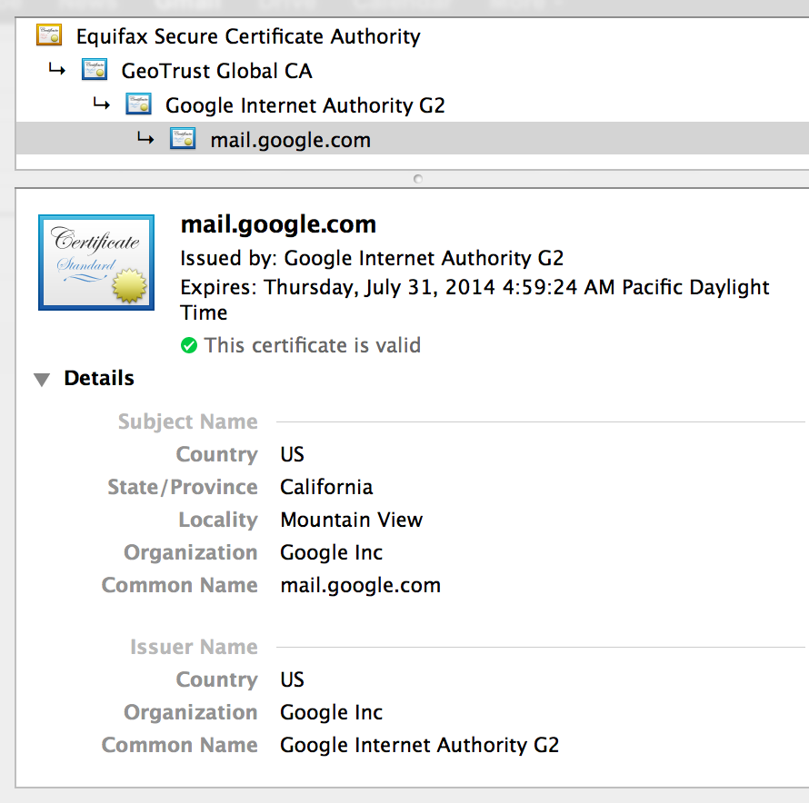
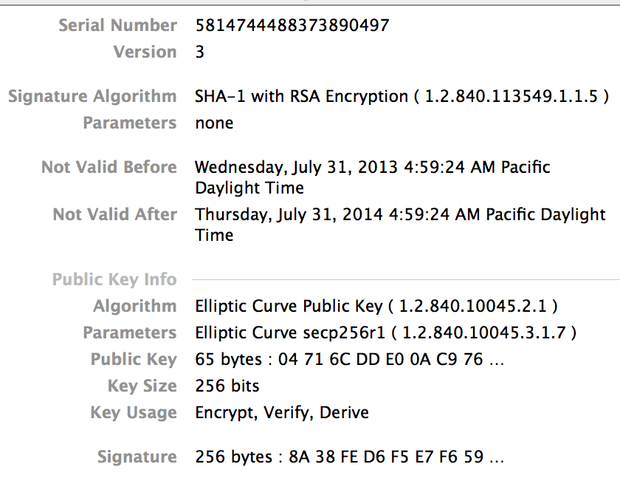
Certificates: example
Important fields:

Slide 16
What entity generates the CA’s secret key sk_{CA} ?
the browser
Gmail
the CA
the NSA

Slide 17
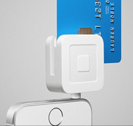
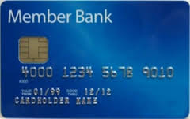
Applications with few verifiers
EMV payments:
(greatly simplified)
Signed email: sender signs email it sends to recipients
Every recipient has sender’s public-key (and cert).
A recipient accepts incoming email if signature verifies.
transaction details
(nonce, PIN)
sk
signature
(card cert)
transaction details
and signature
Point of Sale
terminal
Notes:
For DDA (dynamic data authentication) and CDA (combined data authentication) cards.
Explain why can’t use a MAC: for EMV, don’t want POS terminal to modify transaction. For email, can’t generate a shared key: non-interactive.

Slide 18

Signing email: DKIM (domain key identified mail)
Problem: bad email claiming to be from someuser@gmail.com
but in reality, mail is coming from domain baguy.com
⇒ Incorrectly makes gmail.com look like a bad source of email
Solution: gmail.com (and other sites) sign every outgoing mail
From: bob@gmail.com
DNS
email
query
body
body
Recipients
Gmail pk
signing key
sig
verify sig
Gmail
user
Gmail.com
badguy.com ??
Notes:
Problem: source domain of email is unauthenticated. Interferes with blacklisting services that block sources of bad emails.
DKIM assumes the channel Gmail -> DNS -> recipient is authenticated (but not private): attacker cannot feed its own key as Gmail’s key.

Slide 19
example DKIM header from gmail.com
X-Google-DKIM-Signature: v=1; a=rsa-sha256; c=relaxed/relaxed;
d=1e100.net; s=20130820;
h=x-gm-message-state:mime-version:in-reply-to:references:from:date:
message-id:subject:to:content-type;
bh=MDr/xwte+/JQSgCG+T2R2Uy+SuTK4/gxqdxMc273hPQ=;
b=dOTpUVOaCrWS6AzmcPMreo09G9viS+sn1z6g+GpC/ArkfMEmcffOJ1s9u5Xa5KC+6K
XRzwZhAWYqFr2a0ywCjbGECBPIE5ccOi9DwMjnvJRYEwNk7/sMzFfx+0L3nTqgTyd0ED
EGWdN3upzSXwBrXo82wVcRRCnQ1yUlTddnHgEoEFg5WV37DRP/eq/hOB6zFNTRBwkvfS
0tC/DNdRwftspO+UboRU2eiWaqJWPjxL/abS7xA/q1VGz0ZoI0y3/SCkxdg4H80c61DU
jdVYhCUd+dSV5fISouLQT/q5DYEjlNQbi+EcbL00liu4o623SDEeyx2isUgcvi2VxTWQ
m80Q==
(lookup 20130820. _domainkey.1e100.net in DNS for public key)
(hash of message body)
Gmail’s signature on headers, including DKIM header (2048 bits)
Notes:
b=(signature on headers); bh=(hash of message body using SHA-256); d=(signing domain); s=(selector); h=(list of signed header fields); c=(canonicalization algorithm)
1e100 = 10^100 = googol : 1e100.net is a Google domain
Domain field (d=1e100.net) is verified by signing practice (from previous gmail.com emails or by querying DNS for ADSP (RFC 5617)). Also see DMARC.

Slide 20
Suppose recipients could retrieve new data from DNS for every email received, could Gmail implement DKIM without signatures?
(ignoring, for now, the increased load on the DNS system)
Yes, Gmail would write to DNS a collision-resistant hash
of every outgoing email. The recipient retrieves the hash
from DNS and compares to the hash of the incoming message.
No, the proposal above is insecure.
⇒ Signatures reduce the frequency that recipients need to query DNS

Slide 21
Applications: summary
Code signing
Certificates
Signed email (e.g. DKIM)
Credit-card payments: EMV
and many more.

Slide 22
When to use signatures
Generally speaking:
If one party signs and one party verifies: use a MAC
  Often requires interaction to generate a shared key
  Recipient can modify the data and re-sign it before
  passing the data to a 3rd party
If one party signs and many parties verify: use a signature
  Recipients cannot modify received data before
  passing data to a 3rd party (non-repudiation)

Slide 23
Review: three approaches to data integrity
1. Collision resistant hashing: need a read-only public space
Software
Vendor
Small read-only
public space
Alice
2. Digital signatures: vendor must manage a long-term secret key
Vendor’s signature on software is shipped with software
Software can be downloaded from an untrusted distribution site
Bob
3. MACs: vendor must compute a new MAC of software for every client
and must manage a long-term secret key (to generate a per-client MAC key)
Notes:
Draw untrusted distribution site and the interaction with clients as they download software.

Slide 24
End of Segment

Slide 25
Constructions overview
Online Cryptography Course Dan Boneh
Digital Signatures

Slide 26
Review: digital signatures
Def: a signature scheme (Gen,S,V) is a triple of algorithms:
  Gen(): randomized alg. outputs a key pair (pk, sk)
  S(sk, m∈M) outputs sig. σ
  V(pk, m, σ) outputs ‘yes’ or ‘no’
Security:
Attacker’s power: chosen message attack
Attacker’s goal: existential forgery

Slide 27
Extending the domain with CRHF
Let Sig=(Gen, S, V) be a sig scheme for short messages, say M = {0,1}²⁵⁶
Let H: M^{big} → M be a hash function (s.g. SHA-256)
Def: Sig^{big} = (Gen, S^{big} , V^{big} ) for messages in M^{big} as:
S^{big}(sk, m) = S(sk,H(m)) ; V^{big}(pk, m, σ) = V(pk,H(m),σ)
Thm: If Sig is a secure sig scheme for M and H is collision resistant
then Sig^{big} is a secure sig scheme for M^{big}
⟹ suffices to construct signatures for short 256-bit messages

Slide 28
Suppose an attacker finds two distinct messages m₀, m₁
such that H(m₀) = H(m₁) . Can she use this to break Sig^{big} ?
No, Sig^{big} is secure because the underlying scheme Sig is
It depends on what underlying scheme Sig is used
Yes, she would ask for a signature on m₀ and obtain an
existential forgery for m₁

Slide 29
Primitives that imply signatures: OWF
Recall: f: X ⟶Y is a one-way function (OWF) if:
easy: for all x∈X compute f(x)
inverting f is hard:
Example: f(x) = AES(x, 0)
Signatures from OWF: Lamport-Merkle (see next module), Rompel
Signatures are long: stateless ⇒ > 40KB
stateful ⇒ > 4KB
key
Notes:
Will define OWF precisely in the next module (also in lecture 12.4). Lamport-Merkle signatures actually need CRHF.

Slide 30
Primitives that imply signatures: TDP
Recall: f: X ⟶X is a trapdoor permutation (TDP) if:
easy: for all x∈X compute f(x)
inverting f is hard, unless one has a trapdoor
Example: RSA
Signatures from TDP: very simple and practical (next segment)
Commonly used for signing certificates
Notes:
Will define OWF precisely in the next module

Slide 31
Primitives that imply signatures: DLOG
G = {1,g,g²,…,g^{q-1}}: finite cyclic group with generator g , |G| = q
discrete-log in G is hard if f(x) = g^{x} is a one-way function
note: f(x+y) = f(x) ⋅ f(y)
Examples: = (multiplication mod p) for a large prime p
= (group of points on an elliptic curve mod p)
Signatures from DLOG: ElGamal, Schnorr, DSA, EC-DSA, …
Will construct these signatures in week 3

Slide 32
End of Segment

Slide 33
Signatures From Trapdoor Permutations
Online Cryptography Course Dan Boneh
Digital Signatures

Slide 34
Review: Trapdoor permutation (G, F, F⁻¹)
Key Gen
G
pk
sk
F
F⁻¹
x
y
y
x
f(x) = F(pk, x) is one-to-one (X ⟶ X) and is a one-way function.
Notes:
Standard example: RSA

Slide 35
Full Domain Hash Signatures: pictures
S(sk, msg):
V(pk, msg, sig):
msg
msg
H
H
≟ ⇒
accept
or
reject
F⁻¹(sk,⋅)
sig
F(pk,⋅)
sig

Slide 36
Full Domain Hash (FDH) Signatures
(G_{TDP}, F, F⁻¹ ): Trapdoor permutation on domain X
H: M ⟶ X hash function (FDH)
(Gen, S, V) signature scheme:
Gen: run G_{TDP} and output pk, sk
S(sk, m∈M): output σ ⟵ F⁻¹(sk, H(m))
V(pk, m, σ): output ‘accept’ if F(pk, σ) = H(m)
‘reject’ otherwise

Slide 37
Security
Thm [BR]: (G_{TDP}, F, F⁻¹) secure TDP ⇒ (Gen, S, V) secure signature
when H: M ⟶ X is modeled as an “ideal” hash function
Difficulty in proving security:
us
adversary
pk, F(pk, x)
pk
Signature
Forger
m_{i}
⟲
How can use use forger?
σ_{i}
x
(m,σ)
Solution: “we” will know sig. on all-but-one of m where adv. queries H().
Hope adversary gives forgery for that single message.
Notes:
Recall: security means EUF security.

Slide 38
Why hash the message?
Suppose we define NoHash-FDH as:
S’(sk, m∈X): output σ ⟵ F⁻¹(sk, m)
V’(pk, m, σ): output ‘accept’ if F(pk, σ) = m
Is this scheme secure?
Yes, it is not much different than FDH
No, for any σ∈X, σ is a signature forgery for the msg m=F(pk, σ)
Yes, the security proof for FDH applies here too
It depends on the underlying TDP being used
Notes:
The hash prevents this attack because given H(m):=F(pk, σ) the attacker can’t find m

Slide 39
RSA-FDH
Gen: generate an RSA modulus N = p⋅q and e⋅d = 1 mod φ(N)
construct CRHF H: M ⟶ Z_{N}
output pk = (N,e,H) , sk = (N,d,H)
S(sk, m∈M): output σ ⟵ H(m)^{d} mod N
V(pk, m, σ): output ‘accept’ if H(m) = σ^{e} mod N
Problem: having H depend on N is slightly inconvenient

Slide 40
PKCS1 v1.5 signatures
RSA trapdoor permutation: pk = (N,e) , sk = (N,d)
S(sk, m∈M):
output: σ ⟵ (EM)^{d} mod N
V(pk, m∈M, σ ): verify that σ^{e} mod N has the correct format
Security: no security analysis, not even with ideal hash functions
256 bits
16 bits
EM =
01
0xFF 0xFF 0xFF … 0xFF 0xFF
00
H(m)
RSA modulus size (e.g. 2048 bits)
Notes:
The goal of the pad is to make sure we only compute roots of large values. Computing cube roots of small values (e.g. 256 bits) is vulnerable to Desmedt-Odlyzko attacks.

Slide 41
RSA signatures in practice often use e=65537 (and a large d).
As a result, sig verification is ≈20x faster than sig generation.
e=3 gives even faster signature verification.
Suppose an attacker finds an m*∈M such that
EM is a perfect cube (e.g. 8=2³, 27=3³, 64=4³).
Can she use this m* to break PKCS1?
Yes, the cube root of EM (over the integers) is a sig. forgery for m*
No, this has no impact on PKCS1 signatures
Yes, but the attack only works for a few 2048-bit moduli N
It depends on what hash function is begin used

Slide 42
End of Segment

Slide 43
Security Proofs
(optional)
Online Cryptography Course Dan Boneh
Digital Signatures

Slide 44
Proving security of RSA-FDH
(G, F, F⁻¹): secure TDP with domain X
Recall FDH sigs: S(sk, m) = F⁻¹(sk, H(m)) where H: M ⟶ X
We will show: TDP is secure ⇒ FDH is secure, when H is a random function
us
adversary
pk, y=F(pk, x)
pk
Signature
Forger
m_{i}
⟲
σ_{i}
m_{i}
⟲
H(m_{i})
x
(m,σ)
Notes:
To prove security based on the security of the TDP we have to cheat: we have to assume that H is a random oracle.
q_H: denotes upper bound on number of hash queries from forger.

Slide 45
Proving security
Thm [BR]: (G_{TDP}, F, F⁻¹) secure TDP ⇒ (G_{TDP}, S, V) secure signature
when H: M ⟶ X is modeled as a random oracle.
∀A ∃B: Adv_{SIG}[A,FDH] ≤ q_{H} ⋅ Adv_{TDP}[B,F]
Proof:
^{(RO)}
B
A
pk, y=F(pk, x)
pk
Signature
Forger
choose i* ⟵ {1,…,q_{H}}
m_{i}
⟲
H(m_{i})
if i ≠ i*: x_{i} ⟵ X, H(m_{i}) = F(pk, x_{i})
else: H(m_{i}) = y
m_{i}
⟲
σ_{i}
m = m_{i*} ⇒ σ = F⁻¹(sk, y) = x
(m,σ)
Pr[m=m_{i*}] = 1/q_{H}
Notes:
Adv^{(RO)} denotes advantage in the random oracle model.
If q_H < 2^64 and Adv_TDP is always < 2^{-192} then Adv_SIG < 2^{-128}. Reduction is not tight: we need TDP to be extra secure which implies larger parameters.
In the proof setting H(m_{i}) = F(pk, x_{i}) is valid because H maps m_{i} to a random element in X. This is where we use the fact that H is a full domain hash.

Slide 46
Proving security
Thm [BR]: (G_{TDP}, F, F⁻¹) secure TDP ⇒ (G_{TDP}, S, V) secure signature
when H: M ⟶ X is modeled as a random oracle.
∀A ∃B: Adv_{SIG}[A,FDH] ≤ q_{H} ⋅ Adv_{TDP}[B,F]
Proof:
^{(RO)}
So: Adv_{TDP}[B,F] ≥ (1/q_{H}) ⋅ Adv_{SIG}[A,FDH]
Prob. B
outputs x
Pr[m=m_{i*}]
Prob. forger A
outputs valid forgery

Slide 47
Alg. B has table:
m₁, x₁ : H(m₁) = F(pk, x₁)
m₂, x₂ : H(m₂) = F(pk, x₂)
⋮
How B answers a signature query m_{i} :
m_{i*}, H(m_{i*}) = y
⋮
m_{q}, x_{q} : H(m_{q}) = F(pk, x_{q})
Notes:
If forgery m equals mi* then mi \neq mi* , so easy to answer sig query. Also, assume H(mi) is already defined.

Slide 48
Partial domain hash:
Suppose (G_{TDP}, F, F⁻¹) is defined over domain X = {0,…,B-1}
but H: M ⟶ {0,…,B/2} .
Can we prove FDH secure with such an H?
No, FDH is only secure with a full domain hash
Yes, but we would need to adjust how B defines H(m_{i})
in the proof
It depends on what TDP is used
Notes:
If the hash domain gets too small then we can’t prove security.
This is the problem with PKCS1 v1.5: hash range is size 2^256, but TDP domain size is about 2^2048, so we can’t find an x s.t. F(pk,x) is in the small domain.

Slide 49
PSS: Tighter security proof
Some variants of FDH:
tight reduction from forger to inverting the TDP (no q_{H} factor).
Still assuming hash function H is “ideal.”
Examples:
PSS [BR’96]: part of the PKCS1 v2.1 standard
KW’03: S( (sk,k), m) = [ b⟵PRF(k,m)∈{0,1} , F⁻¹(sk, H(bllm)) ]
many others
Notes:
KW’03: specific to RSA. Needs random self reduction. PSS is tight for all TDPs.

Slide 50
End of Segment

Slide 51
Secure Signatures
Without Random Oracles
Online Cryptography Course Dan Boneh
Digital Signatures

Slide 52
A new tool: pairings
Secure signature without “ideal” hash function (a.k.a. random oracles):
can be built from RSA, but
most efficient constructions use pairings
G , G_{T} : finite cyclic groups G={1,g,…,g^{p-1}}
Def: A pairing e: G×G → G_{T} is a map:
  bilinear: e(gª, h^{b}) = e(g,h)^{ab} ∀a,b∈Z, g,h∈G
  efficiently computable and non-degenerate:
  g generates G ⇒ e(g,g) generates G_{T}
G
G_{T}
gª
e(g,h)^{ab}
h^{b}
Notes:
Useful for lots of things in crypto.

Slide 53
BLS: a simple signature from pairings
e: G×G → G_{T} a pairing where |G|=p , g∈G generator, H: M ⟶ G
Gen: sk = (random α in Z_{p}) , pk = g^{α} ∈ G
S(sk, m): output σ = H(m)^{α} ∈ G
V(pk, m, σ): accept if e( g, σ ) ≟ e( pk, H(m))
Thm: secure assuming CDH in G is hard, when H is a random oracle
Notes:
Write: CDH: g, gx, gy cannot compute gxy.
Explain EUF secure.

Slide 54
Security without random oracles [BB’04]
Gen: sk = (rand. α, β ⟵ Z_{p}) , pk = ( g , y=g^{α} ∈G , z=g^{β} ∈G )
S(sk, m∈Z_{p}): r⟵Z_{p}, σ = g^{1/(α+rβ+m)} ∈ G , output (r,σ)
V(pk, m, (r,σ)): accept if e( σ, y⋅z^{r}⋅g^{m} ) ≟ e(g,g)
Thm: secure assuming q_{S}-BDH in G is hard
∀A ∃B : Adv_{SIG}[A,BBsig] ≤ Adv_{qS-BDH}[B,G] + (q_{S}/p)
Notes:
Recall: security means existential unforgeability under a chosen message attack
Write out q-BDH: (g,g₁,…,g_{q}, h, h_{q+2}) can’t compute e(g_{q+1} , h)

Slide 55
Proof strategy
us
adversary
q-BDH challenge
pk
Signature
Forger
m_{i}
⟲
σ_{i}
solution
(m,σ)
σ
We choose pk so that:
⋯
⋯
m₀
m₁
m₂
m
m₂256

Slide 56
End of Segment

Slide 57

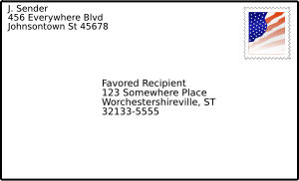

Reducing signature size
Online Cryptography Course Dan Boneh
Digital Signatures

Slide 58
Signature lengths
Goal: best existential forgery attack time ≥ 2¹²⁸
signature
algorithm size _
RSA 2048-3072 bits
EC-DSA 512 bits
Schnorr 384 bits
BLS 256 bits
Open problem: practical 128-bit signatures

Slide 59
Signatures with Message Recovery
Suppose Alice needs to sign a short message, say m ∈ {0,1}⁵¹²
Can we do better? Yes: signatures with message recovery
Security: existential unforgeability under a chosen message attack
sk
verifier
m
m
sig σ
accept
reject
V(pk, m, σ) =
512 bits
2048 bits
sk
accept, m
reject
m
sig σ
V(pk, σ) =
2048 bits
Notes:
Short message example: transaction ID or product serial #.
Security: given signatures of adversary’s choice, attacker cannot come up with a new valid signature.

Slide 60
Sigs with Message Recovery: Example
X₀
X₁
(G_{TDP}, F, F⁻¹ ): TDP on domain (X₀ × X₁)
Hash functions:
H: X₁ ⟶ X₀
G: X₀⟶ X₁
{0,1}²⁵⁶
{0,1}²⁰⁴⁸⁻²⁵⁶⁼¹⁷⁹²
msg space
⟶
⟶
Signing: S(sk, m∈X₁): h ⟵ H(m) ∈ X₀
256 bits
EM =
h
m ⊕ G(h)
∈ X₀ × X₁
output: σ ⟵ F⁻¹(sk, EM)

Slide 61
Sigs with Message Recovery: Example
S(sk, m∈X₁): choose random h ⟵ H(m) ∈ X₀
256 bits
EM =
h
m ⊕ G(h)
∈ X₀ × X₁
output: σ ⟵ F⁻¹(sk, EM)
V(pk, σ): (x₀, x₁) ⟵ F(pk, σ) , m ⟵ x₁⊕ G(x₀)
if x₀=H(m) output “accept, m” else “reject”
Thm: (G_{TDP}, F, F⁻¹) secure TDP ⇒ (G_{TDP}, S, V) secure MR signature
when H, G are modeled as random oracles
Notes:
Say a good exercise: adapt proof for FDH to prove this theorem. Same security loss.

Slide 62
Standard for sigs with message-recovery: RSA-PSS-R (PKCS1)
Consider the following MR signature: S(sk, m) = F⁻¹(sk, [m ll H(m)] )
V(pk, σ): (m,h) ⟵ F(pk, σ)
if h=H(m) outputs “accept, m”
Unfortunately, we can’t prove security.
Should we use this scheme with RSA and with H as SHA-256?
(ISO/IEC 9796-2 sigs. and EMV sigs.)
Yes, unless someone discovers an attack
No, only use schemes that have a clear security analysis
It depends on the size of the RSA modulus
[Practical cryptanalysis of ISO/IEC 9796-2 and EMV signatures, in Proc. of Crypto 2009]
Notes:
Domain of F is 2048-bits and H(m) outputs 256-bits. Note: normally would pad m to 1792 bits using something like PKCS1 v1.5.
This is insecure: Coron-Naccach-Tibouchi-Weinmann Crypto 2009. But does not break EMV for operational reasons: can’t mount a chosen message attack.

Slide 63
Aggregate Signatures [BGLS’03]
Certificate chain:
subj-id:
Equifax CA
pub-key: ….
subj-id:
GeoTrust CA
pub-key: ….
subj-id:
Internal CA
pub-key: ….
subj-id:
www.xyz.com
pub-key: ….
self-signed
signature
signature
signature
Aggregate sigs: lets anyone compress n signatures into one
pk₁ , m₁ ⟶ σ₁
V_{agg}( pk , m , σ* ) = “accept”
means for i=1,…,n:
user i signed msg m_{i}
⋮
aggregate
⟶ σ*
pk_{n} , m_{n} ⟶ σ_{n}

Slide 64
Aggregate Signatures [BGLS’03]
Certificate chain with aggregates sigs:
subj-id:
Equifax CA
pub-key: ….
subj-id:
GeoTrust CA
pub-key: ….
subj-id:
Internal CA
pub-key: ….
subj-id:
www.xyz.com
pub-key: ….
aggregate-sig
Aggregate sigs: let us compress n signatures into one
pk₁ , m₁ ⟶ σ₁
V_{agg}( pk , m , σ* ) = “accept”
means for i=1,…,n:
user i signed msg m_{i}
⋮
aggregate
⟶ σ*
pk_{n} , m_{n} ⟶ σ_{n}
Notes:
Certificate chain becomes shorter because the n signatures are replaced by one.

Slide 65
Further Reading
PSS. The exact security of digital signatures: how to sign with RSA and Rabin, M. Bellare, P. Rogaway, 1996.
On the exact security of full domain hash, J-S Coron, 2000.
Short signatures without random oracles,
D. Boneh and X. Boyen, 2004.
Secure hash-and-sign signatures without the random oracle,
R. Gennaro, S. Halevi, T. Rabin, 1999.
A survey of two signature aggregation techniques,
D. Boneh, C. Gentry, B. Lynn, and H. Shacham, 2003.

Slide 66
End of Segment

