Slide 1

The confinement principle
CS155: Computer Security
Isolation

Slide 2
Running untrusted code
We often need to run buggy/unstrusted code:
  programs from untrusted Internet sites:
    mobile apps, Javascript, browser extensions
  exposed applications: browser, pdf viewer, outlook
  legacy daemons: sendmail, bind
  honeypots
Goal: if application “misbehaves” ⇒ kill it

Slide 3


Approach: confinement
Confinement: ensure misbehaving app cannot harm rest of system
Can be implemented at many levels:
  Hardware: run application on isolated hw (air gap)
app 1
app 2
Network 2
air gap
network 1
⇒ difficult to manage

Slide 4
Approach: confinement
Confinement: ensure misbehaving app cannot harm rest of system
Can be implemented at many levels:
  Virtual machines: isolate OS’s on a single machine
OS₁
OS₂
app1
app2
Virtual Machine Monitor (hypervisor)
Hardware

Slide 5

Approach: confinement
Confinement: ensure misbehaving app cannot harm rest of system
Can be implemented at many levels:
  Process: System Call Interposition (containers)
  Isolate a process in a single operating system
process 1
process 2
Operating System

Slide 6
Approach: confinement
Confinement: ensure misbehaving app cannot harm rest of system
Can be implemented at many levels:
  Threads: Software Fault Isolation (SFI)
    Isolating threads sharing same address space
  Application level confinement:
  e.g. browser sandbox for Javascript and WebAssembly

Slide 7
Implementing confinement
Key component: reference monitor
  Mediates requests from applications
    Enforces confinement
    Implements a specified protection policy
  Must always be invoked:
    Every application request must be mediated
  Tamperproof:
    Reference monitor cannot be killed
    … or if killed, then monitored process is killed too
  Small enough to be analyzed and validated

Slide 8
A old example: chroot
To use do: (must be root)
  chroot /tmp/guest root dir “/” is now “/tmp/guest”
  su guest EUID set to “guest”
Now “/tmp/guest” is added to every file system accesses:
fopen(“/etc/passwd”, “r”) ⇒
fopen(“/tmp/guest/etc/passwd” , “r”)
⇒ application (e.g., web server) cannot access files outside of jail

Slide 9
Jailkit
Problem: all utility progs (ls, ps, vi) must live inside jail
jailkit: auto builds files, libs, and dirs needed in jail env
  jk_init: creates jail environment
  jk_check: checks jail env for security problems
    checks for any modified programs,
    checks for world writable directories, etc.
  jk_lsh: restricted shell to be used inside jail
note: simple chroot jail does not limit network access

Slide 10
Escaping from jails
Early escapes: relative paths
fopen( “../../etc/passwd”, “r”) ⇒
fopen(“/tmp/guest/../../etc/passwd”, “r”)
chroot should only be executable by root.
  otherwise jailed app can do:
    create dummy file “/aaa/etc/passwd”
    run chroot “/aaa”
    run su root to become root
  (bug in Ultrix 4.0)

Slide 11
Many ways to escape jail as root
Create device that lets you access raw disk
Send signals to non chrooted process
Reboot system
Bind to privileged ports

Slide 12
Freebsd jail
Stronger mechanism than simple chroot
To run: jail jail-path hostname IP-addr cmd
  calls hardened chroot (no “../../” escape)
  can only bind to sockets with specified IP address
  and authorized ports
  can only communicate with processes inside jail
  root is limited, e.g. cannot load kernel modules
Notes:
Can run web server inside of jail. If web server is compromised, damage is limited.

Slide 13
Problems with chroot and jail
Coarse policies:
  All or nothing access to parts of file system
  Inappropriate for apps like a web browser
    Needs read access to files outside jail
    (e.g., for sending attachments in Gmail)
Does not prevent malicious apps from:
  Accessing network and messing with other machines
  Trying to crash host OS

Slide 14

System Call Interposition: sanboxing a process
Confinement

Slide 15
System call interposition
Observation: to damage host system (e.g. persistent changes)
app must make system calls:
  To delete/overwrite files: unlink, open, write
  To do network attacks: socket, bind, connect, send
Idea: monitor app’s system calls and block unauthorized calls
Implementation options:
  Completely kernel space (e.g., Linux seccomp)
  Completely user space (e.g., program shepherding)
  Hybrid (e.g., Systrace)
Notes:
GSWTK: generic software wrapper toolkit

Slide 16
Early implementation (Janus) [GWTB’96]
Linux ptrace: process tracing
  process calls: ptrace (… , pid_t pid , …)
  and wakes up when pid makes sys call.
Monitor kills application if request is disallowed
user space
monitored
application
(browser)
monitor
fopen(“/etc/passwd”, “r”)
OS Kernel

Slide 17
Example policy
Sample policy file (e.g., for PDF reader)
path allow /tmp/*
path deny /etc/passwd
network deny all
Manually specifying policy for an app can be difficult:
  Recommended default policies are available
  … can be made more restrictive as needed.

Slide 18
Complications
cd(“/tmp”)
open(“passwd”, “r”)
cd(“/etc”)
open(“passwd”, “r”)
If app forks, monitor must also fork
  forked monitor monitors forked app
If monitor crashes, app must be killed
Monitor must maintain all OS state associated with app
  current-working-dir (CWD), UID, EUID, GID
  When app does “cd path” monitor must update its CWD
    otherwise: relative path requests interpreted incorrectly

Slide 19
Problems with ptrace
Ptrace is not well suited for this application:
  Trace all system calls or none
      inefficient: no need to trace “close” system call
  Monitor cannot abort sys-call without killing app
Security problems: race conditions
  Example: symlink: me ⟶ mydata.dat
    proc 1: open(“me”)
    monitor checks and authorizes
    proc 2: me ⟶ /etc/passwd
    OS executes open(“me”)
  Classic TOCTOU bug: time-of-check / time-of-use
time
not atomic

Slide 20
SCI in Linux: seccomp-bpf
Seccomp-BPF: Linux kernel facility used to filter process sys calls
Sys-call filter written in the BPF language (use BPFC compiler)
Used in Chromium, in Docker containers, …
…
Chrome renderer
process starts
Renderer process
renders site
user space
prctl(PR_SET_SECCOMP, SECCOMP_MODE_FILTER,
&bpf_policy)
due to exploit:
fopen(“/etc/passwd”, “r”)
OS Kernel
seccomp-bpf
run BPF program … kill process
Notes:
Chrome broker process starts renderer process to render new site. First thing it does is install a BPF filter.
prctl: MODE_FILTER means run BPF program on every syscall (MODE_STRICT only allows a small number of syscalls)

Slide 21
BPF filters (policy programs)
Process can install multiple BPF filters:
  once installed, filter cannot be removed (all run on every syscall)
  if program forks, child inherits all filters
  if program calls execve, all filters are preserved
BPF filter input: syscall number, syscall args., arch. (x86 or ARM)
Filter returns one of:
  SECCOMP_RET_KILL: kill process
  SECCOMP_RET_ERRNO: return specified error to caller
  SECCOMP_RET_ALLOW: allow syscall
Notes:
Process is killed as if by SIGSYS signal: bad system call

Slide 22
Installing a BPF filter
Must be called before setting BPF filter.
Ensures set-UID, set-GID ignored on subequent execve()
⇒ attacker cannot elevate privilege
int main (int argc , char **argv ) {
prctl(PR_SET_NO_NEW_PRIVS , 1);
prctl(PR_SET_SECCOMP, SECCOMP_MODE_FILTER, &bpf_policy)
fopen(“file.txt", “w”);
printf(“… will not be printed. \n” );
}
Kill if call open() for write

Slide 23
Docker: isolating containers using seccomp-bpf
containers
Container: process level isolation
Container prevented from
making sys calls filtered by
secomp-BPF
Whoever starts container
can specify BPF policy
  default policy blocks many syscalls, including ptrace
App 1
App 2
App 3
Docker engine
host OS
hardware
Notes:
Chrome: used to sandbox renderes.
Also mention Linux LXC

Slide 24
Docker sys call filtering
Run nginx container with a specific filter called filter.json:
$ docker run --security-opt=“seccomp=filter.json” nginx
Example filter:
“defaultAction”: “SCMP_ACT_ERRNO”, // deny by default
“syscalls”: [
{ "names": ["accept”], // sys-call name
"action": "SCMP_ACT_ALLOW", // allow (whitelist)
"args": [ ] } , // what args to allow
…
]
Notes:
https://antitree.com/2017/09/docker-seccomp-json-format/

Slide 25
More Docker confinement flags
Specify as an unprivileged user:
$ docker run --user www nginx
Limit Linux capabilities:
$ docker run --cap-drop all --cap-add NET_BIND_SERVICE nginx
Prevent process from becoming privileged (e.g., by a setuid binary)
$ docker run --security-opt=no-new-privileges:true nginx
Limit number of restarts and resources:
$ docker run --restart=on-failure:<max-retries>
--ulimit nofile=<max-fd> --ulimit nproc=<max-proc> nginx
drop all capabilities
allow to bind to
privileged ports
Notes:
NET_BIND_SERVICE: enabled by default along with many others. Best to drop all capabilities and only add the ones you need.
max-fd: max # file descriptors, max-proc: max # of processes in container. Resource containment is done using Linux control groups (cgroups).
Linux capabilities: list of capabilities assigned to process. Processes with uid == 0 are privileged, but can only do things allowed by the capabilities assigned to them.

Slide 26
Ostia: SCI with minimal kernel support
Monitored app disallowed from making monitored sys calls
  Minimal kernel change (… but app can call close() itself )
Sys-call delegated to an agent that decides if call is allowed
  Can be done without changing app … using a libc stub
⇒ Incorrect state syncing will not result in policy violation
monitored
application
user space
agent
libc
policy file
for app
fopen(“/etc/passwd”, “r”)
OS Kernel
Notes:
Direct sys-calls are blocked. open(…) request forwarded to agent who makes the request and returns the fd to the app.
Inconsistent CWD state between monitored app and agent is not a security violation.

Slide 27
Via Virtual Machines
Confinement

Slide 28
Virtual Machines
VM2
VM1
Apps
Apps
Guest OS 2
Guest OS 1
Virtual Machine Monitor (VMM, hypervisor)
Host OS
Hardware
  single HW platform with isolated components

Slide 29
Why so popular?
VMs in the 1960’s:
  Few computers, lots of users
  VMs allow many users to shares a single computer
VMs 1970’s – 2000: non-existent
VMs since 2000:
  Too many computers, too few users
    Print server, Mail server, Web server, File server, Database , …
  VMs heavily used in private and public clouds

Slide 30
Hypervisor security assumption
Hypervisor Security assumption:
  Malware can infect guest OS and guest apps
  But malware cannot escape from the infected VM
    Cannot infect host OS
    Cannot infect other VMs on the same hardware
Requires that hypervisor protect itself and is not buggy
(some) hypervisors are much simpler than a full OS

Slide 31
Problem: covert channels
Covert channel: unintended communication channel between isolated components
  Can leak classified data from secure component
  to public component
Classified VM
Public VM
listener
secret
doc
malware
covert
channel
hypervisor

Slide 32
An example covert channel
Both VMs use the same underlying hardware
To send a bit b ∈ {0,1} malware does:
  b= 1: at 1:00am do CPU intensive calculation
  b= 0: at 1:00am do nothing
At 1:00am listener does CPU intensive calc. and measures completion time
  b = 1 ⇒ completion-time > threshold
Many covert channels exist in running system:
  File lock status, cache contents, interrupts, …
  Difficult to eliminate all

Slide 33
VM isolation in practice: cloud
VM instance
customer 1
VM instance
customer 2
Guest OS
Guest OS
Xen hypervisor
Hardware
Type 1 hypervisor:
no host OS
VMs from different customers may run on the same machine
Hypervisor must isolate VMs … but some info leaks
Notes:
On a single core machine: customer 2 can measure customer 1’s CPU utilization.

Slide 34

VM isolation in practice: end-user
Qubes OS: a desktop/laptop OS where everything is a VM
Runs on top of the Xen hypervisor
Access to peripherals (mic, camera, usb, …) controlled by VMs
Disposable VM
Work VM
Personal VM
sketchy PDF:
Debian OS
Windows OS
Debian OS
Xen hypervisor
Hardware
Notes:
VMs are created from template VMs. 30,000 users worldwide. Used by news organizations.

Slide 35
VM isolation in practice: end-user
Qubes OS: a desktop/laptop OS where everything is a VM
Runs on top of the Xen hypervisor
Access to peripherals (mic, camera, usb, …) controlled by VMs
Whonix VM
Vault VM
Work VM
Personal VM
Pwd/U2F Manager
Force all traffic through Tor
Debian OS
Windows OS
Debian OS
Debian OS
Xen hypervisor
Hardware
Notes:
30,000 users worldwide. VMs are created from template VMs.

Slide 36
Every window frame identifies VM source
GUI VM ensures frames are drawn correctly
Notes:
When a dialog pops up, user knows exactly which VM it came from.

Slide 37
VM Introspection: using a VMM for intrusion detection

Slide 38
Intrusion Detection / Anti-virus
Runs as part of OS kernel and user space process
  Kernel root kit can shutdown protection system
  Common practice for modern malware
Better: run IDS as part of VMM, protected from malware
  VMM can monitor virtual hardware for anomalies
  VMI: Virtual Machine Introspection
    VMM checks Guest OS internals
Notes:
IDS = Intrusion Detection System

Slide 39
Infected VM
malware
Guest OS
VMM
IDS
Hardware

Slide 40
Sample checks
Stealth root-kit malware:
  Creates processes that are invisible to “ps”
  Opens sockets that are invisible to “netstat”
1. Lie detector check
  Goal: detect stealth malware that hides processes
  and network activity
  Method:
    VMM lists processes running in GuestOS
    VMM requests GuestOS to list processes (e.g. ps)
    If mismatch: kill VM

Slide 41
Sample checks
2. Application code integrity detector
  VMM computes hash of user app code running in VM
  Compare to whitelist of hashes
    Kills VM if unknown program appears
3. Ensure GuestOS kernel integrity
  example: detect changes to sys_call_table
4. Virus signature detector
  Run virus signature detector on GuestOS memory

Slide 42
Hypervisor detection
Can an OS detect it is running on top of a hypervisor?
Applications:
  Malware can detect hypervisor
    refuse to run to avoid reverse engineering
  Software that binds to hardware can refuse to run in VM
  DRM systems may refuse to run on top of hypervisor

Slide 43
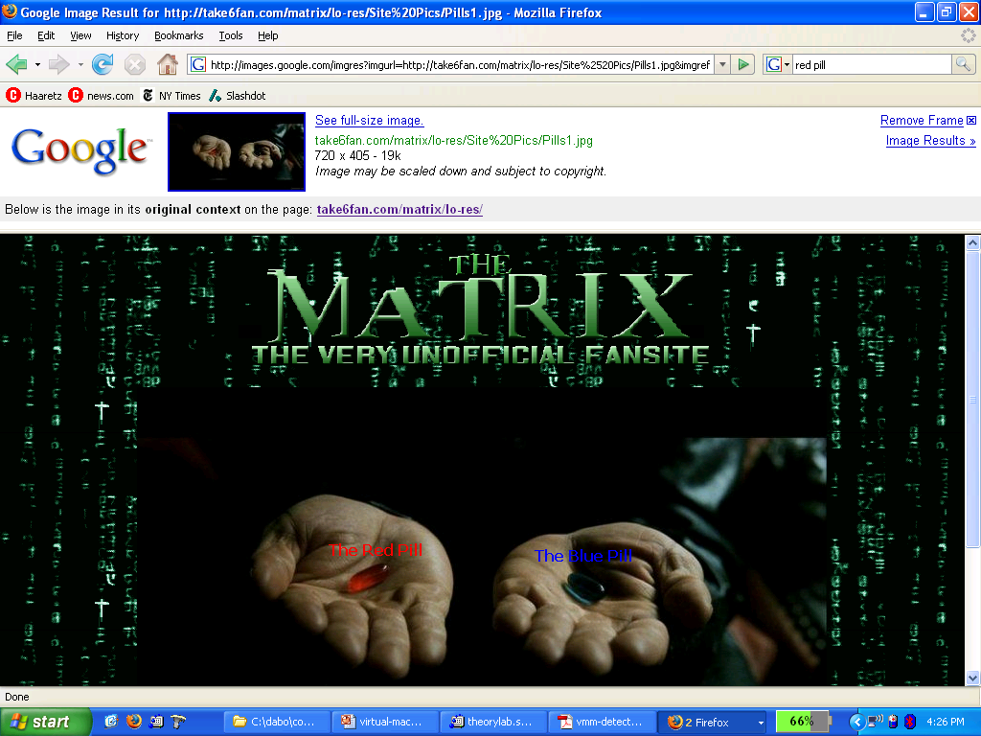
Hypervisor detection

Slide 44
Hypervisor detection (red pill techniques)
VM platforms often emulate simple hardware
      VMWare emulates an ancient i440bx chipset
      … but report 8GB RAM, dual CPUs, etc.
Hypervisor introduces time latency variances
      Memory cache behavior differs in presence of hypervisor
      Results in relative time variations for any two operations
Hypervisor shares the TLB with GuestOS
      GuestOS can detect reduced TLB size
… and many more methods [GAWF’07]
Notes:
http://www.usenix.org/event/hotos07/tech/full_papers/garfinkel/garfinkel.pdf

Slide 45
Hypervisor detection in the browser [HBBP’14]
Can we identify malware web sites?
Approach: crawl web,
load pages in a browser running in a VM,
look for pages that damage VM
The problem: Web page can detect it is running in a VM
How? Using timing variations in writing to screen
Malware in web page becomes benign when in a VM
⇒ evade detection

Slide 46
Hypervisor detection
Bottom line: The perfect hypervisor does not exist
Hypervisors today focus on:
  Compatibility: ensure off the shelf software works
  Performance: minimize virtualization overhead
VMMs do not provide transparency
  Anomalies reveal existence of hypervisor

Slide 47
Software Fault Isolation: isolating threads
Confinement

Slide 48
Software Fault Isolation [Whabe et al., 1993]
Goal: confine apps running in same address space
  Kernel module should not corrupt kernel
  Native libraries should not corrupt JVM
Simple solution: runs apps in separate address spaces
  Problem: slow if apps communicate frequently
    requires context switch per message

Slide 49
Software Fault Isolation
SFI approach: Partition process memory into segments
Locate unsafe instructions: jmp, load, store
  At compile time, add guards before unsafe instructions
  When loading code, ensure all guards are present
code
segment
data
segment
code
segment
data
segment
app #1
app #2

Slide 50
Segment matching technique
Guard ensures code does not
load data from another segment
Designed for MIPS processor. Many registers available.
dr1, dr2: dedicated registers not used by binary
  compiler pretends these registers don’t exist
  dr2 contains segment ID
Indirect load instruction R12 ⟵ [R34] becomes:
dr1 ⟵ R34
scratch-reg ⟵ (dr1 >> 20) : get segment ID
compare scratch-reg and dr2 : validate seg. ID
trap if not equal
R12 ⟵ [dr1] : do load

Slide 51
Address sandboxing technique
dr2: holds segment ID
Indirect load instruction R12 ⟵ [R34] becomes:
dr1 ⟵ R34 & segment-mask : zero out seg bits
dr1 ⟵ dr1 | dr2 : set valid seg ID
R12 ⟵ [dr1] : do load
Fewer instructions than segment matching
  … but does not catch offending instructions
Similar guards placed on all unsafe instructions

Slide 52
Problem: what if jmp [addr] jumps directly into indirect load?
(bypassing guard)
Solution:
This is why jmp instructions need a guard:
jmp guard ensures [addr] does not bypass load guard
Notes:
Defense: clear low order bits of jump address.

Slide 53
Cross domain calls
caller
domain
callee
domain
call stub
draw:
return
call draw
br addr
br addr
ret stub
br addr
br addr
br addr
br addr
Only stubs allowed to make cross-domain jumps
Jump table contains allowed exit points
  Addresses are hard coded, read-only segment

Slide 54
SFI Summary
Performance
  Usually good: mpeg_play, 4% slowdown
Limitations of SFI: harder to implement on x86 :
  variable length instructions: unclear where to put guards
  few registers: can’t dedicate three to SFI
  many instructions affect memory: more guards needed

Slide 55
Confinement: summary
Many sandboxing techniques:
  Physical air gap, Virtual air gap (hypervisor),
  System call interposition (SCI), Software Fault isolation (SFI)
  Application specific (e.g. Javascript in browser)
Often complete isolation is inappropriate
  Apps need to communicate through regulated interfaces
Hardest aspects of sandboxing:
  Specifying policy: what can apps do and not do
  Preventing covert channels

Slide 56
THE END

