Slide 1
Cryptocurrencies and Blockchain Technologies
CS251 Fall 2020
(cs251.stanford.edu)
Dan Boneh Benedikt Bünz
Stanford University

Slide 2
What is a blockchain?
Abstract answer: a blockchain provides
coordination between many parties,
when there is no single trusted party
if trusted party exists ⇒ no need for a blockchain
[financial systems: often no trusted party]
Notes:
but blockchains also used in other areas, like digital asset management, e.g., as in online games.

Slide 3
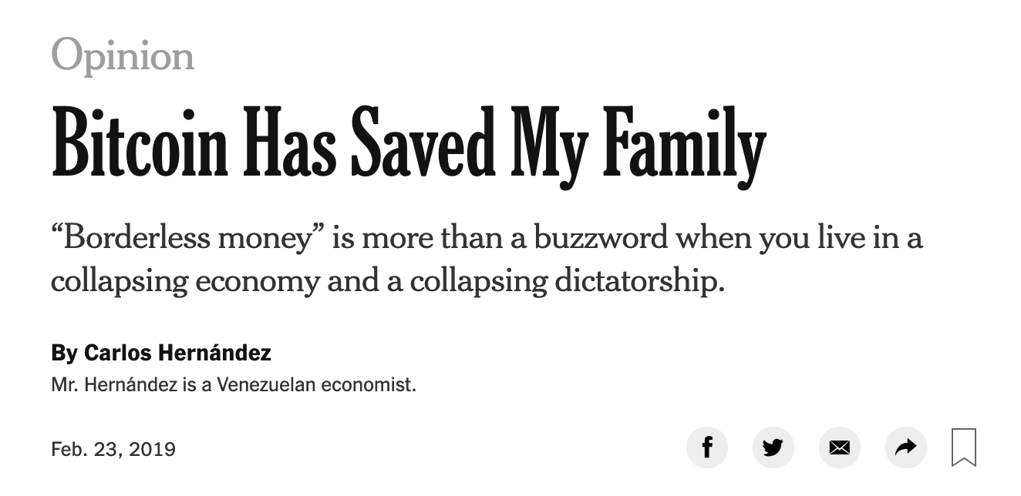
What is all the excitement about?
(1) Basic application: a digital currency (stored value)
Current largest: Bitcoin (2009), Ethereum (2015), Tether (2014)
Global: accessible to anyone with an Internet connection

Slide 4
What is all the excitement about?
(1) Basic application: a digital currency (stored value)
Current largest: Bitcoin (2009), Ethereum (2015), Tether (2014)
Global: accessible to anyone with an Internet connection
(2) Beyond stored value: decentralized applications (DAPPs)
DeFi: financial applications managed by public programs
examples: stablecoins, lending, exchanges, ….
Asset management (e.g., domain names, games).
(3) New programming model: writing decentralized programs

Slide 5
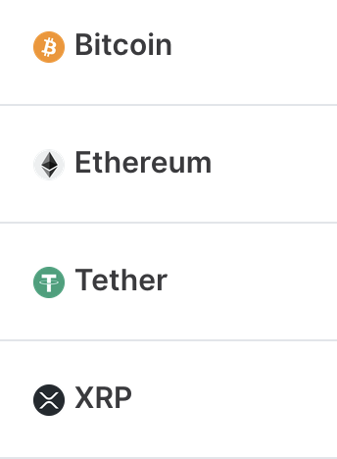
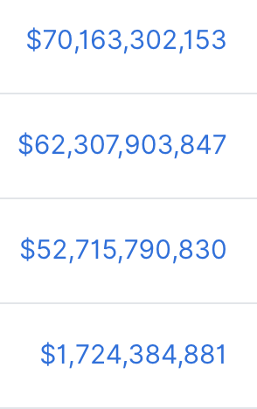
Transaction volume
(Sep, 2020)

Slide 6
Central Bank Digital Currency (CBDC)
30 central banks actively working on retail CBDC
[BIS survey Jan. 2019]
Notes:
NSD: Russian National Settlement Depository.

Slide 7
What is a blockchain?
Layer 3:
user facing tools (cloud servers)
Layer 2:
applications (DAPPs, smart contracts)
Layer 1.5:
compute layer (blockchain computer)
Layer 1:
consensus layer

Slide 8
Consensus layer (informal)
achieved by replication
A public append-only data structure:
Persistence: once added, data can never be removed*
Consensus: all honest participants have the same data**
Liveness: honest participants can add new transactions
Open(?): anyone can add data (no authentication)
Layer 1:
consensus layer
Notes:
[Pass, Seeman, Shelat, 2016]
Blockchain data needs to be public: private blockchains are not part of this course.

Slide 9
This not a new problem …
State machine replication: studied since the 1980s
Google, Amazon, Bank of America, all have lots of servers:
need to ensure consistent state across all servers
Private blockchains
So what is new?
(a) new consensus protocols
the new aspect: a public blockchain
anyone can use, all data is public ⟹ interoperability, composability, verifiability
Notes:
Why impossible: sybil attack

Slide 10
How are blocks added to chain?
blockchain
signed
I am the leader
2 ETH
sk_{A}
verify
block
verify
block
sk_{B}
sk_{C}

Slide 11
How are blocks added to chain?
blockchain
…
2 ETH
I am the leader
sk_{A}
sk_{B}
2 ETH
sk_{C}
Notes:
Like a cloud service paid for by inflation.

Slide 12
Layer 1.5: The blockchain computer
DAPP logic is encoded in a program that runs on blockchain
Rules are enforced by a public program (public source code)
⇒ transparency: no single trusted 3rd party
The DAPP program is executed by parties who create new blocks
⇒ public verifiability: everyone can verify state transitions
Layer 1.5:
compute layer
Layer 1:
consensus layer

Slide 13
Layer 2: Decentralized applications (DAPPS)
Run on blockchain
computer
Layer 2:
applications (DAPPs, smart contracts)
Layer 1.5:
blockchain computer
Layer 1:
consensus layer

Slide 14
Layer 3: Common DAPP architecture
Layer 3: user facing servers
end user
blockchain computer
DAPP
DAPP
DAPP
(layer 2)
on-chain state
(layer 1.5)
consensus layer
(layer 1)

Slide 15
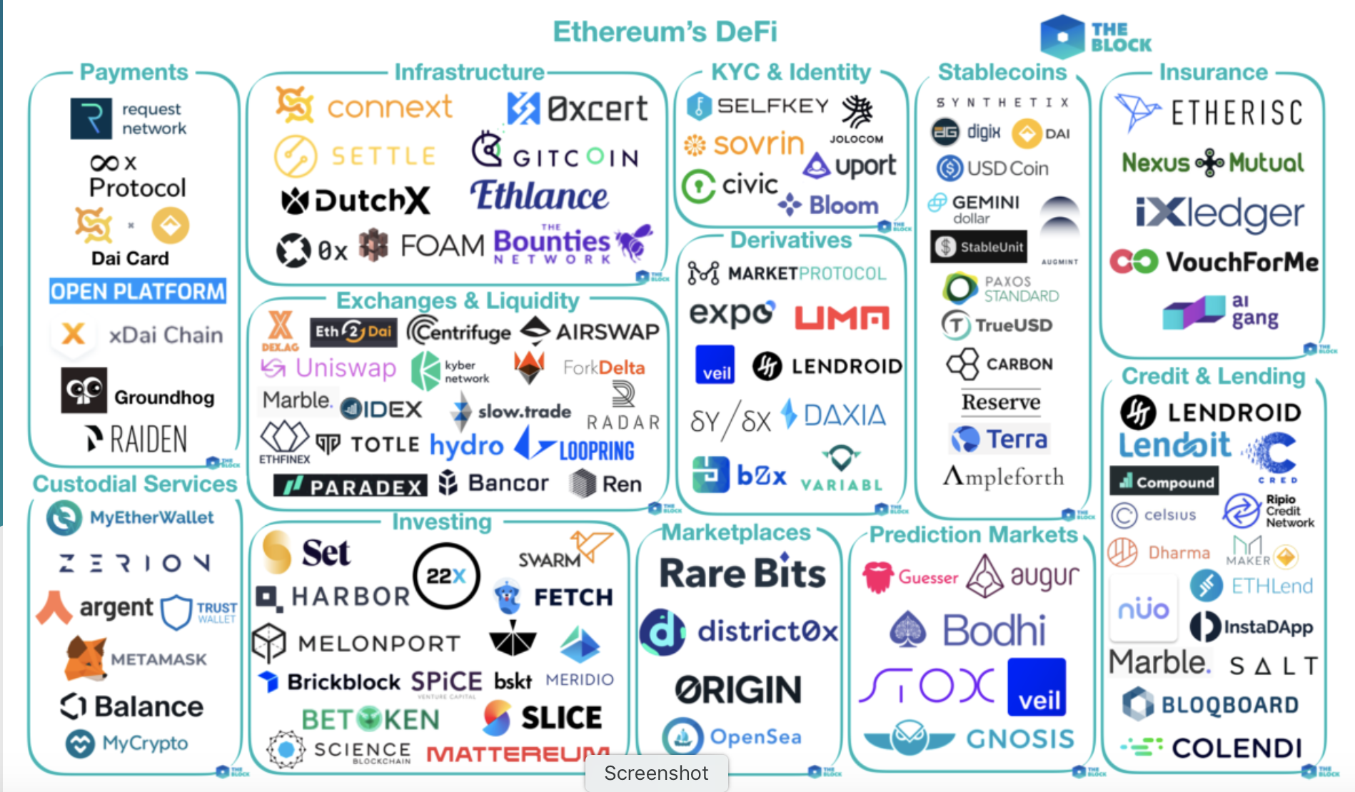
[source: the Block Genesis]
Notes:
By the end of the course: you will know how to write your own DAPP.

Slide 16
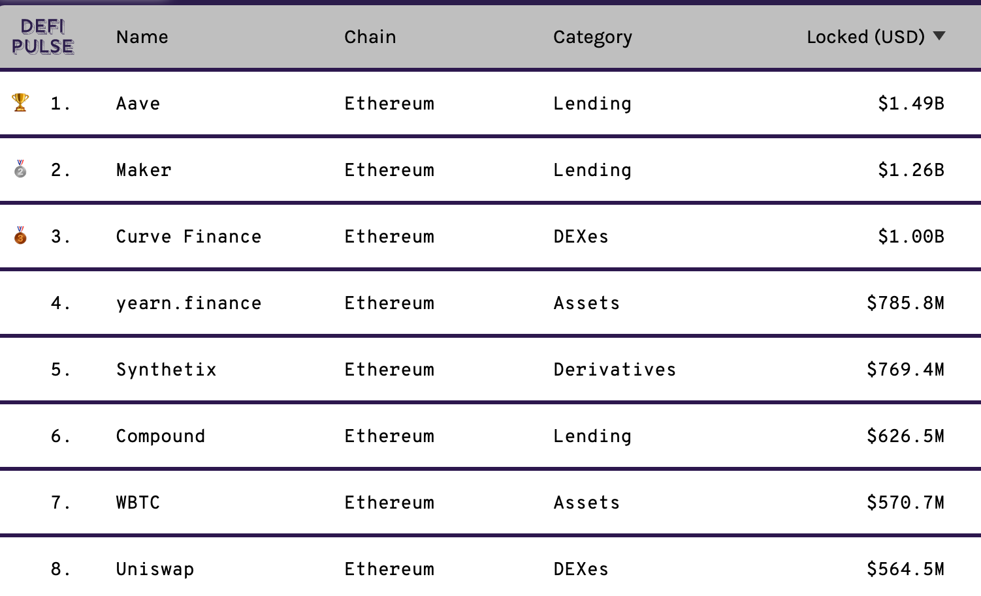
lots of experiments …

Slide 17
This course
Cryptography
Distributed systems
Economics

Slide 18
Course organization
The starting point: Bitcoin mechanics
Consensus protocols
Ethereum and decentralized applications
Economics of decentralized applications
Scaling the blockchain: 10K Tx/sec and more
Private transactions on a public blockchain (SNARKs and zero knowledge proofs)

Slide 19
Course organization
cs251.stanford.edu
Three homework problems, four projects, final exam(?)
Optional weekly sections on Friday
Please tell us how we can improve … Don’t wait until the end of the quarter

Slide 20
Let’s get started …

Slide 21
Cryptography Background
cryptographic hash functions
An efficiently computable function $H: M ⇾ T$
where $|M|≫|T|$
32 bytes
megabytes
hash value
$$T = \{0,1\}256$$

Slide 22
Collision resistance
Def: a collision for $H:M⇾T$ is pair $x≠y∈M$ s.t. $H(x)=H(y)$
$|M|≫|T|$implies that many collisions exist
Def: a function $H:M⇾T$ is collision resistant if it is “hard” to find even a single collision for $H$ (we say $H$ is a CRHF)
Example: SHA256: {$x$ : len($x$)<2⁶⁴ bytes} ⇾ {0,1}²⁵⁶
details in CS255

Slide 23
An application: committing to data
Alice has a large file $m$. She publishes $h=H(m)$(32 bytes)
Bob has $h$. Later he learns $m’$ s.t. $H(m’)=h$
$H$ is a CRHF ⇒ Bob is convinced that $m’=m$
(otherwise, $m$ and $m’$ are a collision for $H$)
We say that $h=H(m)$ is a binding commitment to $m$
(note: not hiding, $h$ may leak information about $m$)

Slide 24
Committing to a list (of transactions)
32 bytes
Alice has $S=(m1,m2, …,mn)$
Goal:
- Alice publishes a short binding commitment to $S$, $h=commit(S)$
Bob has $h$. Given $\left(mi, proof πi\right)$ can check that $S[i]=mi$
Bob runs $verify\left(h, i, mi, πi\right)$ ⇾ accept/reject
security: adv. cannot find $(S, i, m, π)$s.t. $m≠S[i]$ and $verify(h,i,m,π)=accept$where $h=commit(S)$

Slide 25
Committing to a list
method 1: commit(S) $=h=H(H(m1),…,H(mn))$
Later: given $h, m1$and $H(m2),…,H(mn)$Bob can check $S[1]=m1$
Problem: long proof! $(n−1)$ hash values
Better method: Merkle tree. Proof length = $log2n$ hash values
proof π₁

Slide 26
Merkle tree (Merkle 1989)
commitment
$$h$$
Goal:
commit to list S
Later prove $S[i]=mi$
Merkle tree commitment
$$m1$$
$$m2$$
$$m3$$
$$m_{4}$$
$$m_{5}$$
$$m_{6}$$
$$m_{7}$$
$$m_{8}$$
list of values S

Slide 27
Merkle tree (Merkle 1989)
commitment
$$h$$
Goal:
commit to list S
Later prove $S[i]=mi$
$$y_{5}$$
H
$$y_{6}$$
H
H
$$y1$$
$$y_{2}$$
$$y_{3}$$
$$y_{4}$$
To prove ${S\left[4\right]= m}_{4}$ ,
proof $π= \left(m_{3}, y_{1}, y_{6}\right)$
H
H
H
H
$$m1$$
$$m_{2}$$
$$m_{3}$$
$$m_{4}$$
$$m_{5}$$
$$m_{6}$$
$$m_{7}$$
$$m_{8}$$
length of $π$: $log2 |S|$
list of values S

Slide 28
Merkle tree (Merkle 1989)
commitment
$$h$$
To prove ${S\left[4\right]= m}_{4}$ ,
proof $π= \left(m_{3}, y_{1}, y_{6}\right)$
$$y_{5}$$
H
$$y_{6}$$
H
H
Bob does:
$y2 ⇽ H(m3,m4)$
$$y5 ⇽ H(y1, y2)$$
$$h’ ⇽ H(y5, y6)$$
accept if $h=h’$
$$y1$$
$$y_{2}$$
$$y_{3}$$
$$y_{4}$$
H
H
H
H
$$m1$$
$$m_{2}$$
$$m_{3}$$
$$m_{4}$$
$$m_{5}$$
$$m_{6}$$
$$m_{7}$$
$$m_{8}$$
list of values S

Slide 29
Merkle tree (Merkle 1989)
Thm: H CRHF ⇒ adv. cannot find $(S, i, m, π)$s.t. $m≠S[i]$ and $verify(h,i,m,π)=accept$where $h=commit(S)$
(to prove, prove the contra-positive)
How is this useful?
When writing a block of transactions $S$ to the blockchain, suffices to write commit($S$) to chain. Keep chain small.
Later, can prove contents of every Tx.
Super useful. Example

Slide 30
Another application: proof of work
Goal: computational problem that
takes time $Ω(D)$ to solve, but (D is called the difficulty)
solution takes time O(1) to verify
How? $H:X × Y⇾\{0,1,2,…,2n−1\}$ e.g. $n=256$
puzzle: input $x∈X$, output $y∈Y$ s.t. $H(x,y)<2n/D$
verify($x,y$): accept if $H(x,y)<2n/D$

Slide 31
Another application: proof of work
Thm: if H is a “random function” then the best algorithm requires $D$ evaluations of $H$ in expectation.
Note: this is a parallel algorithm
⇒ the more machines I have, the faster I solve the puzzle.
Bitcoin uses $H(x) = SHA256(SHA256(x))$

Slide 32
Cryptography background: Digital Signatures

Slide 33
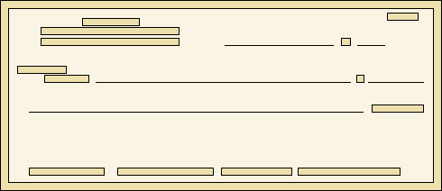
Signatures
Physical signatures: bind transaction to author
Bob agrees to pay Alice 1$
Bob agrees to pay Alice 100$
Problem in the digital world:
anyone can copy Bob’s signature from one doc to another
Notes:
Bad example: will see why on the last slide of this segment.

Slide 34
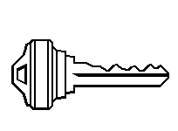
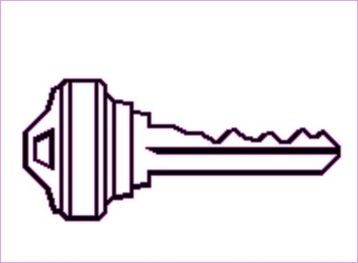
Digital signatures
Solution: make signature depend on document
Signer
Verifier
‘accept’
or
‘reject’
Bob agrees to pay Alice 1$
verifier
signature
signing
algorithm
secret signing key (sk)
public verification key (pk)

Slide 35
Digital signatures: syntax
Def: a signature scheme is a triple of algorithms:
Gen(): outputs a key pair (pk, sk)
Sign(sk, msg) outputs sig. σ
Verify(pk, msg, σ) outputs ‘accept’ or ‘reject’
Secure signatures: (informal)
Adversary who sees signatures on many messages of his choice, cannot forge a signature on a new message.

Slide 36
Families of signature schemes
RSA signatures (old … not used in blockchains):
long sigs and public keys (≥256 bytes), fast to verify
Discrete-log signatures: Schnorr and ECDSA
short sigs (48 or 64 bytes) and public key (32 bytes)
BLS signatures: 48 bytes, aggregatable, easy threshold
Post-quantum signatures: long (≥768 bytes)
(Bitcoin, Ethereum)
(Ethereum 2.0, Chia, Dfinity)

Slide 37
Signatures on the blockchain
Signatures are used everywhere:
ensure Tx authorization,
governance votes,
consensus protocol votes.
verifyTx
verifyTx
verify Tx
sk₁
data
signatures
sk₂
data
signatures

Slide 38
END OF LECTURE
Next lecture: the Bitcoin blockchain

