Slide 1
Scaling II: Rollup
CS251 Fall 2020
(cs251.stanford.edu)
Benedikt Bünz

Slide 2


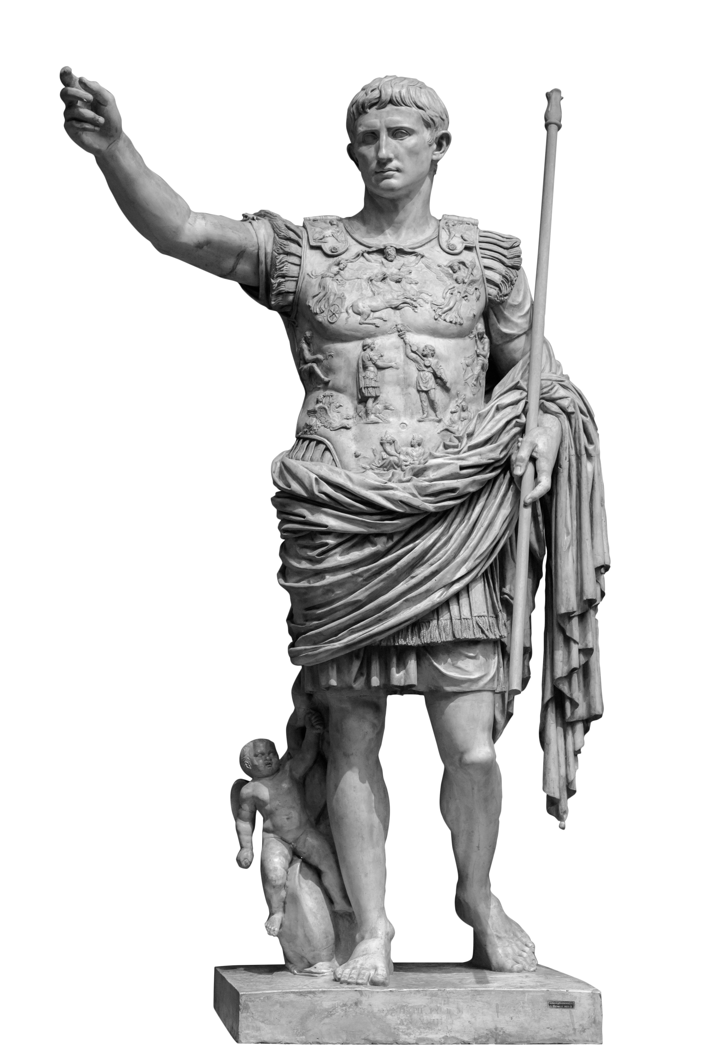
Lightning network
Many extensions possible:
Multi currency hubs
Credit hubs

Slide 3

Watchtowers
Lightning requires nodes to be periodically online to check for claim TX
Watchtowers outsource this task
User gives latest state to watchtower.
Trusted for availability not custodian of funds
Risk of bribing

Slide 4
Downsides of Payment/State Channels
Everyone needs to be online
  Mitigated by watchtowers
  Hubs need to be online
Capital is locked up
  Funds in one channel can’t be used in different channel
  If network is separated transactions are not possible
Only Peer to Peer payments
  No multi party contracts channels
TX to fund/close

Slide 5
Blockchain Layers
Layer 3:
user facing tools (cloud servers)
Layer 2:
applications (DAPPs, smart contracts)
Layer 1.5:
compute layer (blockchain computer)
Layer 1:
consensus layer
Bitcoin/Ethereum combine ordering (layer 1) and verification (1.5)
What if we can outsource verification? Makes consensus cheaper

Slide 6
Idea: Aggregate Transactions
Payment channels move more transactions offchain
Idea: Combine Transaction, Coordinator verifies
TX1:
A->B 5ETH
TX Agg:
TX1,TX2,TX3
Smaller than sum of TX
TX2:
C->D 2ETH
TX3:
D->B 1ETH
Coordinator (untrusted)
Blockchain

Slide 7
Recap: The Ethereum blockchain
prev hash
prev hash
…
…
accts.
accts.
updated
world
state
Tx
log
messages
updated
world
state
Tx
log
messages

Slide 8





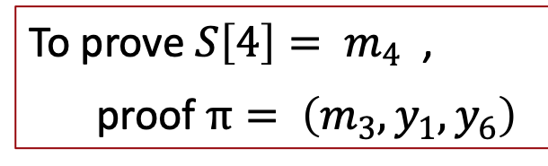




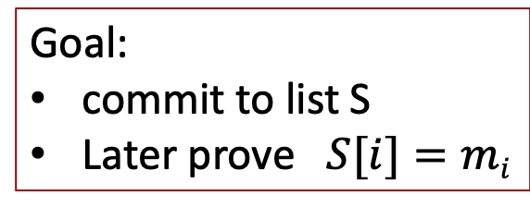



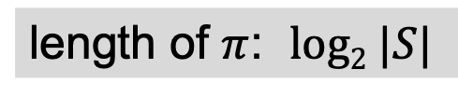



Recap: Merkle tree (Merkle 1989)
commitment
$$h$$
Goal:
commit to list S
Later prove $S[i]=mi$
$$y_{5}$$
H
$$y_{6}$$
H
H
$$y1$$
$$y_{2}$$
$$y_{3}$$
$$y_{4}$$
To prove ${S\left[4\right]= m}_{4}$ ,
proof $π= \left(m_{3}, y_{1}, y_{6}\right)$
H
H
H
H
$$m1$$
$$m_{2}$$
$$m_{3}$$
$$m_{4}$$
$$m_{5}$$
$$m_{6}$$
$$m_{7}$$
$$m_{8}$$
length of $π$: $log2 |S|$
list of values S

Slide 9
Recap State Commitment
Every contract has an associated storage array S[]:
S[0], S[1], … , S[2²⁵⁶-1]: each cell holds 32 bytes, init to 0.
Account storage root: Merkle Patricia Tree hash of S[]
  Cannot compute full Merkle tree hash: 2²⁵⁶ leaves
0
0, a
S[000] = a
S[010] = b
S[011] = c
S[110] = d
time to compute
root hash:
≤ 2×|S|
0
0
⊥, b
root
1
1
10, d
1
⊥, c
|S| = # non-zero cells
Notes:
Store suffix in nodes.

Slide 10
Merke (Patricia) Tree Proofs
Logarithmic in tree height
Given proof for i -> Possible to update S[i] and recompute root
Given proof for i, proof for j and update of S[j] it’s possible to update proof for S[i]
Exclusion proofs possible in Patricia Trees

Slide 11
Rollup
Users
Coordinator
Rollup Smart Contract
Rollup State S
Stores S
S[A’s PK] = {3 ETH, nonce}
S[B’s PK] = {2 ETH, nonce}
S[C’s PK] = {10 ETH, nonce}
S[D’s PK] = {1 ETH, nonce}
0
0, a
0
0
⊥, b
root
1
1
10, d
1
⊥, c

Slide 12
Rollup Deposit
TX Deposit
Users
Rollup Smart Contract
root
TX Deposit:
Proof that A’s PK ∉ S given
3 ETH transfer
Checks Proof
Updates root such that S[A’s PK]={3 ETH, 0}
root

Slide 13
Rollup Withdraw
TX Withdraw
Users
Rollup Smart Contract
root
TX Withdraw:
Proof that S[A’s PK]={3 ETH, nonce} given
Destination Address NewA
Signature by A
Checks Proof
Checks Signature
Sends 3 ETH to NewA
root

Slide 14
Rollup Transfer
Space saved but no computation
TX Transfer
Users
Rollup Smart Contract
root
TX Transfer:
Checks Proofs
Checks Signature
Set
  S[A’s PK]={1 ETH, 1}
  S[B’s PK]={4 ETH, -}
Proof that given
S[A’s PK]={3 ETH, 0}
S[B’s PK]={2 ETH, 0}
Transfer amount 2 ETH
Signature by A
root

Slide 15
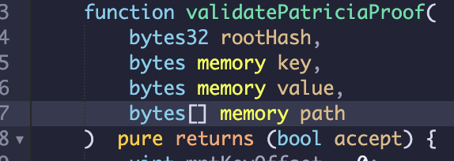
Verifiable Computation
Provides Proof/SNARK that given given public inputs (rootHash, key, value) it knows private inputs (path) such that function outputs true
SNARK is short/easy to check

Slide 16
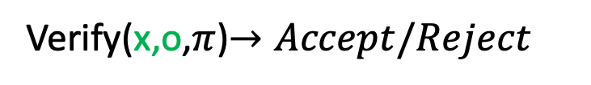

Verifiable Computation
Public
F(x,w)-> o
Private
Prover
Verifier
Prove(x,o,w)$→π$ (SNARK)
Verify(x,o,$π$)$→Accept/Reject$

Slide 17
Verifiable Computation
Public
F(x,w)-> o
Private
Completeness:
Honest Prover convinces honest Veifier
Prover
Verifier
Prove(x,o,w)$→π$ (SNARK)
Verify(x,o,$π$)$→Accept/Reject$

Slide 18
Verifiable Computation
Public
F(x,w)-> o
Private
Knowledge Soundness:
If Verifier accepts then Prover knows w
such that F(x,w)= o
Prover
Verifier
Prove(x,o,w)$→π$ (SNARK)
Verify(x,o,$π$)$→Accept/Reject$

Slide 19
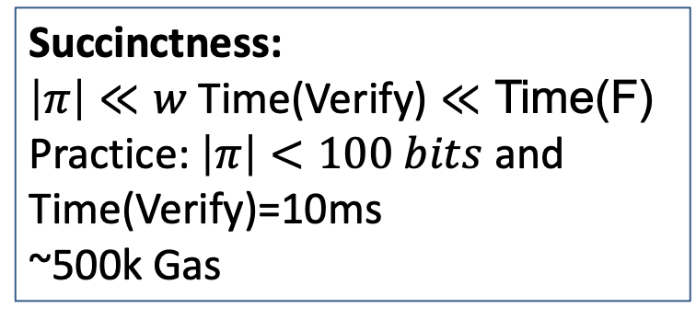
Verifiable Computation
Public
F(x,w)-> o
Private
Succinctness:
$\left|π\right|≪w$ Time(Verify) $≪$ Time(F)
Practice: $\left|π\right|<100 bits$ and Time(Verify)=10ms
~500k Gas
Prover
Verifier
Prove(x,o,w)$→π$ (SNARK)
Verify(x,o,$π$)$→Accept/Reject$

Slide 20
SNARKRollup
Merkelize Transactions (omit)
SNARK proves that given transactions I know signatures such that state transition S -> S’ valid
No Data availability problem

Slide 21

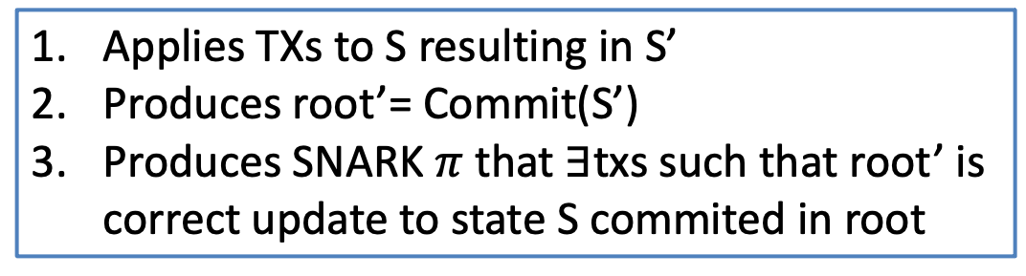
SNARKRollup (ZKRollup)
Users
root’
$$π$$
Transactions
Coordinator
Stores S
Rollup Smart Contract
Coordinator does:
root
Applies TXs to S resulting in S’
Produces root’= Commit(S’)
Produces SNARK $π$ that $∃$txs such that root’ is correct update to state S commited in root
Commitment to S

Slide 22
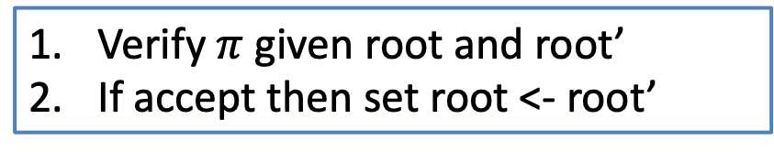
SNARKRollup (ZKRollup)
Users
root’
$$π$$
Transactions
Coordinator
Stores S’
Rollup Smart Contract
Smart Contract does:
root’
Verify $π$ given root and root’
If accept then set root <- root’
Commitment to S
Smart contract still allows “manual” withdrawals

Slide 23


Data Availability Problem
⁇
root’
$$π$$
Update must be valid!
What if Coordinator does not reveal data?
Can’t update Merkle proofs

Slide 24
Publish diff on chain
Users
root’
$$π$$
Transactions with signatures
Coordinator
txlist
Stores S’
Rollup Smart Contract
root’
Txlist= [{A-> B 3}, {C-> D 2}, {D-> B 1}]
No signatures, Sender, Receiver, Amount only in Calldata (not stored)
<100bytes per tx ~400 gas/tx, SNARK verification ~1500 gas/tx (if full)
Full Block 3600 rollup tx vs 570 normal tx

Slide 25
Cool things to do with Rollup
SNARKRollup is cheaper than onchain tx
Can scale to max ~300tx now, 1000tx soon
Cost dominated by SNARK verification
Finality ~ Blockchain finality (no instant transfer)
Only simple transfers of value

Slide 26
Insurance of Rollup -> Instant Finality
Rollup is not instant
But if coordinator is trusted then giving them transaction -> finality
Idea: Use insurance to achieve finality
Coordinator signs insurance
If transaction not included in next (few) blocks insurance can be used to get insurance premium

Slide 27
Multiple Assets
Very easy to support many assets
Simply add asset field to TX
Hardly increases SNARK complexity
Txlist= [{A-> B 3 ETH}, {C-> D 2 DAI}, {D-> B 1 BAT}]
1 byte → 256 assets
2 bytes→ 65k assets

Slide 28
Transaction List/Atomic Swaps
Support transaction list that are executed together
Transactions need to be signed by all senders
Can’t execute part of transaction only all together!
Enables atomic swaps: Alice swaps with Bob 3 ETH for 2 DAI
Txlist= [{A-> B 3 ETH and B-> A 2 DAI}, {D-> B 1 BAT}]

Slide 29

Exchanges
Buy 3 ETH for 5 DAI
Exchanges match orders
Classical exchanges
also store funds
Sell 3 ETH for 5 DAI
Order book
give
get
Alice | 3 | ETH | 5 | DAI
Bob | 5 | DAI | 3 | ETH
Carol | 4 | BAT | 10 | DAI

Slide 30
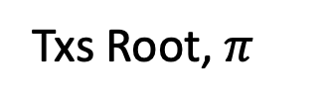
Rolled up Exchange
Txs Root, $π$
Submit orders
Verifies TX
Has orderbook
Matches orders
Rolls up transactions as atomic swaps
Root of balance tree
Exchange trusted for honest matching

Slide 31
Rolled up Exchange
Txs Root, $π$
Submit orders
Verifies TX
Updates orderbook tree on chain and proves correct matching
Root of balance tree
Root of orderbook tree
Benefit: No trust
Downside: Every order creates rollup TX, No instant matching

Slide 32
SNARKRollup Problems
Creating SNARKs is very expensive
  Only simple TX possible
  No arbitrary SMART Contracts
  SNARKs are improving all the time (hot research area)
SNARK verification is expensive on chain
  500k gas -> 1.5k gas/tx
  Likely to get better soon

Slide 33
Optimistic Rollup
Users
root’
$$π$$
Transactions with signatures
Coordinator
txlist
Stores S’
Rollup Smart Contract
root’
What if we remove the SNARK?
Idea: Instead of proving correctness, prove fraud!
New Role: Validator checks correctness, provides fraud proofs

Slide 34
Optimistic Rollup
Coordinator updates transaction root
Coordinator adds high bond
If transaction update is invalid users/validators provide fraud proof
Successful fraud proof means bond gets slashed
  Part to validator providing proof part gets burned
Unsuccessful fraud proof costs validator money
How to proof fraud?

Slide 35
Fraud Proofs
root
Commits to state S
Validator
txlist
Coordinator
Stores S agrees on root
Applies txlist to S to compute S’
Computes root’’ from S’
If root’≠root’’ call “Fraud”
root’
Problem: Validator doesn’t know what’s in root’

Slide 36
Referee Delegation
Idea: Coordinator and Validator find first point of disagreement
Break down computation of S’ into small steps, e.g. cycles on a VM
Validator does the same
Let S_{i} be Coordinators intermediate states and S’_{i} the validator’s
root
txlist
root’
S₁
S₂
Computation
S_{n-1}

Slide 37
Referee Delegation
Coordinator and Validator run interactive binary search
S_{n/2}
Checks whether
S_{n/2}=S’_{n/2}
If yes disagreement in fist half
Otherwise in second
root
txlist
root’
S_{n-1}
S₁
S₂
Computation
S_{n}

Slide 38
Referee Delegation
Repeat protocol for log₂(n) steps
End with agreement on S_{i} and disagreement on S_{i+1} and S’_{i+1}
Smart Contract checks transition between S_{i} and S_{i+1} and declares winner
root
txlist
S₁
S₂
S_{n/2-1}
S_{n/2}

Slide 39
Problem: Checks take a long time
log₂(n) messages (1 hash per message)
1 Verification step on smart contract
If either party timeouts declares winner
Looser gets slashed, Winner rewarded
Problem: log₂(n)*timeout
No incentive to cheat
But: Long wait till finalization!

Slide 40
Pipelined Assertions
Bond i
Bond i+1
Bond i+2
Rollup state i
Rollup state i+1
Rollup state i+2
Coordinators can build on states before timeouts
If prior state invalid, all subsequent bonds are slashed

Slide 41
Pipelined Assertions
State i valid
Bond i
Bond i+1
Bond i+2
Rollup state i
Rollup state i+1
Rollup state i+2
State i not valid
Coordinators can claim prior state not valid and continue given this.
Bond i+1
Rollup state i+1’
If no successful fraud proof then reward gets slashed

Slide 42
Multiple Rollup Coordinators
Rollup coordinator (in either scheme) is not trusted for security
It can reasonably be a single coordinator
But it is trusted for liveness
  Censorship resistance
  Progress of rollup state
Multiple Coordinators?

Slide 43
Multiple Rollup Coordinators
Rotating coordinators
Random coordinator (using Beacon)
Race to submit new rollup state (usually same party wins)
One solution is using classical consensus between fixed set of coordinators
  At least 2/3rd of coordinators sign roll up
  If trusted instant finality

Slide 44
Multi Coordinator Insurance
Get insurance signature from 2/3rd of coordinators
If next block does not include transaction post signature
Slash reward from intersection of insurer and rollup block signers
  At least 1/3rd of the coordinators

Slide 45
END OF LECTURE
Next lecture:
Privacy 1: Tracing transactions and Mixers

