Slide 1
Rollup, Privacy and Mixers
CS251 Fall 2020
(cs251.stanford.edu)
Benedikt Bünz

Slide 2
Recap: Rollup
Today: every miner must verify every posted Tx
verify
π
verify
all Tx
verify all Tx
⇒ short proof π
verify
all Tx
verify
π
verify
all Tx
summary, π
Coordinator
verifying proof is much easier than verifying 10K Tx

Slide 3
Referee Delegation
Coordinator and Validator run interactive binary search
S_{n/2}
Checks whether
S_{n/2}=S’_{n/2}
If yes disagreement in fist half
Otherwise in second
root
txlist
root’
S_{n-1}
S₁
S₂
Computation
S_{n}

Slide 4
Problem: Checks take a long time
log₂(n) messages (1 hash per message)
1 Verification step on smart contract
If either party timeouts declares winner
Looser gets slashed, Winner rewarded
Problem: log₂(n)*timeout
No incentive to cheat
But: Long wait till finalization!

Slide 5
Pipelined Assertions
Bond i
Bond i+1
Bond i+2
Rollup state i
Rollup state i+1
Rollup state i+2
Coordinators can build on states before timeouts
If prior state invalid, all subsequent bonds are slashed

Slide 6
Pipelined Assertions
State i valid
Bond i
Bond i+1
Bond i+2
Rollup state i
Rollup state i+1
Rollup state i+2
State i not valid
Coordinators can claim prior state not valid and continue given this.
Bond i+1
Rollup state i+1’
If no successful fraud proof then reward gets slashed

Slide 7
Multiple Rollup Coordinators
Rollup coordinator (in either scheme) is not trusted for security
It can reasonably be a single coordinator
But it is trusted for liveness
  Censorship resistance
  Progress of rollup state
Multiple Coordinators?

Slide 8
Multiple Rollup Coordinators
Rotating coordinators
Random coordinator (using Beacon)
Race to submit new rollup state (usually same party wins)
One solution is using classical consensus between fixed set of coordinators
  At least 2/3rd of coordinators sign roll up
  If trusted instant finality

Slide 9
Multi Coordinator Insurance
Get insurance signature from 2/3rd of coordinators
If next block does not include transaction post signature
Slash reward from intersection of insurer and rollup block signers
  At least 1/3rd of the coordinators

Slide 10
Comparison SNARK vs Optimistic Rollup
Optimistic Rollup
zkRollup
Higher TPS
Arbitrary Smart complex
Slow finality (hours/days)
Instant finality with insurance
Trust that someone verifies
Lower TPS
Only simple transfers
Faster Finality (minutes)
Instant finality with insurance
No trust required

Slide 11
Privacy

Slide 12
Privacy for Cryptocurrencies
What information might a user want to hide?
Identity (anonymity):
Who they are
Who they pay
Who pays them
Amounts:
How much they are paying
How much are they receiving
E.g. salary
Metadata:
Script Sig, e.g multisig threshold
Smart contract

Slide 13


Anonymity
Weak Anonymity (Pseudonymity):
One consistent Pseudonym (e.g. reddit)
Pros: Reputation
Cons: Linkable posts, one post linked to you-> all posts linked to you
Writing style, topics of interest may link you
Strong Anonymity:
Cons: No Reputation

Slide 14
Who needs privacy for payments
Companies
Ford does not want to reveal cost of tires
Salaries of employees
Hedge funds want to keep investments private
Notes:
Split into 4 slides

Slide 15


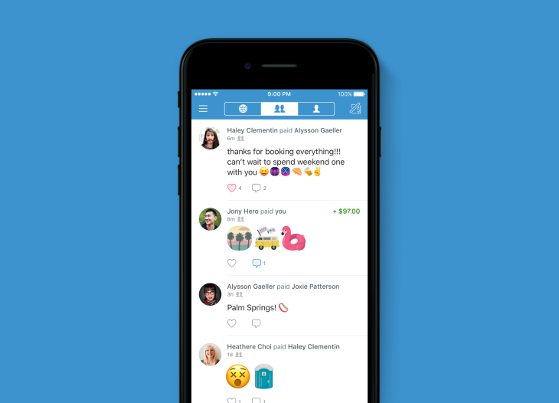

Who needs privacy for payments
Consumers
Salary, Rent, Purchasing things online, Donations
Notes:
Split into 4 slides

Slide 16
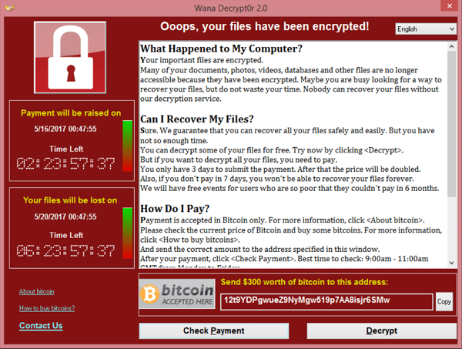

Who needs privacy for payments
Criminals
Stolen funds (WannaCry), buying/selling drugs, tax evasion
Notes:
Split into 4 slides

Slide 17

Who needs privacy for payments
Applications
Privacy can prevent frontrunning
Exchanges may want to keep orderbook private
Sealed bid auction
Notes:
Split into 4 slides

Slide 18
Privacy of Digital Payments
Payments publicly visible/linkable
Payments only visible to bank/venmo. Optionally sender/receiver public
Unlinkable private payments
Less private
More private

Slide 19
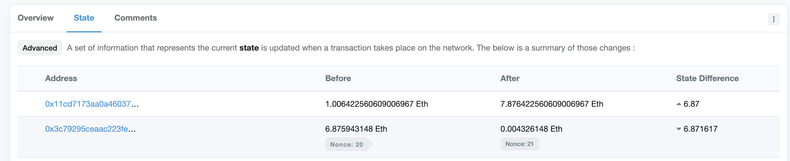
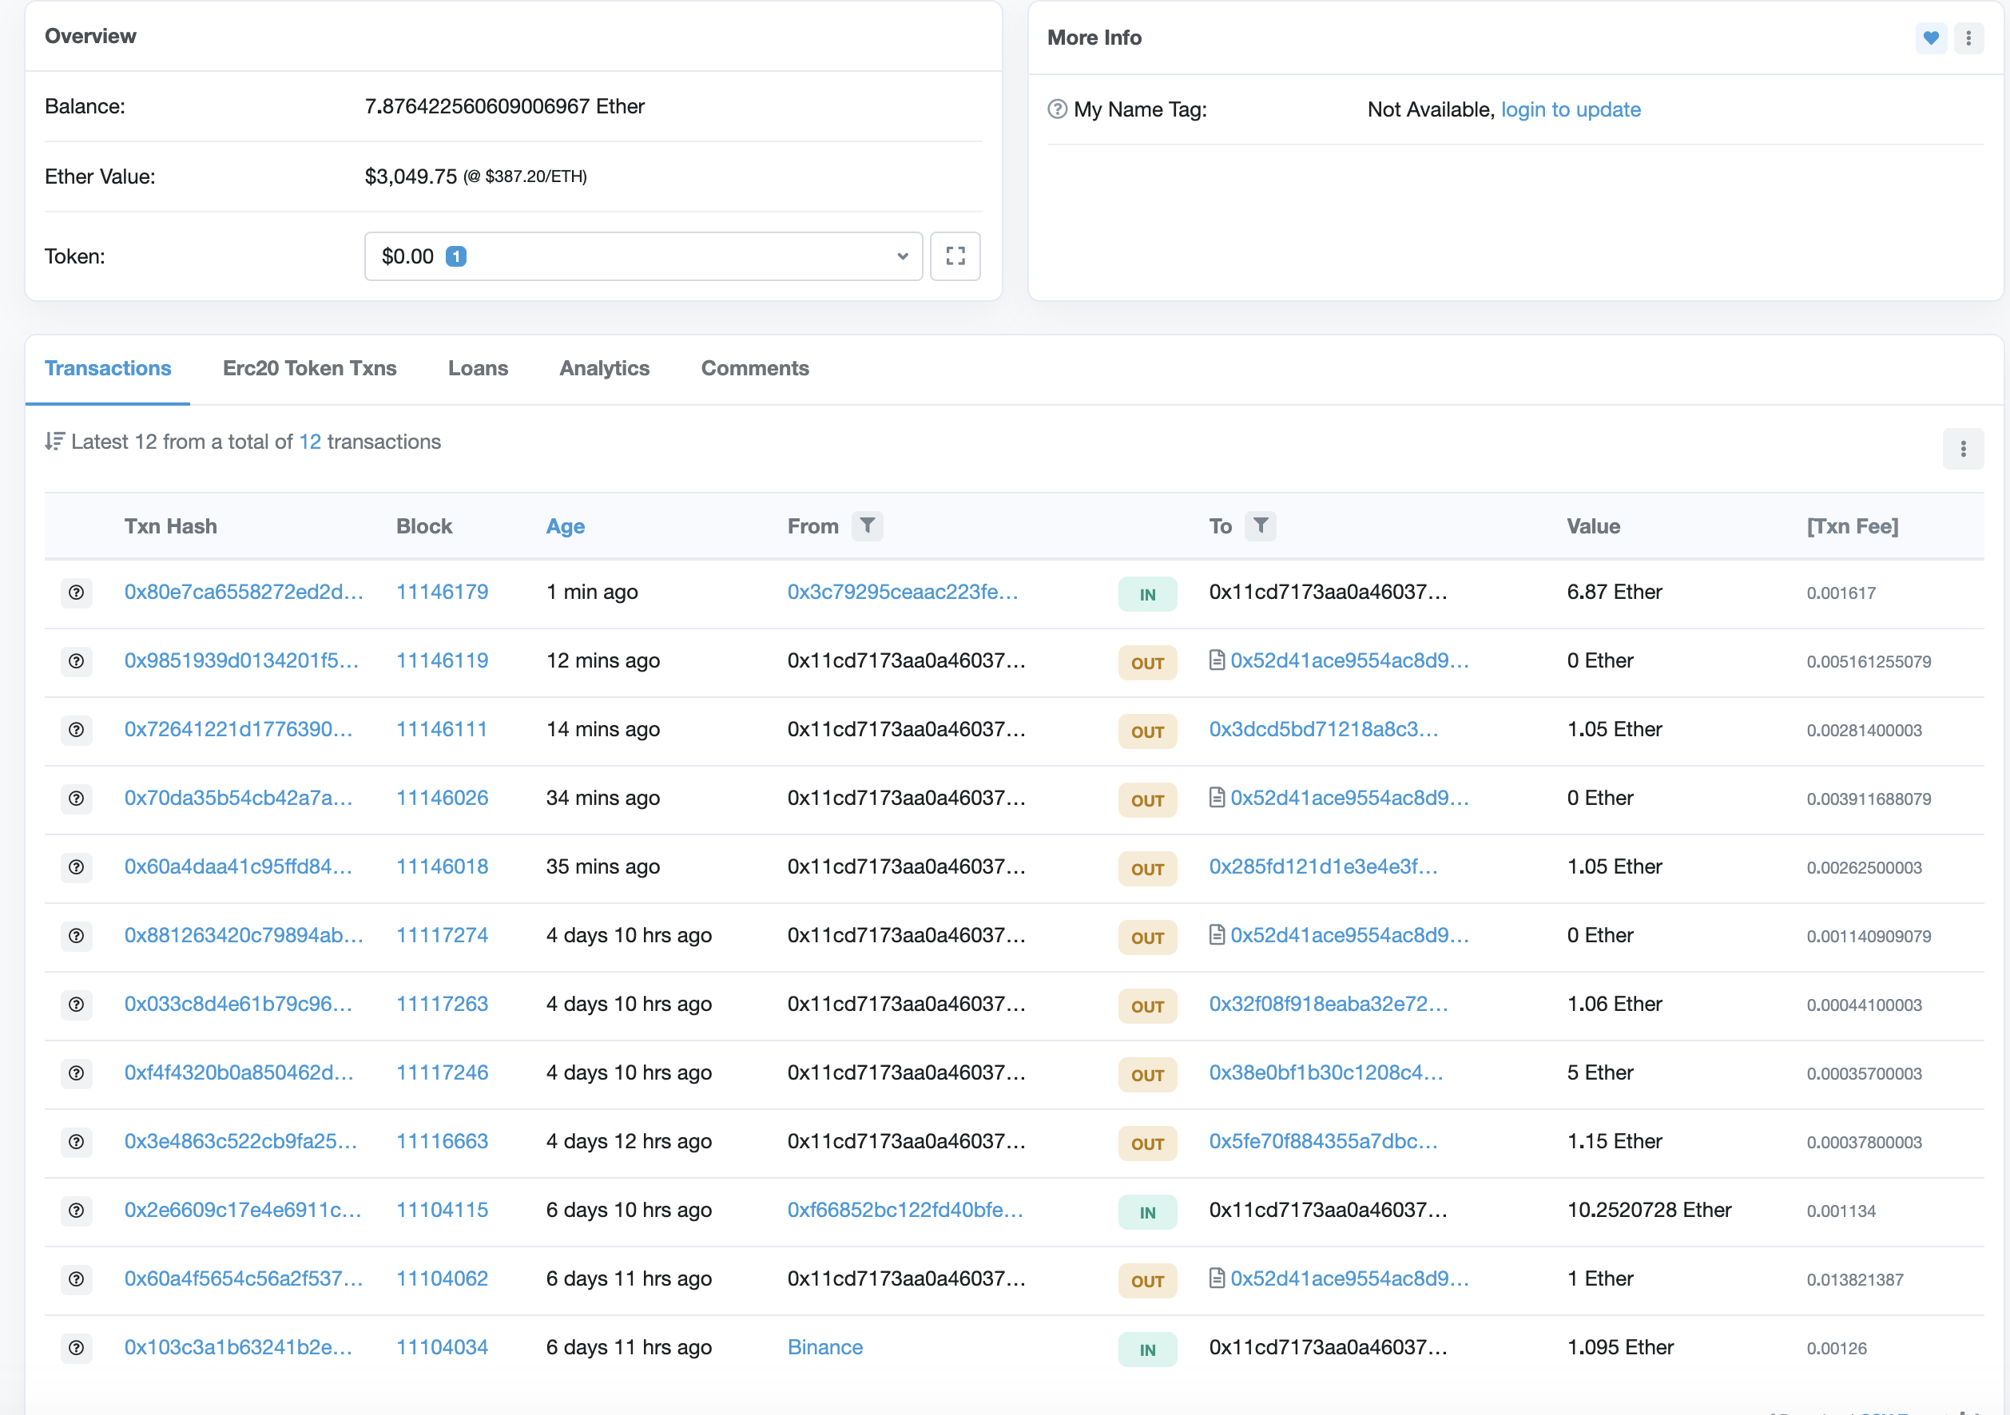
Privacy in Ethereum
Weak Pseudonymity
Account public
Values public
Mostly one account per user
Some accounts known (Binance)

Slide 20
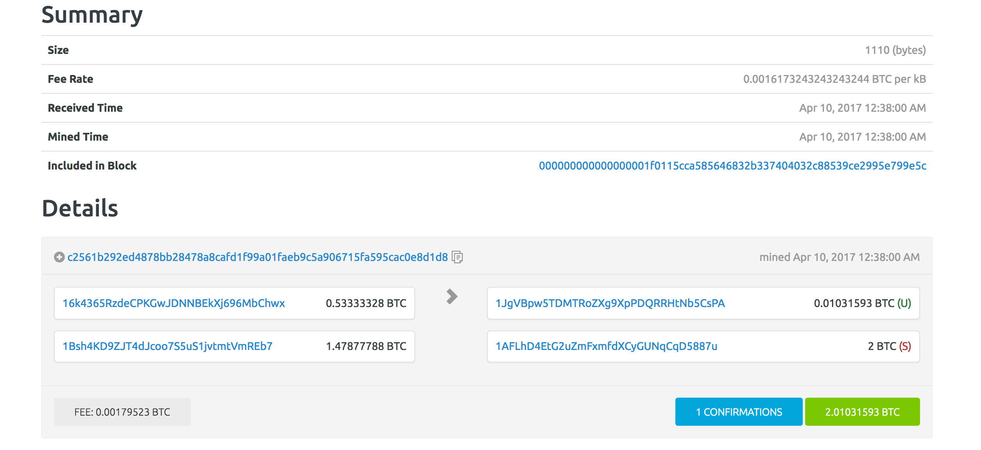
Privacy in Bitcoin

Slide 21
Privacy in Bitcoin
Alice can have many addresses (creating address is free)
Ins: A1: 4 A2: 5 out: B: 6, A3: 3
Change address
Alice’s addresses
Bob’s address

Slide 22
Linking Addresses to Identities
Ins: A1: 4 A2: 5 out: B: 6, A3: 3
Buying book from merchant
  Alice learns one of merchant’s addresses (B)
  Merchant learns three of Alice’s addresses
Alice uses an exchange
  KYC (Know your customer)
  Money serving business collect and verify IDs
BTC ←→ $

Slide 23
Linking Addresses to Identities
Ins: A1: 4 A2: 5 out: B: 6, A3: 3
Buying book from merchant
  Alice learns one of merchant’s addresses (B)
  Merchant learns three of Alice’s addresses
Alice uses an exchange
  KYC (Know your customer)
  Money serving business collect and verify IDs
  Exchange learns real ID
BTC ←→ $

Slide 24
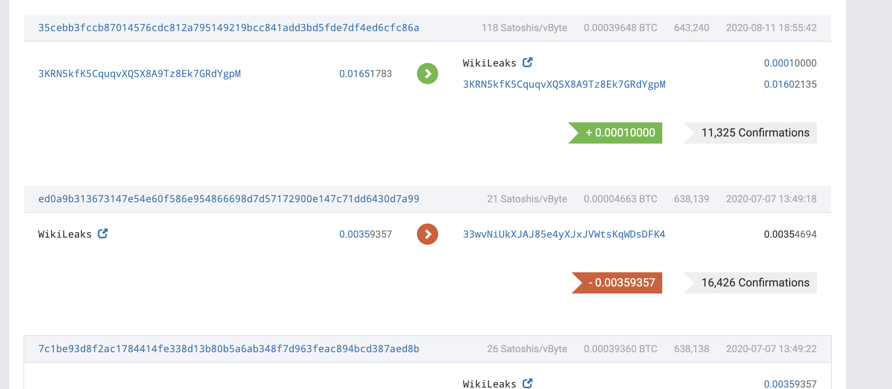
Donating to Wikileaks
Wikileaks had one address -> Easy to see who donates

Slide 25
Is Bitcoin Anonymous?
Now commercialized:
No!
It is possible to:
Link all addresses of a single entity:
  Determine total assets
Given two TX A->B, C->D, Are B&C the same
  If D knows C, can unmask B
  Trace stolen funds, find tax evasion
  Oppressive governments (Venezuela, North Korea)
Test if Alice ever paid Bob (Wikileaks)
Often answer is yes for all 3. How?

Slide 26


Network Anonymity
Bitcoin P2P network
end users
signed Tx
sk_{A}
sk_{B}
sk_{C}
Can learn Alice’s IP address
Solution:

Slide 27
Light client network anonymity
SPV client
Full node
All addresses and transactions
Fully linkable!

Slide 28
Idioms of use
Heuristic 1:
Two addresses are input to same TX (and not multisig script)
-> both addresses are controlled by same entity

Slide 29
Idioms of use
Heuristic 2:
Change address is controlled by same user as input address
Which is change address: Used to be first address
Heuristic: Only new address, Non round, Less than inputs

Slide 30
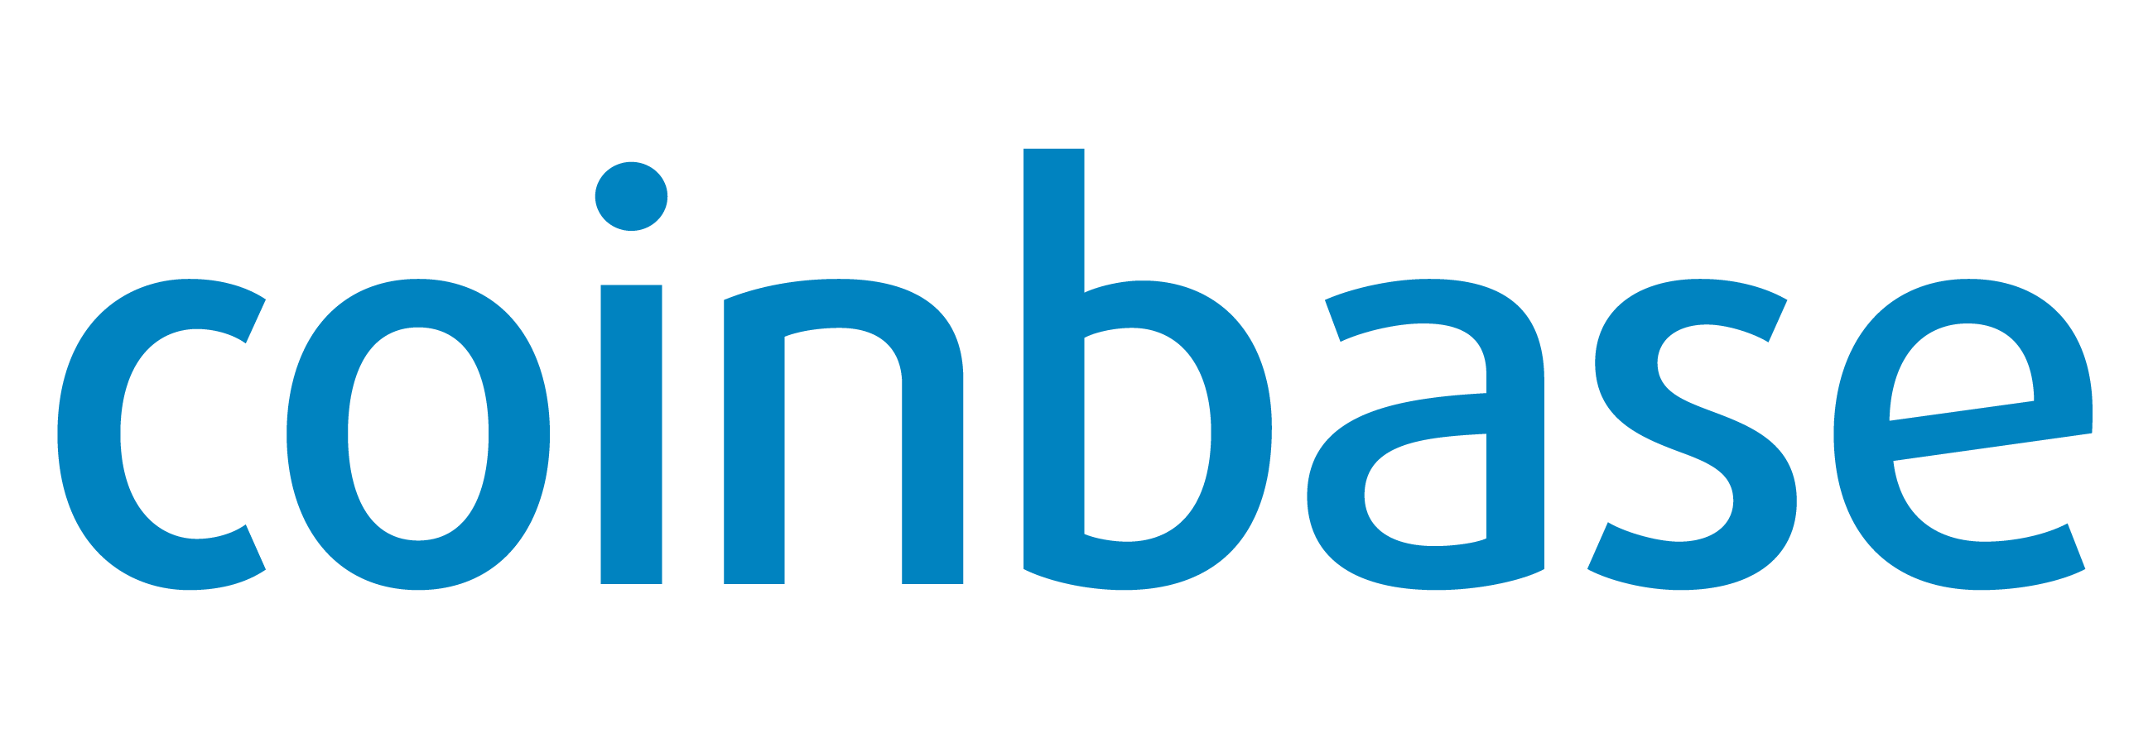
Example tracing
output
transaction
chg
chg.
chg.
chg.
Coinbase knows entity!

Slide 31
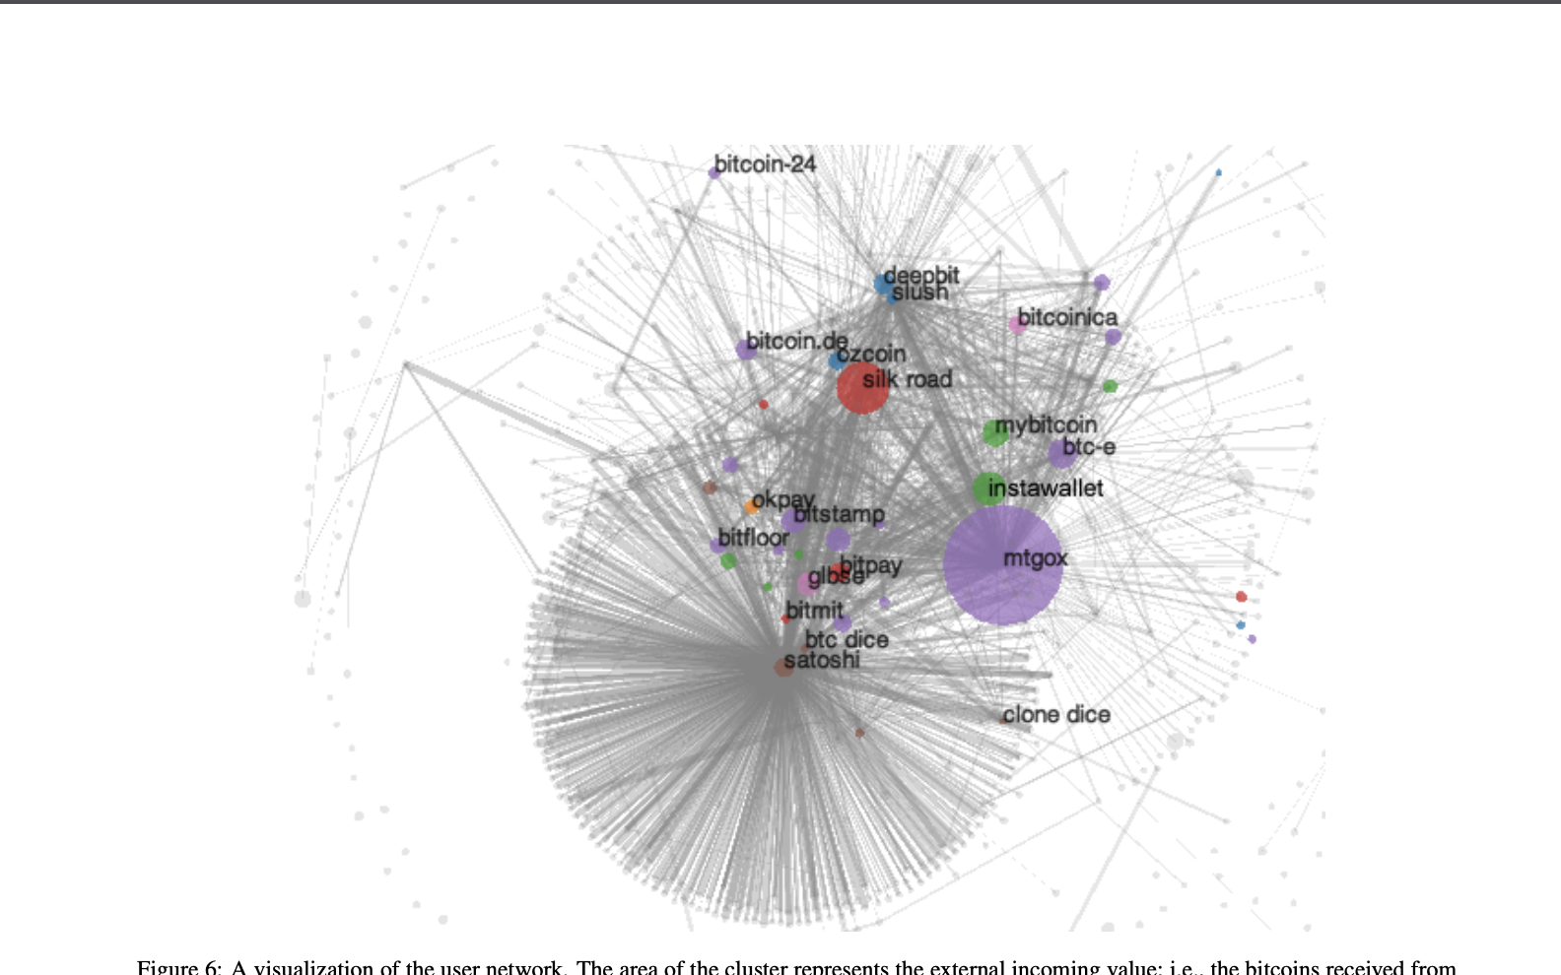
Experiment (2013)
Use Heuristic 1 and 2 -> 3.3M clusters
ID 1070 addreses by interacting with merchants
  Coinbase, Bitpay, …
Learn ID of 2200 clusters
  1.8M address
  15% of total value
  Track multiple thefts
  Learn total assets for each cluster

Slide 32

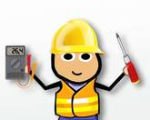
Another example
Ins: A1: 1. out: EC1 1
Ins: EC1: 1 out: S: 0.8, EC2: 0.2
Alice and Subcontractor learn EC’s profit margin.
How can we prevent this?

Slide 33
Another example
Ins: A1: 1. out: EC1 1
Ins: EC1: 1 out: S: 0.8, EC2: 0.2
EC has many customers. Mix payments -> use some to pay sub

Slide 34

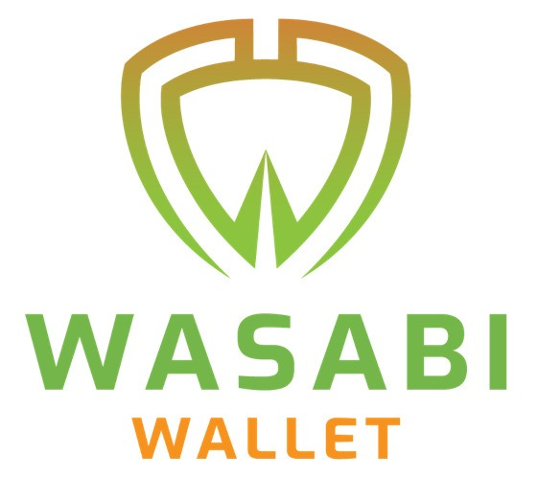
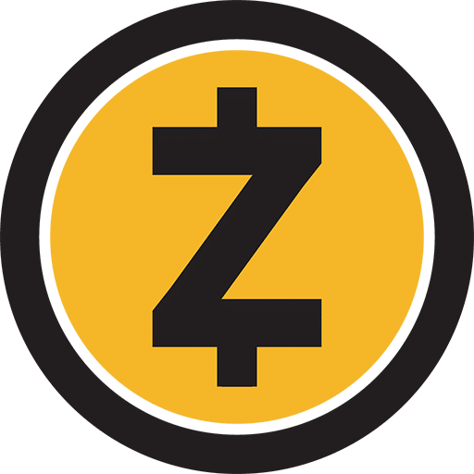
Making Cryptocurrencies anonymous
Mixing
Anonymous cryptocurrencies

Slide 35
Mixing
A1 -> M: 1
A2
Mixer
B1 -> M: 1
B2
C2
C1 -> M: 1
TLS
Ins: M: 3 Outs: B2: 1, A2: 1, C2: 1

Slide 36
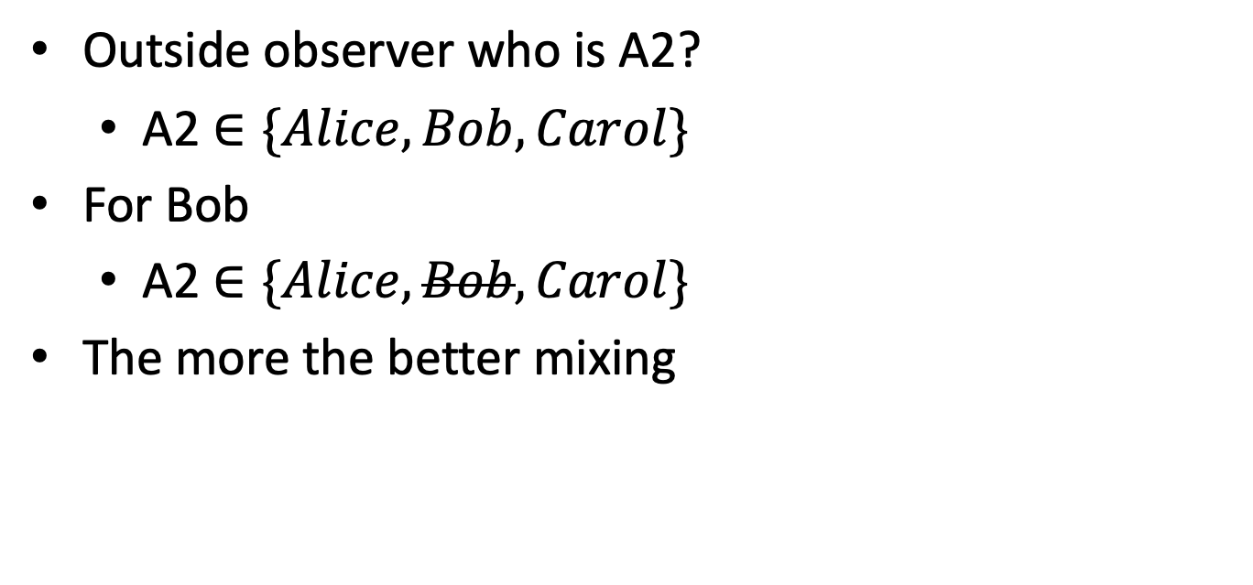
Mixing Analysis
Outside observer who is A2?
  A2 $∈\{Alice, Bob, Carol\}$
For Bob
  A2 $∈\{Alice, Bob, Carol\}$
The more the better mixing

Slide 37
Mixer Problems
Mixer can deanonymize
All outputs MUST have same value
  If not you can match inputs and outputs
Mixer takes transaction fees
Mixer can steal funds
ScriptPK for all outputs must be the same
  Otherwise linkable on spend

Slide 38
CoinJoin (Mixing without Mixer)
CoinJoin TX
Ins: :A1: 5, B1: 3, C1: 2
Outs: B2: 2, A2: 2, C2: 2
Change (not private): A3: 3, B3: 1
Signed: Multisig A1, B1, C1
Out value = min of inputs
Usually ~40 inputs

Slide 39
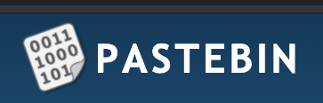
CoinJoin
Online Forum
A1: 5, A3 (change)
A2 (over Tor)
A1: 5, A3
B1: 3, B3
C1: 2, C3
B2,A2,C2
Same
Add Signatures
Publish Transaction
What if A1 is spent?

Slide 40
END OF LECTURE
Next lecture:
Zero-knowledge SNARKs

