Slide 1
Building a SNARK
CS251 Fall 2020
(cs251.stanford.edu)
Dan Boneh

Slide 2
Recap: high-level goals
Private transactions on a public blockchain
Blockchain scaling, such as proof-based Rollup
Privately prove compliance, such as a private proof of solvency

Slide 3

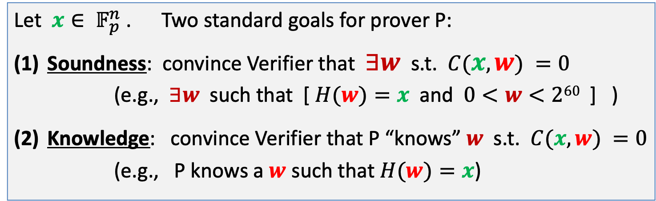
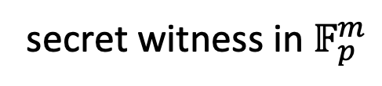
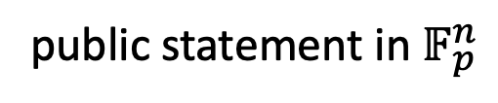
Recap: non-interactive proof systems (for NP)
Public arithmetic circuit: $C( x, w ) ⇾ 𝔽p$
public statement in $𝔽_{p}^{n}$
secret witness in $𝔽_{p}^{m}$
Let $x∈ 𝔽_{p}^{n}$ . Two standard goals for prover P:
Soundness: convince Verifier that $∃w$ s.t. $C(x, w) =0$
(e.g., $∃w$ such that [ $H(w)=x$ and $0<w<260$ ] )
Knowledge: convince Verifier that P “knows” $w$ s.t. $C(x, w) =0$
(e.g., P knows a $w$ such that $H(w)=x$)
Notes:
Knowledge is stronger the soundness.

Slide 4
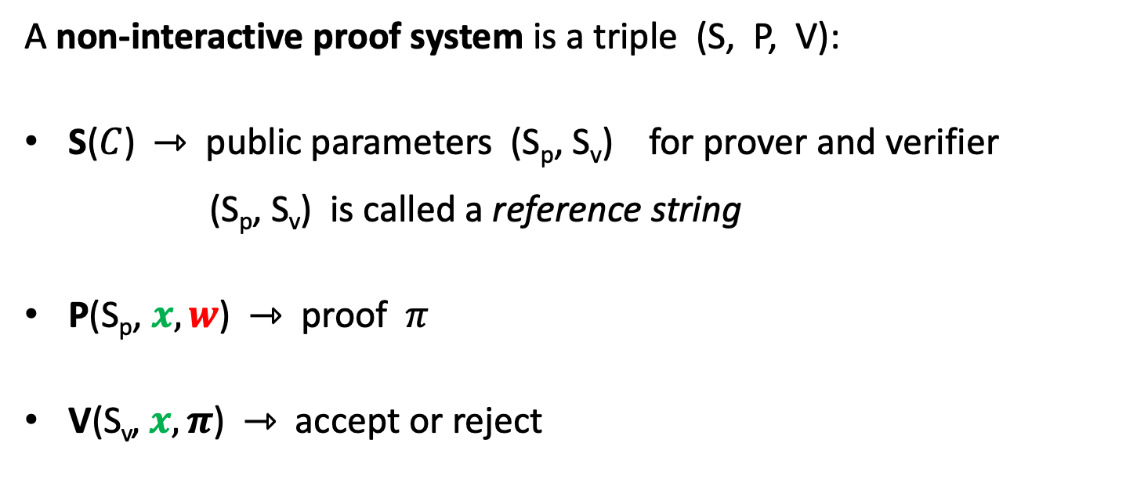
Non-interactive Proof Systems (for NP)
A non-interactive proof system is a triple (S, P, V):
S($C$) ⇾ public parameters (S_{p}, S_{v}) for prover and verifier
(S_{p}, S_{v}) is called a reference string
P(S_{p}, $x, w$) ⇾ proof $π$
V(S_{v}, $x, π$) ⇾ accept or reject

Slide 5
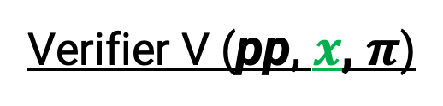
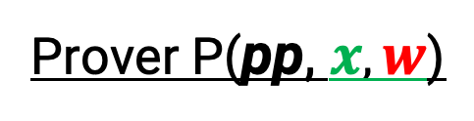
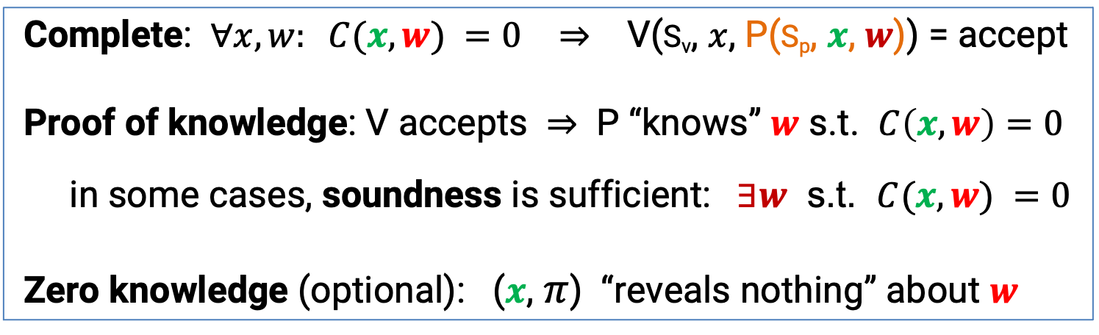
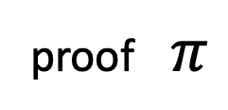
proof systems: properties (informal)
Prover P(pp, $x, w$)
Verifier V (pp, $x$, $π$)
proof $π$
accept or reject
Complete: $∀x, w: C(x, w) =0$ ⇒ V(S_{v}, $x$, P(S_{p}, $x$, $w$)) = accept
Proof of knowledge: V accepts ⇒ P “knows” $w$ s.t. $C\left(x, w\right)=0$
in some cases, soundness is sufficient: $∃w$ s.t. $C(x, w) =0$
Zero knowledge (optional): ($x$, $π$) “reveals nothing” about $w$

Slide 6

SNARK: succinct argument of knowledge
Goal: P wants to show that it knows $w$ s.t. $C(x, w) =0$
Succinct:
Proof $π$ should be short [ i.e., $|π|=O( \log\left(\left|C\right|\right), λ)$ ]
Verifying $π$ should be fast [ i.e., time(V) = $O(\left|x\right|, \log\left(\left|C\right|\right), λ)$ ]
note: if SNARK is zero-knowledge, then called a zkSNARK
Notes:
Succinctness requires an argument (cannot be a proof). [Goldreich-Hastad]

Slide 7
A simple PCP-based SNARK
[Kilian’92, Micali’94]

Slide 8
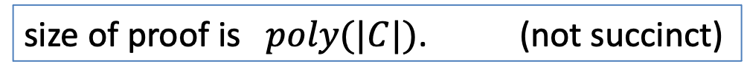
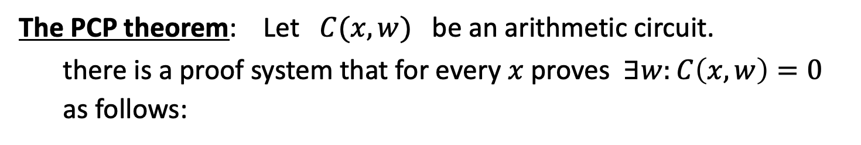
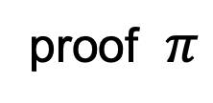
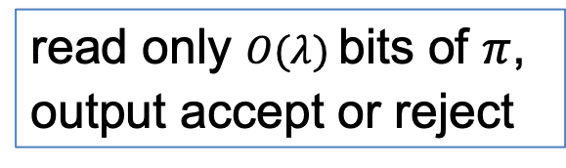
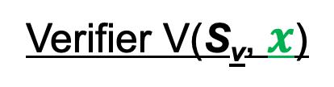
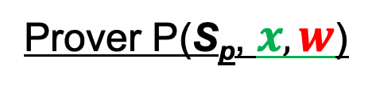
A simple construction: PCP-based SNARK
The PCP theorem: Let $C(x,w)$ be an arithmetic circuit.
there is a proof system that for every $x$ proves $∃w:C\left(x,w\right)=0$
as follows:
Prover P(S_{p}, $x, w$)
Verifier V(S_{v}, $x$)
proof $π$
read only $O(λ)$bits of $π$,
output accept or reject
V always accepts valid proof. If no $w$, then V rejects with high prob.
size of proof is $poly(|C|)$. (not succinct)
Notes:
V reads RANDOM locations in proof π, and checks looks like a*b=c.

Slide 9
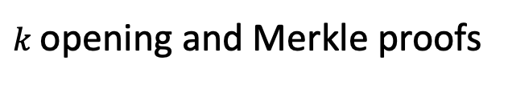
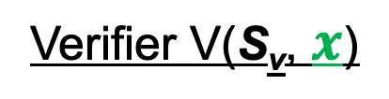
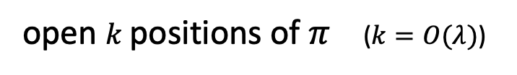
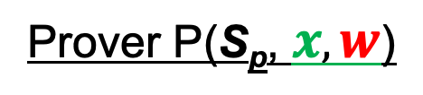


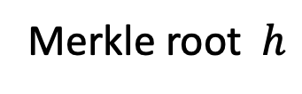


Converting a PCP proof to a SNARK
Prover P(S_{p}, $x, w$)
Verifier V(S_{v}, $x$)
$$h$$
Merkle
$$π$$
Merkle root $h$
1 hash
open $k$positions of $π$ ($k=O(λ)$)
$O(k log |C|)$ hashes
$k$opening and Merkle proofs
output accept or reject
Verifier sees $O(λ log⁡|C|)$data ⇒ succinct proof.
Problem: interactive

Slide 10
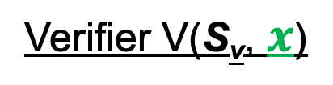

Making the proof non-interactive
The Fiat-Shamir heuristic:
public-coin interactive protocol ⇒ non-interactive protocol
public coin: all verifier randomness is public (no secrets)
Prover P(S_{p}, $x, w$)
Verifier V(S_{v}, $x$)
msg1
r
choose random bits r
msg2
accept or reject

Slide 11
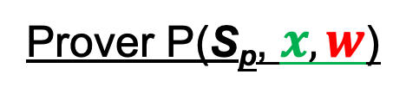
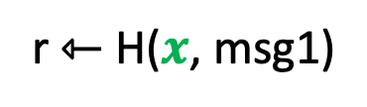
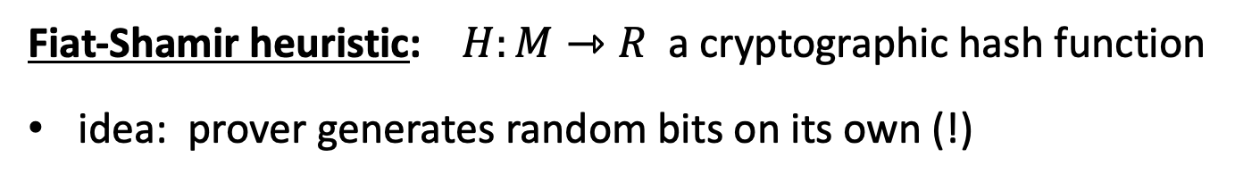
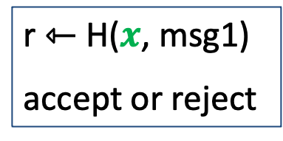

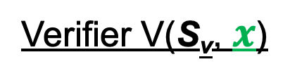
Making the proof non-interactive
Fiat-Shamir heuristic: $H:M⇾R$ a cryptographic hash function
idea: prover generates random bits on its own (!)
Prover P(S_{p}, $x, w$)
Verifier V(S_{v}, $x$)
generate msg1
r ⇽ H($x$, msg1)
$π$ = (msg1, msg2)
|π| = O($λ log |C|)$
r ⇽ H($x$, msg1)
accept or reject
generate msg2
Thm: this is a secure SNARK assuming H is a random oracle

Slide 12
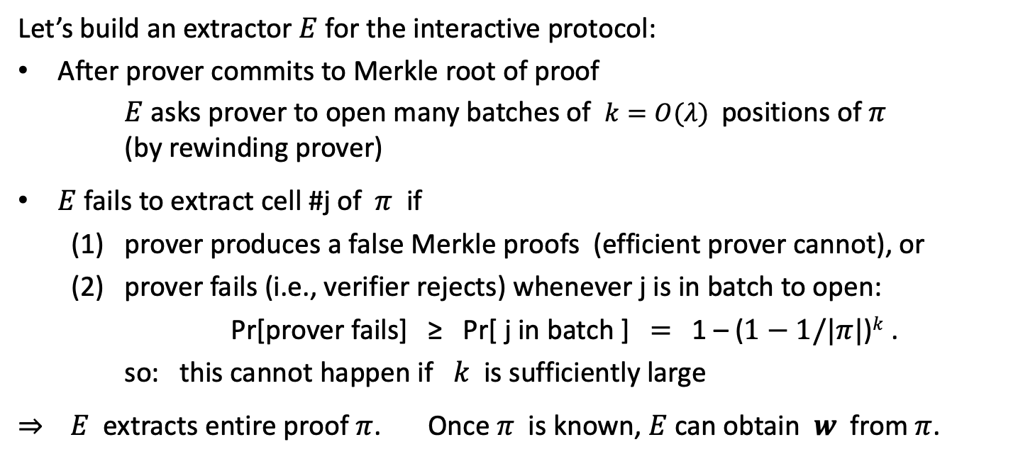
Why is this an argument of knowledge? (can skip)
Let’s build an extractor $E$ for the interactive protocol:
After prover commits to Merkle root of proof
$E$ asks prover to open many batches of $k=O(λ)$positions of $π$
(by rewinding prover)
$E$ fails to extract cell #j of $π$ if
  (1) prover produces a false Merkle proofs (efficient prover cannot), or
  (2) prover fails (i.e., verifier rejects) whenever j is in batch to open:
Pr[prover fails] ≥ Pr[ j in batch ] $=$ 1 – ($1−1/|π|$)$k$ .
so: this cannot happen if $k$ is sufficiently large
⇒ $E$ extracts entire proof $π$. Once $π$ is known, $E$can obtain $w$ from $π$.

Slide 13

Are we done?
Simple transparent SNARK from the PCP theorem
Use Fiat-Shamir heuristic to make non-interactive
We will apply Fiat-Shamir in many other settings
The bad news: an impractical SNARK --- Prover time too high
Better SNARKs: Goal: Time(Prover) = $\tilde{O}$(|C|)

Slide 14
Building an efficient SNARK

Slide 15

General paradigm
Many SNARKs are built in two steps:
polynomial
interactive
oracle proofs
(poly-IOP)
polynomial
commitment
scheme
(zk)SNARK for general circuits

Slide 16
Recall: commitments
Two algorithms:
commit(m, r) ⇾ com
verify(m, com, r) ⇾ accept or reject
Properties:
binding: cannot produce two valid openings for com.
hiding: com reveals nothing about committed data

Slide 17

(1) Polynomial commitment schemes
Notation:
Fix a finite field: $𝔽_{p}=\left\{0,1,…,p−1\right\}$
$𝔽_{p}^{(≤d)}\left[X\right]:$ all polynomials in $𝔽_{p}[X]$ of degree ≤ d.

Slide 18
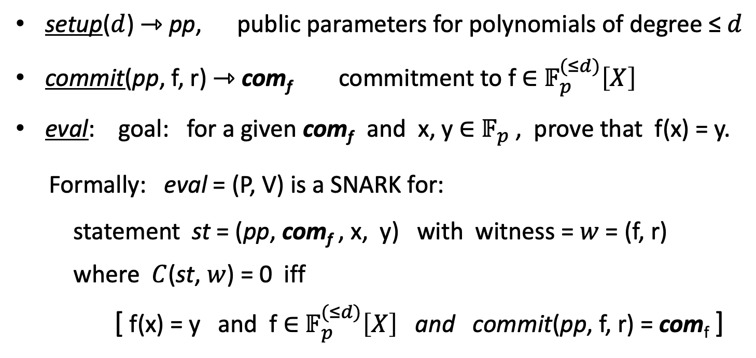
(1) Polynomial commitment schemes
setup($d$) ⇾ pp, public parameters for polynomials of degree ≤ $d$
commit(pp, f, r) ⇾ com_{f} commitment to f ∈ $𝔽_{p}^{(≤d)}\left[X\right]$
eval: goal: for a given com_{f} and x, y ∈ $𝔽_{p}$, prove that f(x) = y.
Formally: eval = (P, V) is a SNARK for:
statement st = (pp, com_{f} , x, y) with witness = $w$ = (f, r)
where $C$(st, $w$) = 0 iff
[ f(x) = y and f ∈ $𝔽_{p}^{(≤d)}\left[X\right]$ and commit(pp, f, r) = com_{f} ]

Slide 19
(1) Polynomial commitment schemes
Properties:
Binding: cannot produce two valid openings (f_{1,} r₁), (f_{2,} r₂) for com_{f}.
eval is an argument of knowledge (can extract (f, r) from a successful prover)
optional:
    commitment is hiding
    eval is zero knowledge

Slide 20
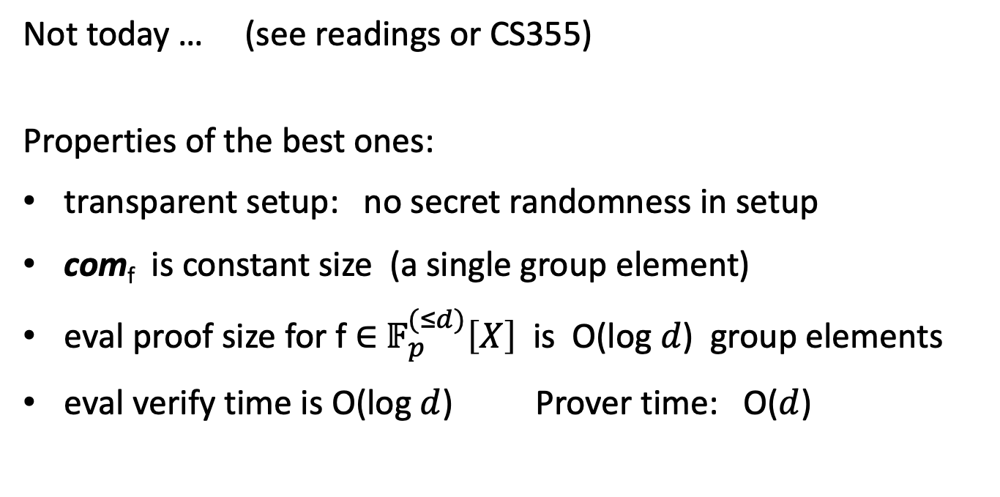
Constructing polynomial commitments
simple construction
without this requirement
Not today … (see readings or CS355)
Properties of the best ones:
transparent setup: no secret randomness in setup
com_{f} is constant size (a single group element)
eval proof size for f ∈ $𝔽_{p}^{(≤d)}\left[X\right]$ is O(log $d$) group elements
eval verify time is O(log $d$) Prover time: O($d$)

Slide 21
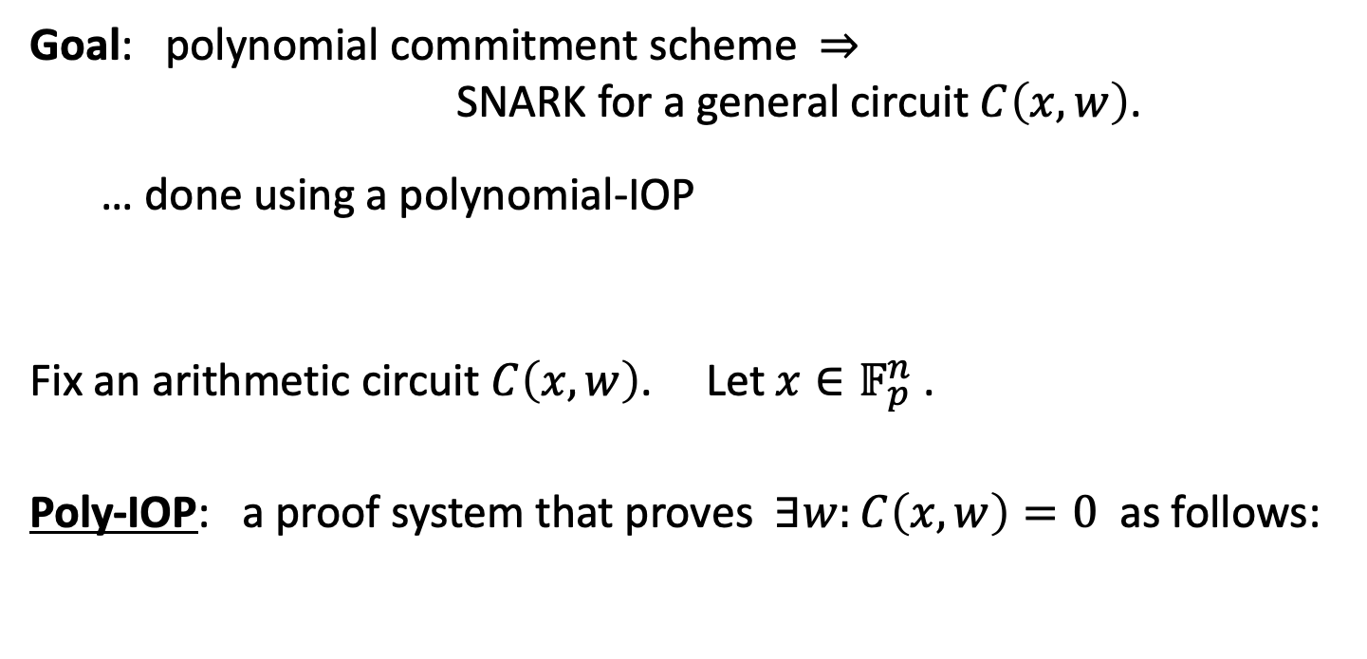
(2) Polynomial IOP
Goal: polynomial commitment scheme ⇒
SNARK for a general circuit $C\left(x,w\right)$.
… done using a polynomial-IOP
Fix an arithmetic circuit $C\left(x,w\right)$. Let $x∈𝔽_{p}^{n}$ .
Poly-IOP: a proof system that proves $∃w:C\left(x,w\right)=0$ as follows:

Slide 22

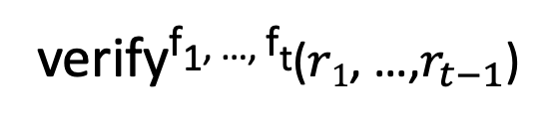
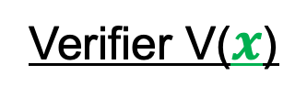


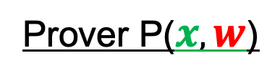






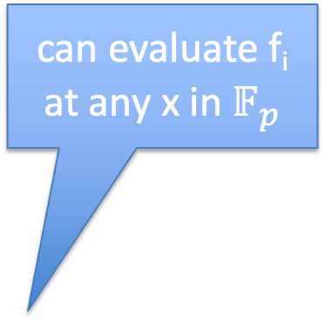
(2) Polynomial IOP
Prover P($x, w$)
Verifier V($x$)
$f1$ ${∈ 𝔽}_{p}^{(≤d)}\left[X\right]$
$$r1⇽𝔽_{p}$$
$r$₁
$f2$ ${∈ 𝔽}_{p}^{(≤d)}\left[X\right]$
can evaluate f_{i}
at any x in $𝔽_{p}$
$$r2⇽𝔽_{p}$$
$r$₂
⋮
$$r_{t−1}$$
$$r_{t−1}⇽𝔽_{p}$$
$ft$ ${∈ 𝔽}_{p}^{(≤d)}\left[X\right]$
verify^{f1, …, ft}($r1$, …,$r_{t−1}$)

Slide 23
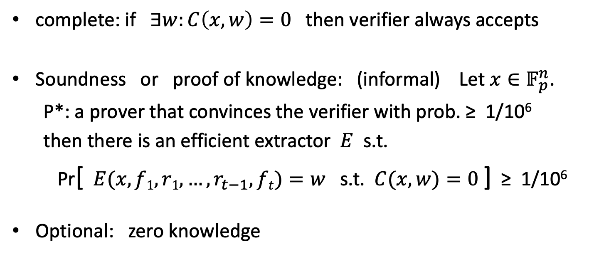
Properties
complete: if $∃w:C\left(x,w\right)=0$ then verifier always accepts
Soundness or proof of knowledge: (informal) Let $x∈𝔽_{p}^{n}$.
P*: a prover that convinces the verifier with prob. ≥ 1/10⁶
then there is an efficient extractor $E$ s.t.
Pr[ $E(x, f1, r1, …,r_{t−1}, ft)=w$ s.t. $C(x,w)=0$] ≥ 1/10⁶
Optional: zero knowledge

Slide 24
The resulting SNARK
Poly-IOP params: #polynomials = t, # eval queries in verify = q
The SNARK:
During interactive phase of poly-IOP: send t poly commitments
During poly-IOP verify: run poly-commit eval protocol q times
Use Fiat-Shamir to make the proof system non-interactive
Length of SNARK proof: t poly-commits + q eval proofs
SNARK verify time: q poly eval proof verifications + time(IOP-verify)
SNARK prover time: t poly commits + time(IOP-prover)

Slide 25
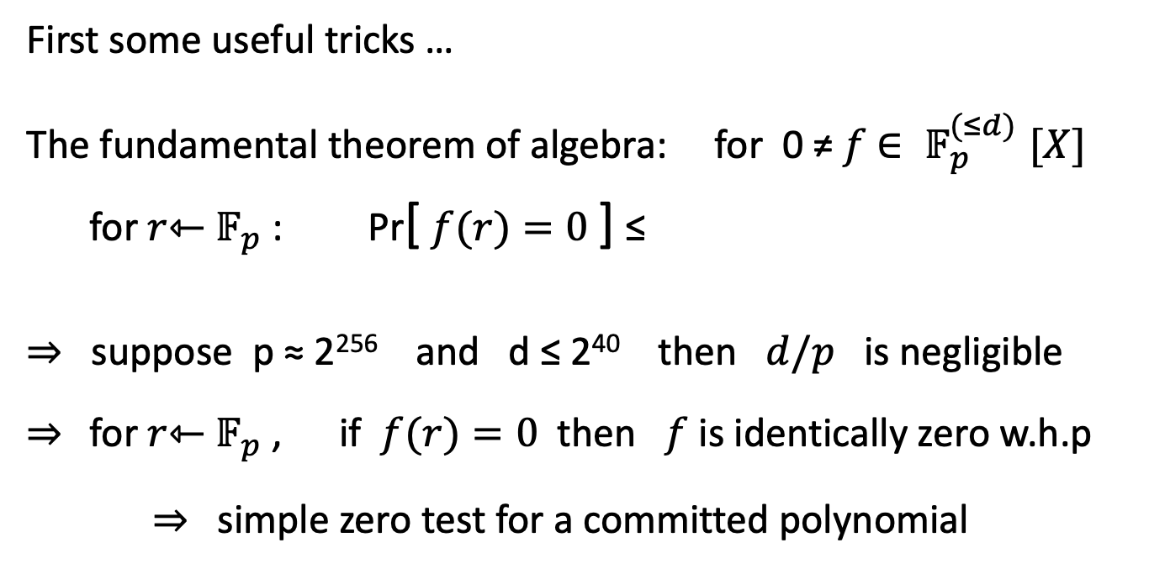

Constructing a Poly-IOP
First some useful tricks …
The fundamental theorem of algebra: for 0 ≠ $f$ ${∈ 𝔽}_{p}^{(≤d)}[X]$
for $r$⇽ $𝔽_{p}$: Pr[ $f(r)=0$] ≤
⇒ suppose p ≈ 2²⁵⁶ and d ≤ 2⁴⁰ then $d/p$ is negligible
⇒ for $r$⇽ $𝔽_{p}$ , if $f(r)=0$then $f$ is identically zero w.h.p
⇒ simple zero test for a committed polynomial
$$d/p$$
Notes:
This generalizes to multivariates: Schwartz-Zipple lemma

Slide 26
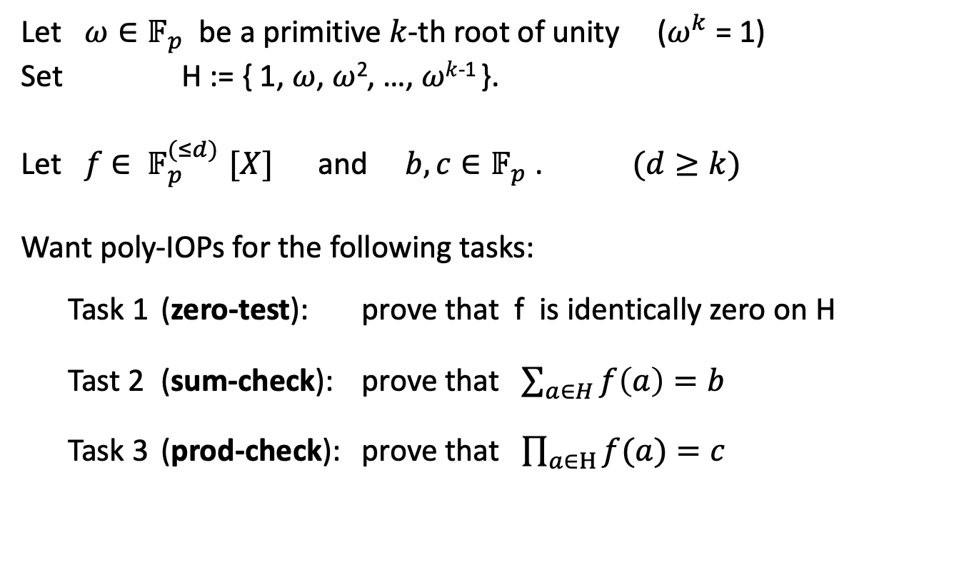
Some useful gadgets
Let $ω∈𝔽_{p}$ be a primitive $k$-th root of unity ($ω^{k}$ = 1)
Set H := { 1, $ω$, $ω$², …, $ωk$⁻¹ }.
Let $f$ ${∈ 𝔽}_{p}^{(≤d)}[X]$ and ${b, c∈𝔽}_{p}$ . $(d≥k)$
Want poly-IOPs for the following tasks:
  Task 1 (zero-test): prove that f is identically zero on H
  Tast 2 (sum-check): prove that $\sum_{a∈H}{f\left(a\right)=b }$
  Task 3 (prod-check): prove that $\prod_{a∈H}{f(a)}=c$

Slide 27

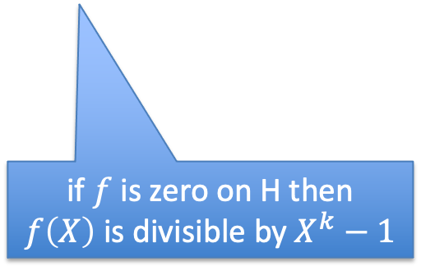


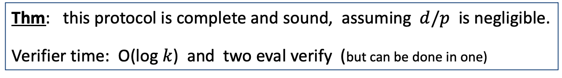

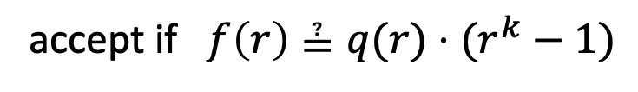
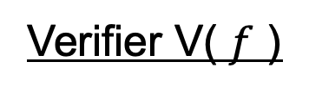
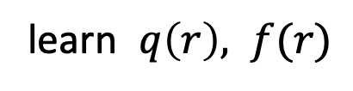
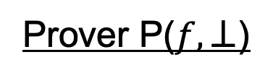
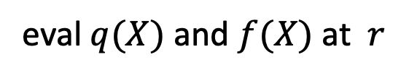

Zero test on H ( H = { 1, $ω$, $ω$², …, $ωk$⁻¹ } )
Prover P($f,⊥$)
Verifier V( $f$ )
$$q(X)⇽f(X)/(Xk –1)$$
$q$ ${∈ 𝔽}_{p}^{(≤d)}\left[X\right]$
$$r⇽𝔽_{p}$$
eval $q(X)$ and $f(X)$ at $r$
learn $q\left(r\right), f(r)$
if $f$ is zero on H then
$f\left(X\right)$ is divisible by $X^{k}−1$
accept if $f\left(r\right)≟q(r)⋅(r^{k}−1)$
(implies that $f(X)=q(X)(X^{k}−1)$ )
Thm: this protocol is complete and sound, assuming $d/p$ is negligible.
Verifier time: O(log $k$) and two eval verify (but can be done in one)
Notes:
Soundness: if $f(X)=q(X)(X^{k}−1)$ then f is indeed zero on H.

Slide 28
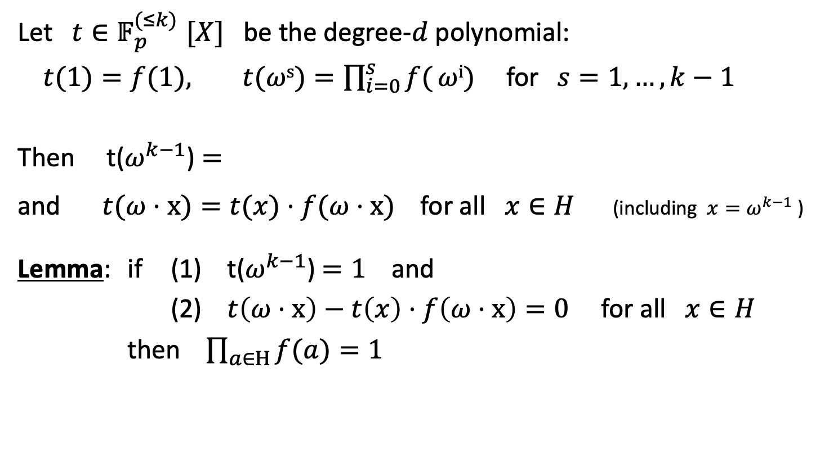

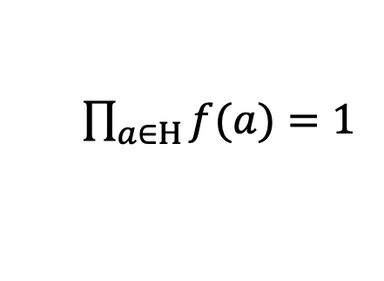
Product check on H: $\prod_{a∈H}{f(a)}=1$
Let $t{∈𝔽}_{p}^{(≤k)}[X]$ be the degree-$d$ polynomial:
$t(1)=f(1), t(ωs)=\prod_{i=0}^{s}{f(}ωi)$for$s=1, …, k−1$
Then t($ω^{k−1}$) $=$
and $t(ω⋅x)=t(x)⋅f(ω⋅x)$for all $x∈H$ (including $x=ω^{k−1}$ )
Lemma: if (1) t($ω^{k−1}$) $=1$ and
(2) $t\left(ω⋅x\right)−t\left(x\right)⋅f\left(ω⋅x\right)=0$ for all $x∈H$
then $\prod_{a∈H}{f(a)}=1$
$\prod_{a∈H}{f(a)}=1$

Slide 29

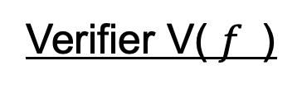








Product check on H (unoptimized)
Prover P($(f,c),⊥$)
Verifier V( $f$)
construct $t\left(X\right)$ ${∈ 𝔽}_{p}^{(≤k)}$ , $t1(X) = t(ω⋅X)−t(X)⋅f(ω⋅X)$
and q$(X)=t1(X){/(X^{k}−1) ∈ 𝔽}_{p}^{(≤k)}$
q$, t$ ${∈ 𝔽}_{p}^{(≤k)}\left[X\right]$
$$r⇽𝔽_{p}$$
eval $t(X)$ at $ω^{k−1} , r, ωr$
learn $t(ω^{k−1}$), t(r), $t(ωr)$, $q(r)$, $f(ωr)$
eval $q\left(X\right)$ at $r$ , and $f(X)$ at $ωr$
accept if $t(ω^{k−1}$) ≟ 1 and
$$t\left(ωr\right)−t(r)f(ωr) ≟q(r)⋅(r^{k}−1)$$
$t1(H) = 0$ :

Slide 30








PLONK: a poly-IOP for a general circuit $C(x,w)$
Step 1: compile circuit to a sequence of ops (gate fan-in = 2)
$$(x1+x2)(x2+w1)$$
Program P
(2)
compile
0: inp₁ , inp₂ : +
1: inp₂ , inp₃ : +
2: out₀, out₁ : ×
$$\text{×}$$
(0)
(1)
$$+$$
$$+$$
$$x1$$
$$x2$$
$$w1$$
(topological sort of gates)
output
Notes:
Mention R1CS

Slide 31

Encoding the inputs to the circuit
Step 2: let $d=3 \left|C\right|+|I|$ and H = { 1, $ω$, $ω$², …, $ω^{d−1}$ }
$|C|$ $=$ total # of gates in $C$ , |$I$| $=$ |$Ix$| + |$Iw$| $=$ # inputs to $C$
encode the $x$-inputs to the circuit in a polynomial $v$ ${∈ 𝔽}_{p}^{(≤|I_{x}|)}$[X]
for $j=1,..,|I_{x}|: v(ω^{−j})=$input #j
constructing $v(X)$ takes time proportional to the size of the input
Let H_{inp} = {${ ω}^{−1},ω^{−2}, …,ω^{−\left|I_{x}\right|} \}$ (points encoding the input)

Slide 32



Encoding the circuit internal values
(prover uses FFT to compute coefficients of P in time $d \text{log}2d$ )
The plan:
Define a polynomial $P{∈ 𝔽}_{p}^{(≤d)}$[X] such that ∀ $l=0,…,\left|C\right|−1$:
P($ω3l$): left input to gate #$l$
P($ω3l$⁺¹): right input to gate #$l$
P($ω3l$⁺²): output of gate #$l$
and P($ω^{−j})=$ input #j
example: x₁=5, x₂=6, $w1$=1
$ω$⁻¹, $ω$⁻², $ω$⁻³ : 5, 6, 1
0: $ω$⁰, $ω$¹, $ω$² : 5, 6, 11
1: $ω3$, $ω$⁴, $ω$⁵ : 6, 1, 7
2: $ω6$, $ω$⁷, $ω$⁸ : 11, 7, 77
for j = 1, …, $|I|$
(all inputs)

Slide 33


Encoding the gates of the circuit
Step 3: encode gate types using a selector polynomial S(X)
define S(X) ${∈ 𝔽}_{p}^{(≤d)}$[X] such that ∀ $l=0,…,\left|C\right|−1$:
S($ω3l$) = 1 if gate #$l$ is an addition gate
S($ω3l$) = 0 if gate #$l$ is a multiplication gate
Then, ∀ x ∈ H_{gates} = { 1, $ω3$, $ω6$, $ω9$, …, $ω^{3(\left|C\right|−1)}$ }:
S(x)⋅[P(x) + P($ω$x)] + (1 – S(x))⋅P(x)⋅P($ω$x) =
P($ω$²x)

Slide 34


Encoding the circuit wiring
example: x₁=5, x₂=6 , $w1$=1
$ω$⁻¹, $ω$⁻², $ω$⁻³ : 5, 6, 1
$ω$⁰, $ω$¹, $ω$² : 5, 6, 11
$ω3$, $ω$⁴, $ω$⁵ : 6, 1, 7
$ω6$, $ω$⁷, $ω$⁸ : 11, 7, 77
Step 4: encode the wires of $C$:
P($ω$⁻²) = P($ω$¹) = P($ω$³)
P($ω$⁻¹) = P($ω$⁰)
P$(ω$²) = P($ω$⁶)
P($ω$⁻³) = P($ω$⁴)
Define a polynomial W: H ⇾ H that implements a rotation:
W($ω$⁻², $ω$¹ , $ω$³) = ($ω1, ω$³, $ω$⁻² ) , W($ω$⁻¹, $ω$⁰) = ($ω$⁰ , $ω$⁻¹) , …
Lemma: ∀ $x$∈H: P($x$) = P(W($x$)) ⇒ wire constraints are satisfied

Slide 35

Encoding the circuit wiring
Problem: the constraint P($x$) = P(W($x$)) has degree d²
⇒ prover would need to manipulate polynomials of degree d²
⇒ quadratic time prover !! (goal: linear time prover)
Cute trick: use prod-check proof to reduce this to a
constraint of linear degree

Slide 36

Reducing wiring check to a linear degree
Lemma: P($x$) = P(W($x$)) for all $x$∈H if and only if $L(Y,Z)≡1$,
where $L\left(Y,Z\right)=\prod_{x∈H}{\frac{P\left(x\right)+Y∙W\left(x\right)+Z}{P\left(x\right)+Y∙x+Z}}$
To prove that $L\left(Y,Z\right)≡1$ do:
(1) verifier chooses random $y, z ∈ 𝔽_{p}$
(2) prover builds $L1$(X) s.t. $L1$($x$) $=$ $\frac{P\left(x\right)+y∙W\left(x\right)+z}{P\left(x\right)+y∙x+z}$ for all $x$∈H
(3) run prod-check to prove $\prod_{x∈H}{L1(x)}=1$
(4) validate $L1$: run zero-test to prove $L2$($x$) = 0 for all $x$∈H where
$L2$(x)$=$ ($P\left(x\right)+y∙x+z$) $L1$($x$) – ($P\left(x\right)+y∙W\left(x\right)+z$)

Slide 37






The final (S, P, V) SNARK
Setup($C$): S_{v} = ( poly commitment to S(X) and W(X) )
Prover P($x,w$)
Verifier V($Sv, x$)
$$P$$
build P$(X){∈𝔽}_{p}^{(≤d)}$[X]
build $v(X){∈𝔽}_{p}^{(≤|I_{x}|)}\text{[}\text{X}\text{]}$
Prove:
(1) S(x)⋅[P(x) + P($ω$x)] + (1 – S(x))⋅P(x)⋅P($ω$x) $−$ P($ω$²x) $=$ $0$ ∀ x ∈ H_{gates}
(2) P(x) $−$ $v$(x) $=$ $0$ ∀ x ∈ H_{inp}
(3) P(x) $−$ P(W(x)) $=$ $0$ ∀ x ∈ H
(4) P($ω^{3\left|C\right|−1})=0$ (output of last gate = 0)
gates:
inputs:
wires:
output:

Slide 38
Many extensions …
Can handle circuits with more general gates than + and ×
  PLOOKUP: efficient SNARK for circuits with lookup tables
The SNARK can easily be made into a zkSNARK
Main challenge: reduce prover time

Slide 39
END OF LECTURE
Next lecture: recursive SNARKs

