Slide 1
Final topics: Cute Crypto Tricks
CS251 Fall 2020
(cs251.stanford.edu)
Dan Boneh

Slide 2


Quick Recap: Rollup with privacy
rollup server
[A⇾B: 2 ETH], ${sig}_{A}$
Layer 1 blockchain
(e.g. Ethereum)
atomic swap:
[B⇾Z: 1 ETH]
[Z⇾B: 2 BAT]
root
block 354
$${sig}_{B} {sig}_{Z}$$
Merkle Tree
Alice:
5 DAI
3 ETH
Bob:
2 ETH
Zoe:
1 ETH
3 BAT
Tx
…

Slide 3
Quick Recap: Rollup with privacy
rollup server
[A⇾B: 2 ETH], ${sig}_{A}$
Layer 1 blockchain
(e.g. Ethereum)
atomic swap:
[B⇾Z: 1 ETH]
[Z⇾B: 2 BAT]
new root
block 354
Tx data , [SNARK]
$${sig}_{B} {sig}_{Z}$$
Merkle Tree
block 357
Alice:
5 DAI
1 ETH
Bob:
3 ETH
2 BAT
Zoe:
2 ETH
1 BAT
Tx
…

Slide 4
Privacy?
The Rollup server sees:
  all account balances, and
  all transactions.
Can we hide this from the Rollup server?
Yes! Using zkSNARKs

Slide 5

Replace balances with commitments (simplified)
A ⇾ B: 2 ETH
rollup server
Layer 1 blockchain
(e.g. Ethereum)
[Δ-com, SNARK], ${sig}_{A}$
root
block 354
Merkle Tree
open of com_{A}
Alice:
com_{A}
Bob:
com_{B}
Zoe:
com_{Z}
…
Tx
(commitment to balances)
Notes:
Δ-com is a Pedersen commitment to the amount to subtract from Alice and add to Bob.

Slide 6

Replace balances with commitments (simplified)
A ⇾ B: 2 ETH
rollup server
Layer 1 blockchain
(e.g. Ethereum)
[Δ-com, SNARK], ${sig}_{A}$
new root
block 354
Tx data , [recursive
SNARK]
Merkle Tree
block 357
open of com_{A}
Alice:
com’_{A}
Bob:
com’_{B}
Zoe:
com_{Z}
…
Tx
(commitment to balances)

Slide 7
Replace balances with commitments (simplified)
A ⇾ B: 2 ETH
rollup server
Layer 1 blockchain
(e.g. Ethereum)
[Δ-com, SNARK], ${sig}_{A}$
new root
block 354
Tx data , [recursive
SNARK]
Merkle Tree
block 357
open of com_{A}
Alice:
com’_{A}
Bob:
com’_{B}
Zoe:
com_{Z}
…
Tx
(commitment to balances)

Slide 8
(zk)²-Rollup
Problem: Rollup server sees identity of payer and payee
Better data structure enables fully private Tx
… can even run DAPPs privately (e.g., ZEXE)

Slide 9
General discussion

Slide 10
Discussion Topics
Open problems in blockchains
The future of blockchains and crypto currencies
  Where is this headed?
A career in blockchains?
Where can I learn more?
  EE374: Scaling blockchains (Winter 2021)
  CS255 and CS355: Cryptography
  Stanford blockchain conference (SBC)

Slide 11
Fun crypto tricks

Slide 12
BLS signatures
one Bitcoin block
inputs
outputs
Signatures make up
most of Tx data.
Can we compress
signatures?
Yes: aggregation!
not possible for ECDSA
Tx1:
sig
sig
sig
Tx2:
sig
sig
sig
sig
Tx3:
sig
sig
Tx4:
sig
sig
sig

Slide 13
BLS Signatures
Used in modern blockchains: Ehtereum 2.0, Dfinity, Chia, etc.
The setup:
G = {1, g, …, g^{q-1}} a cyclic group of prime order q
H: M × G ⇾ G a hash function (e.g., based on SHA256)

Slide 14
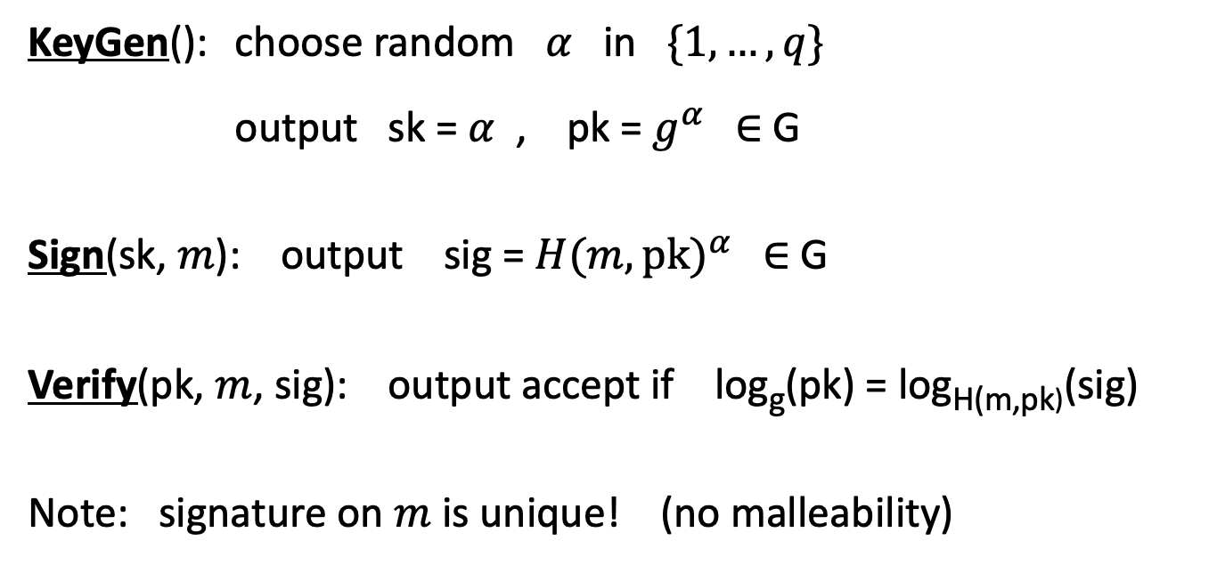
BLS Signatures
KeyGen(): choose random $α$ in $\{1, …, q\}$
output sk = $α$ , pk = $g^{α}$ ∈ G
Sign(sk, $m$): output sig = ${H(m,pk)}^{α}$ ∈ G
Verify(pk, $m$, sig): output accept if log_{g}(pk) = log_{H(m,pk)}(sig)
Note: signature on $m$ is unique! (no malleability)

Slide 15
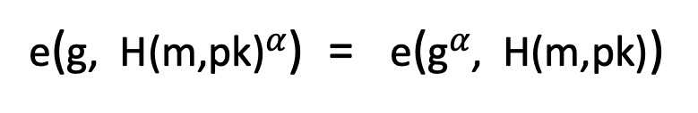
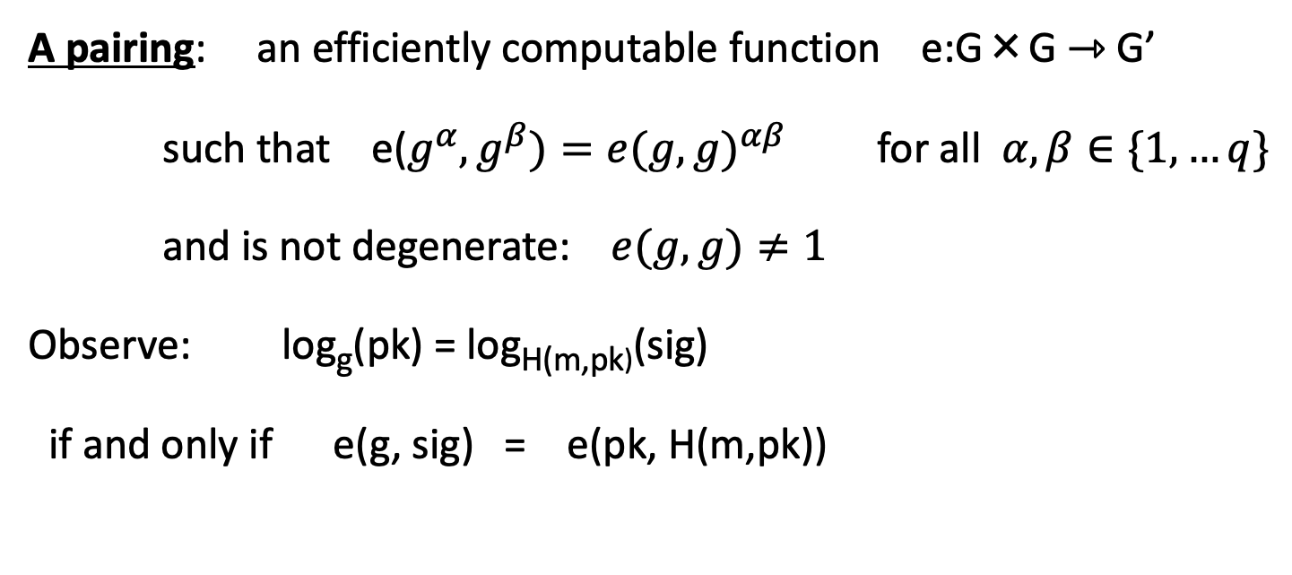
How does verify work?
A pairing: an efficiently computable function e:G×G ⇾ G’
such that e($g^{α},g^{β})={e(g,g)}^{αβ}$ for all $α,β∈\{1,…q\}$
and is not degenerate: $e(g, g)≠1$
Observe: log_{g}(pk) = log_{H(m,pk)}(sig)
if and only if e(g, sig) = e(pk, H(m,pk))
verify test
=
=
e(g, H(m,pk)$α$) = e(g$α$, H(m,pk))

Slide 16
Properties: signature aggregation [BGLS’03]
Anyone can compress n signatures into one
Verify( pk , m , σ* ) = “accept”
convinces verifier that
for i=1,…,n:
user i signed msg m_{i}
pk₁ , m₁ ⟶ σ₁
⋮
aggregate
⟶ σ*
pk_{n} , m_{n} ⟶ σ_{n}
single short signature

Slide 17
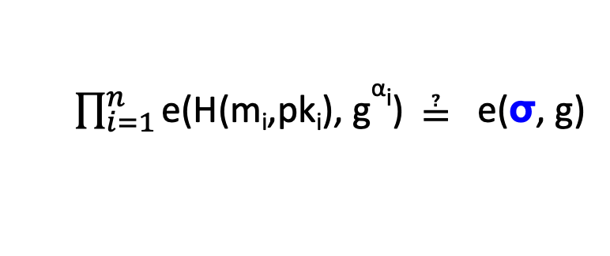
Aggregation: how
user 1: pk₁ = g^{α1} , m₁ ⟶ σ₁=H(m₁,pk₁)^{α1}
σ ⟵ σ₁⋯ σ_{n}
user n: pk_{n} = g^{αn} , m_{n} ⟶ σ_{n}=H(m_{n},pk_{n})^{αn}
Verifying an aggregate signature: (incomplete)
  $\prod_{i=1}^{n}{\text{e}\text{(}\text{H}\text{(}\text{mi}\text{,}\text{pki}\text{), }\text{g}\text{α}\text{i}\text{)}}$ ≟ e(σ, g)
=
=
Π_{i=1} e(H(m_{i},pk_{i})^{αi}, g) = e(Π_{i=1}H(m_{i},pk_{i})^{αi}, g)

Slide 18
Compressing the blockchain with BLS
one Bitcoin block
if needed:
compress all signatures in a block into a single aggregate signatures
⇒ shrink block
or: aggregate in smaller batches
inputs
outputs
sig*
Tx1:
sig
sig
sig
Tx2:
sig
sig
sig
sig
Tx3:
sig
sig
Tx4:
sig
sig
sig

Slide 19
Reducing Miner State

Slide 20
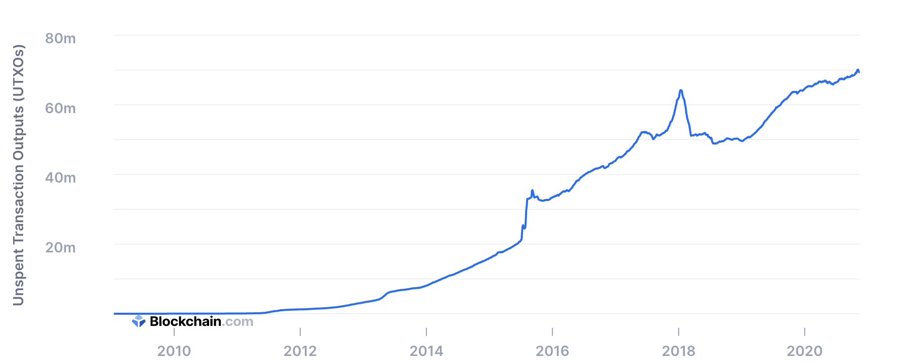
UTXO set size
≈70M UTXOs
Miners need to keep all UTXOs in memory to validate Txs
Can we do better?

Slide 21
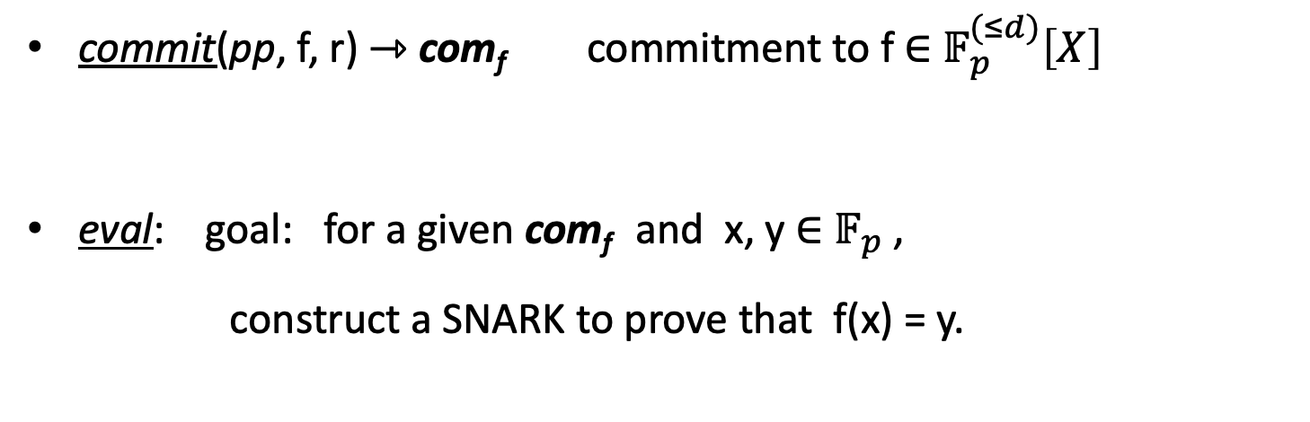
Recall: polynomial commitments
commit(pp, f, r) ⇾ com_{f} commitment to f ∈ $𝔽_{p}^{(≤d)}\left[X\right]$
eval: goal: for a given com_{f} and x, y ∈ $𝔽_{p}$,
construct a SNARK to prove that f(x) = y.

Slide 22
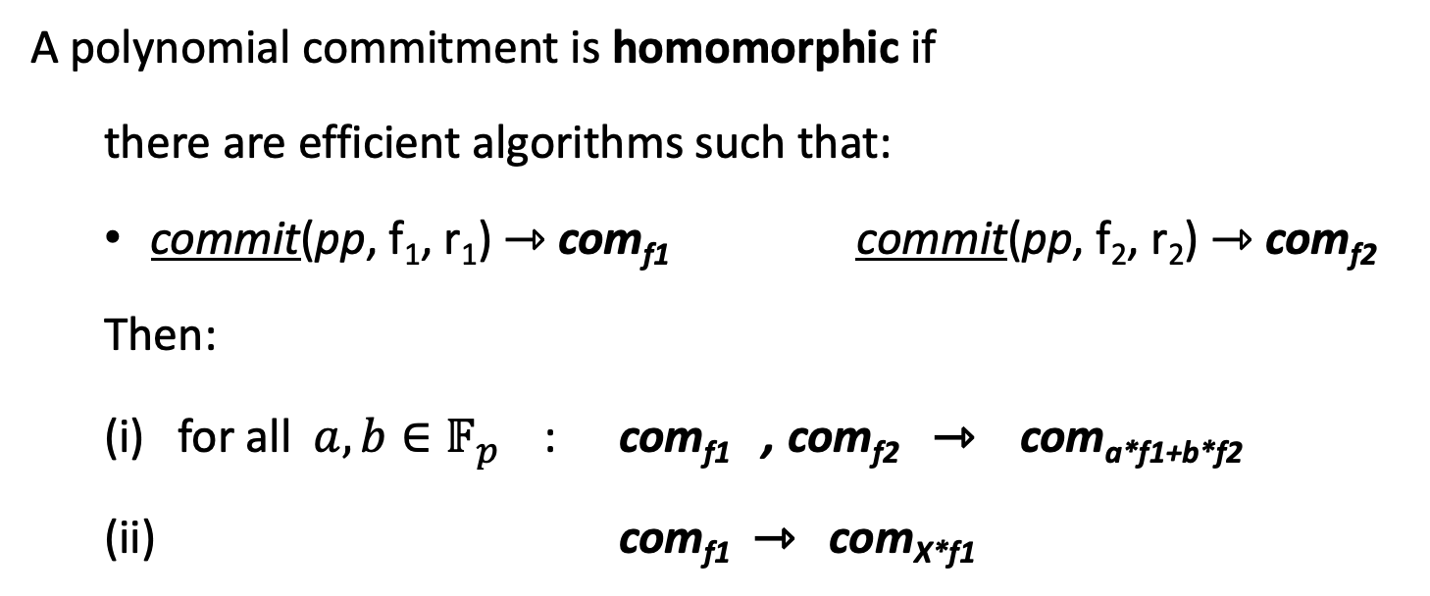
Homomorphic polynomial commitment
A polynomial commitment is homomorphic if
there are efficient algorithms such that:
  commit(pp, f₁, r₁) ⇾ com_{f1} commit(pp, f₂, r₂) ⇾ com_{f2}
  Then:
  (i) for all $a, b∈𝔽_{p}^{}$ : com_{f1} , com_{f2} ⇾ com_{a*f1+b*f2}
  (ii) com_{f1} ⇾ com_{X*f1}

Slide 23
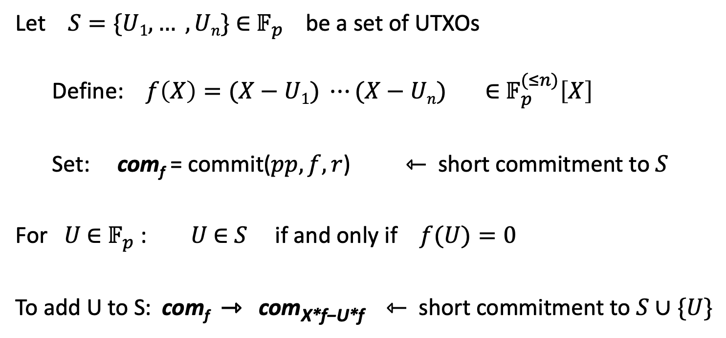
Committing to a set (of UTXOs)
(accumulator)
Let $S=\{U1, … , Un\}$ ∈ $𝔽_{p}$ be a set of UTXOs
Define: $f\left(X\right)=(X−U1) ⋯(X−Un)$ ∈ $𝔽_{p}^{(≤n)}\left[X\right]$
Set: com_{f} = commit($pp, f, r$) ⇽ short commitment to $S$
For $U$ ∈ $𝔽_{p}$ : $U$ ∈ $S$ if and only if $f(U)=0$
To add U to S: com_{f} ⇾ com_{X*f−U*f} ⇽ short commitment to $S∪\{U\}$

Slide 24
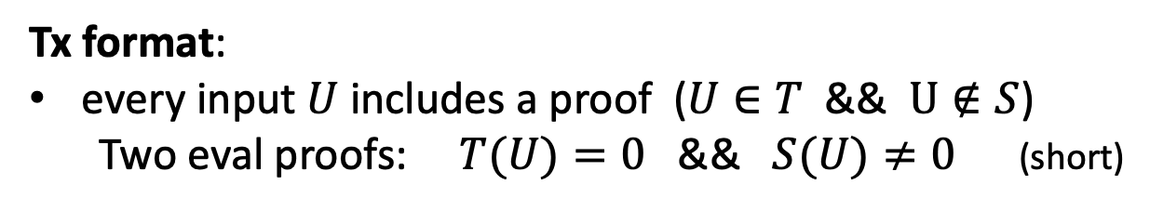
How does this help?
Miners maintain two commitments:
(i) commitment to set T of all UTXOs
(ii) commitment to set S of spent TXOs
≤ 1KB
com_{T}, com_{S}
Tx format:
every input $U$ includes a proof ($U∈T$ && $U∉S$)
  Two eval proofs: $T(U)=0$ && $S(U)≠0$ (short)
Tx processing: miners check eval proofs, and if valid,
add inputs to set S and outputs to set T. That’s it!

Slide 25


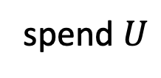
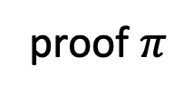
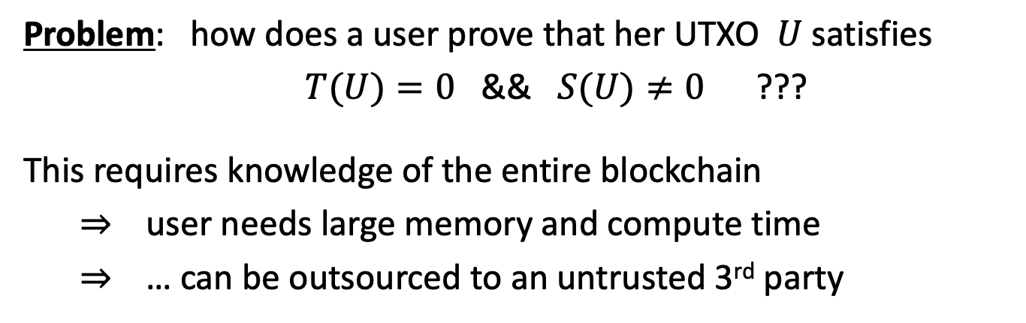
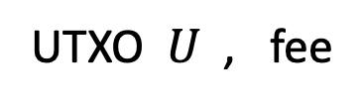
Does this work ??
Problem: how does a user prove that her UTXO $U$ satisfies
$T(U)=0$ && $S(U)≠0$ ???
This requires knowledge of the entire blockchain
⇒ user needs large memory and compute time
⇒ … can be outsourced to an untrusted 3rd party
UTXO $U$ , fee
polynomials
S and T
proof $π$
spend $U$
The proof factory

Slide 26
Is this practical?
Not quite …
Problem: the factory’s work per proof is linear in the number of UTXOs ever created
Many variations on this design:
  can reduce factory’s work to log₂(# current UTXOs) per proof
  Factory’s memory is linear in (# current UTXOs)
End result: outsource memory requirements to a
small number of 3rd party service providers
Notes:
factory work is logarithmic by using 2-3 trees.

Slide 27
Taproot: semi-private scripts in Bitcoin

Slide 28
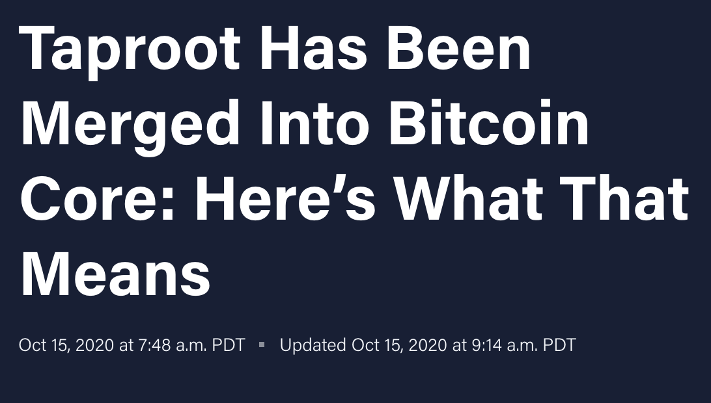
Taproot is coming …

Slide 29
Script privacy
Currently: Bitcoin scripts must be fully revealed in spending Tx
Can we keep the script secret?
Answer: Yes, easily! when all goes well …

Slide 30
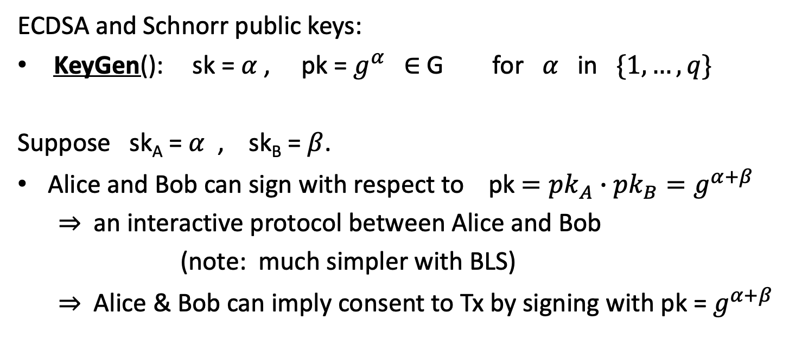
How?
ECDSA and Schnorr public keys:
KeyGen(): sk = $α$ , pk = $g^{α}$ ∈ G for $α$ in $\{1, …, q\}$
Suppose sk_{A} = $α$ , sk_{B} = $β$.
Alice and Bob can sign with respect to pk $={pk}_{A}∙{pk}_{B}=g^{α+β}$
⇒ an interactive protocol between Alice and Bob
(note: much simpler with BLS)
⇒ Alice & Bob can imply consent to Tx by signing with pk = $g^{α+β}$

Slide 31

How?
S: Bitcoin script that must be satisfied to spend a UTXO $U$
S involves only Alice and Bob. Let ${pk}_{AB}={pk}_{A}∙{pk}_{B}$
Goal: keep S secret when possible.
How: modify S so that a signature with respect to
pk =${pk}_{AB}∙$ $g^{H({pk}_{AB} , S)}$
is sufficient to spend UTXO, without revealing S !!

Slide 32
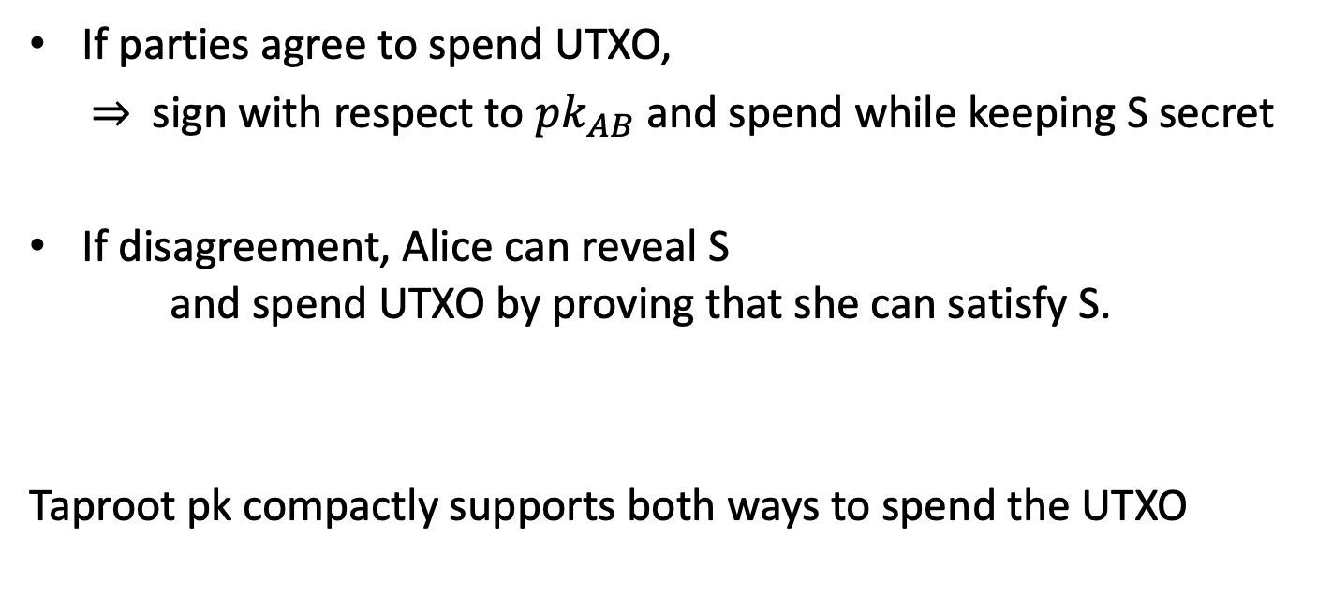
The main point
If parties agree to spend UTXO,
  ⇒ sign with respect to ${pk}_{AB}$ and spend while keeping S secret
If disagreement, Alice can reveal S
and spend UTXO by proving that she can satisfy S.
Taproot pk compactly supports both ways to spend the UTXO

Slide 33
END OF LECTURE
Next lecture: super cool final guest lecture

