Slide 1
Classical Consensus
CS251 Fall 2020
(cs251.stanford.edu)
Benedikt Bünz

Slide 2
Blockchain Layers
Layer 3:
user facing tools (cloud servers)
Layer 2:
applications (DAPPs, smart contracts)
Layer 1.5:
compute layer (blockchain computer)
Layer 1:
consensus layer

Slide 3

Blockchain Forks
Send 3 BTC to Bob
TX_{A}
…
TX_{A}

Slide 4
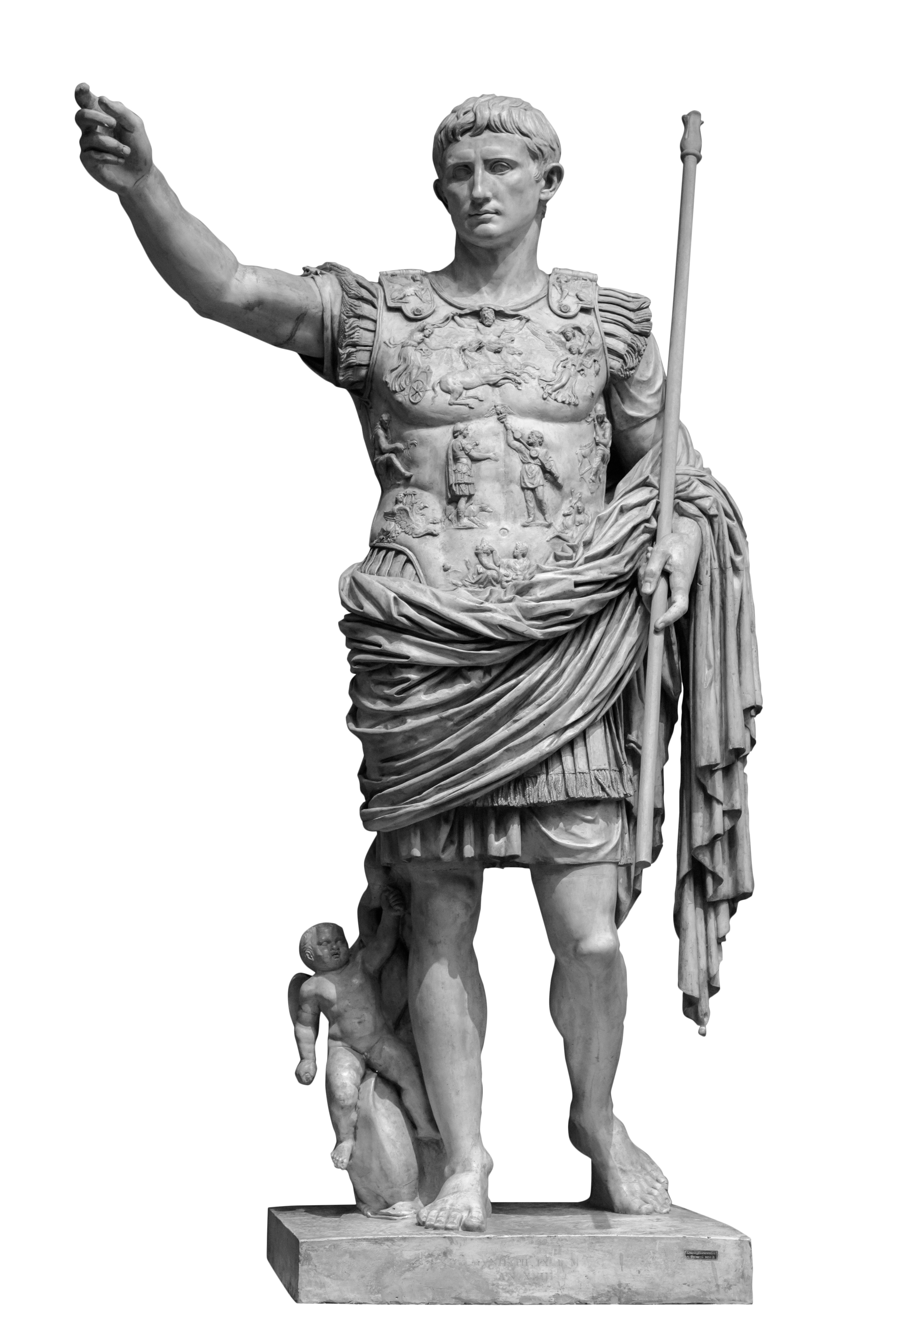
Byzantine Generals Problem
Attack
Retreat?
Attack
Retreat
404

Slide 5
Byzantine Generals Problem
Leader gets an input bit 0/1
Every round each node sends messages to every other general. Messages are received in the next round
At the end of the protocol honest nodes output a bit or abort
Attack
Attack
Notes:
A round in the real world can be some fixed time in which all participants will be able to send their messages

Slide 6

Byzantine Generals Problem
Honest generals follow the protocol.
Malicious generals behave arbitrarily
Assuming signatures

Slide 7
Byzantine Generals Problem
Consistency
If two honest nodes output b and b’′ respectively, then ′
b=b’.
Validity
If the leader is honest and receives input b then all honest nodes output b
Notes:
Each trivial on their own

Slide 8
Voting Protocol
Leader sends b to all nodes
All nodes forward received bit to all other nodes (Voting)
Each node tallies votes (including its own vote) and outputs majority bit
Broken by corrupt leader

Slide 9
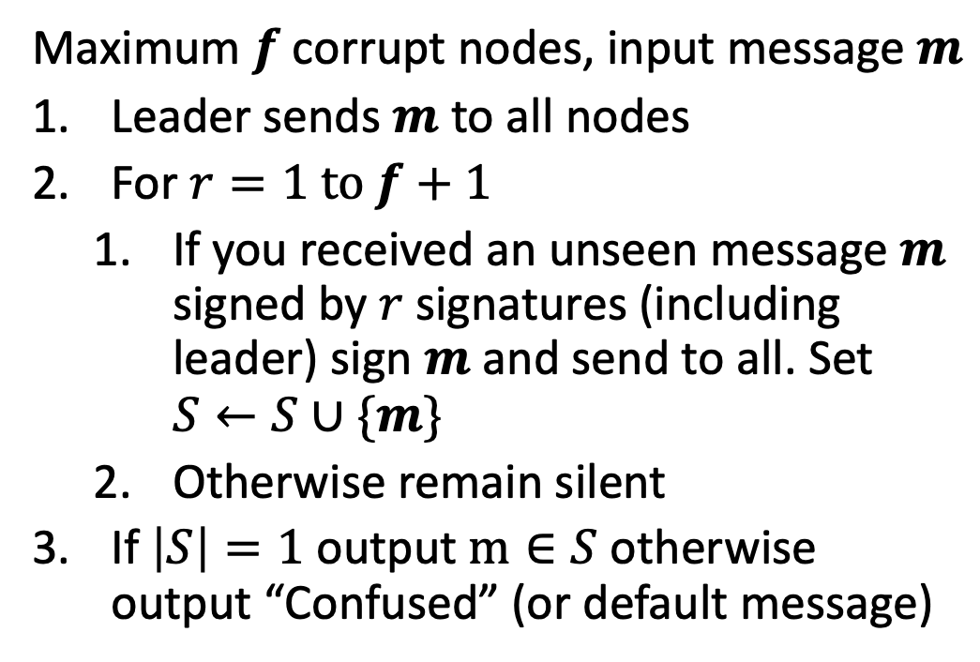
Dolev Strong Protocol
Maximum $f$ corrupt nodes, input message $m$
Leader sends $m$ to all nodes
For $r=1 to f+1$
  If you received an unseen message $m$ signed by $r$ signatures (including leader) sign $m$ and send to all. Set $S←S∪\{m\}$
  Otherwise remain silent
If $\left|S\right|=1$ output $m∈S$ otherwise output “Confused” (or default message)
f+1 rounds too slow for practice

Slide 10
Dolev Strong Example
Attack=1
f=2
1_{Caesar}
1_{Caesar}
1_{Caesar}
1_{Caesar}
Brutus
Marc Anthony
Pompeius
Augustus

Slide 11
Dolev Strong Example
Attack=1
f=2
r=1
1_{Caesar,MA}
1_{Caesar,MA}
1_{Caesar,MA}
1_{Caesar,MA}
1_{Caesar,MA}
Brutus
Marc Anthony
1_{Caesar, Aug}
1_{Caesar, Aug}
1_{Caesar, Aug}
1_{Caesar, Aug}
1_{Caesar, Aug}
Pompeius
Augustus

Slide 12
Dolev Strong Example
Attack=1
f=2
r=2
1_{Caesar,MA}
Brutus
Marc Anthony
0_{Brutus,Pompeius}
1_{Caesar, Aug}
Pompeius
Augustus

Slide 13
Dolev Strong Example
Attack=1
f=2
r=3
1_{Caesar,MA}
Brutus
Marc Anthony
1_{Caesar, Aug}
Pompeius
Augustus

Slide 14
Dolev Strong Example
Attack=1
f=2
r=3
Attack
1_{Caesar,MA}
Brutus
Marc Anthony
Attack
1_{Caesar, Aug}
Pompeius
Augustus

Slide 15
More than f corruptions
f=2
r=3
1_{Caesar,MA}
Brutus
Marc Anthony
0_{Caesar,Brutus,Pompeius}
1_{Caesar, Aug}
Pompeius
Augustus

Slide 16
More than f corruptions
f=2
r=3
Confused
0_{Caesar,Brutus,Pompeius}
1_{Caesar,MA}
Brutus
Attack
Marc Anthony
1_{Caesar, Aug}
Pompeius
Augustus

Slide 17
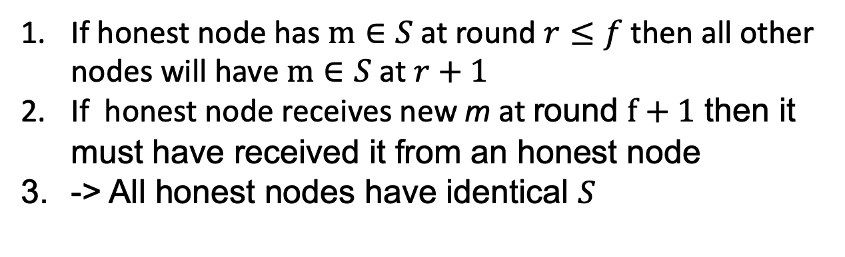

Dolev Strong Analysis
Why f+1 rounds?
f corrupt nodes can confuse honest node
Validity?
Honest nodes only update set $S$ if signed by leader
Consistency?
If honest node has $m∈S$ at round $r≤f$ then all other nodes will have $m∈S$ at $r+1$
If honest node receives new m at round $f+1$ then it must have received it from an honest node
-> All honest nodes have identical $S$

Slide 18
From Byzantine Consensus to Blockchains
…
Notes:
Fixed nodes agree on single message vs ledger of transactions. Arbitrary nodes can join/leave

Slide 19
Sybil Resistance
In BC participants are fixed but we want an open consensus
Approach 1: Anyone can join

Slide 20






Permissioned Consensus

Slide 21

Proof of Stake
Weighted Byzantine Consensus
Super large consensus
3 ETH
1 ETH
7 ETH
2 ETH
Assumption 2/3rd of stake with honest nodes
How to initialize? Incentives?
5 ETH

Slide 22

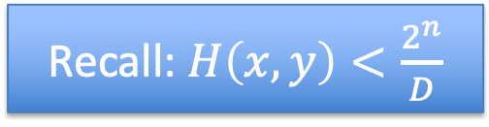
Proof of Work
Recall: $H\left(x,y\right)<\frac{2^{n}}{D}$
Truly permissionless
3 TH/s
5 TH/s
7 TH/s
2 TH/s
Terrible for the environment
More next lecture
5 TH/s

Slide 23
Network Model
Dolev Strong assumes messages gets delivered by next round
  Not realistic (honest nodes can have network outages)
  Protocol broken if messages aren’t delivered in time

Slide 24
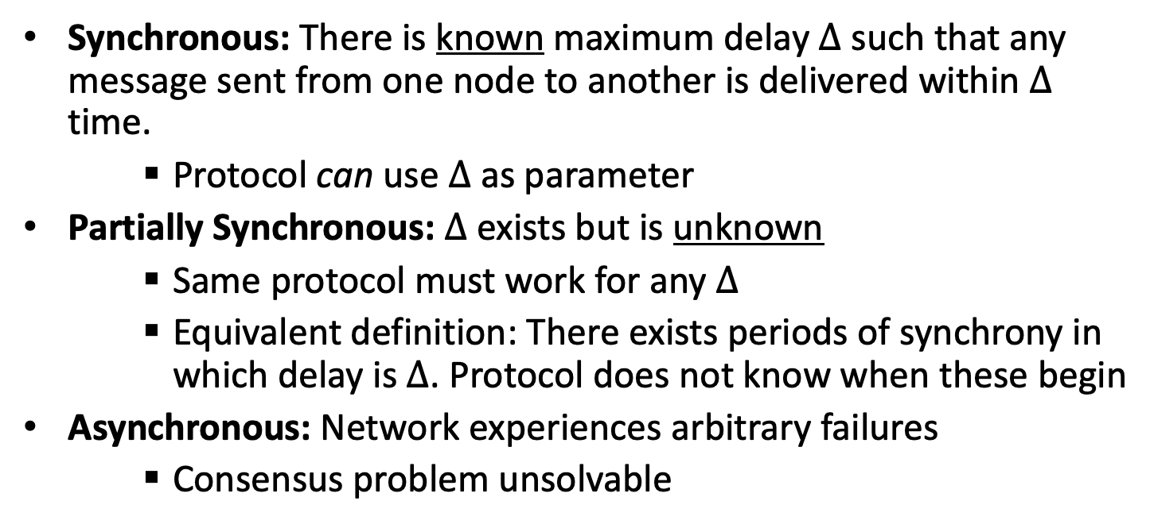

Network Model
Synchronous: There is known maximum delay $Δ$ such that any message sent from one node to another is delivered within $Δ$ time.
    Protocol can use $Δ$ as parameter
Partially Synchronous: $Δ$ exists but is unknown
    Same protocol must work for any $Δ$
    Equivalent definition: There exists periods of synchrony in which delay is $Δ$. Protocol does not know when these begin
Asynchronous: Network experiences arbitrary failures
    Consensus problem unsolvable
Any f (Dolev-Strong)
$$f<n/3$$
Notes:
D-S
1/3 lower bound

Slide 25
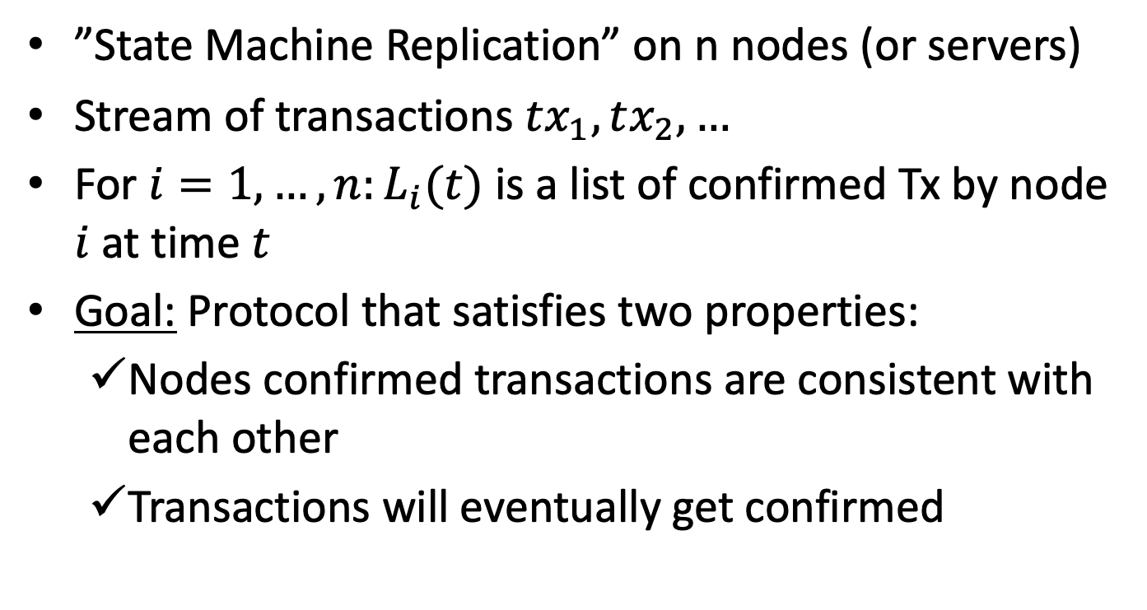
Blockchain Consensus
”State Machine Replication” on n nodes (or servers)
Stream of transactions $tx_{1},tx_{2},…$
For $i=1,…,n:L_{i}(t)$ is a list of confirmed Tx by node $i$ at time $t$
Goal: Protocol that satisfies two properties:
  Nodes confirmed transactions are consistent with each other
  Transactions will eventually get confirmed
Notes:
Note that accepting/rejecting transactions is done at a different layer (the blockchain computer)

Slide 26
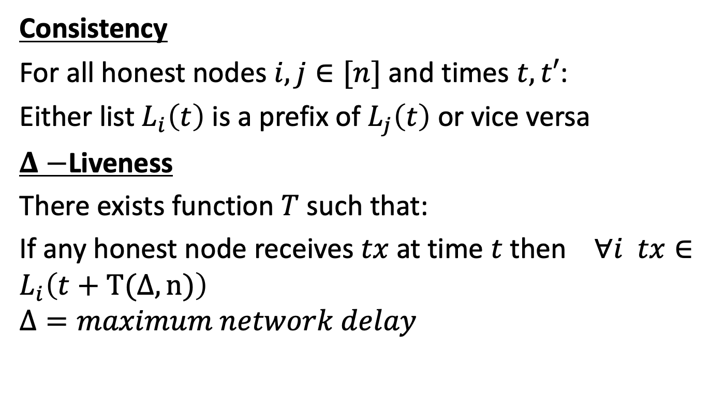
Blockchain Consensus
Consistency
For all honest nodes $i,j∈[n]$ and times $t,t′$:
Either list $L_{i}\left(t\right)$ is a prefix of $L_{j}\left(t\right)$ or vice versa
$Δ−$Liveness
There exists function $T$ such that:
If any honest node receives $tx$ at time $t$ then $∀i tx∈L_{i}\left(t+T(Δ,n)\right)$
$$Δ=maximum network delay$$

Slide 27






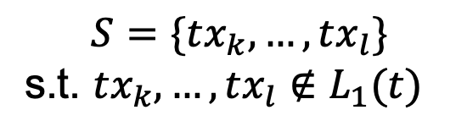

Blockchain from Byzantine Consensus
Epoch t
$$L_{2}(t)$$
$$L_{1}(t)$$
$$S=\{tx_{k},…,tx_{l}\}$$
s.t. $tx_{k},…,tx_{l}∉L_{1}(t)$
BC using $S$
$$L_{3}(t)$$
$$L_{5}(t)$$
$$L_{4}(t)$$

Slide 28





Blockchain from Byzantine Consensus
Epoch t+1
$$L_{2}\left(t+1\right)=L_{2}\left(t\right)∪S$$
$$L_{1}\left(t+1\right)=L_{1}\left(t\right)||S$$
BC using $S$
$$L_{5}(t+1)=L_{5}\left(t\right)∪S$$
$$L_{3}\left(t+1\right)=L_{3}\left(t\right)∪S$$
$$L_{4}(t+1)=L_{4}\left(t\right)∪S$$

Slide 29





Blockchain from Byzantine Consensus
Epoch t+1
$$L_{2}\left(t+1\right)$$
$$L_{1}\left(t+1\right)$$
$$L_{5}(t+1)$$
$$L_{3}\left(t+1\right)$$
Malicious leader?
Confirmation time?
$$L_{4}(t+1)$$
Notes:
IF BC takes R rounds then O(n*R)

Slide 30


Streamlet: A simple Blockchain protocol
Assumptions:
n nodes (permissioned)
Less than 1/3 corrupt
Partially synchronous network
Proceed in epochs
Random rotating leader:
Leader id= H(epoch) mod n
2
2
$$⊥$$
$$⊥$$
1
Each node stores locally notarized chain

Slide 31
Streamlet [Chan,Shi20]
Propose Vote In every epoch:
Leader creates block of TXs extending longest local notarized chain
Nodes sign off on first block from leader iff it extends one of their longest local notarized chain
If Block has signatures from 2n/3 nodes it becomes notarized
Finalize
If a chain has 3 notarized blocks from consecutive epochs, chop off the final block and finalize the chain

Slide 32

Streamlet: A simple Blockchain protocol
Assumptions:
Less than 1/3 corrupt
Partially synchronous network
Proceed in epochs
Random rotating leader:
Leader id= H(epoch) mod n
2
$$⊥$$
$$⊥$$
2
5
5
1
Each node stores locally notarized chain

Slide 33
Streamlet: A simple Blockchain protocol
Assumptions:
Less than 1/3 corrupt
Partially synchronous network
Proceed in epochs
Random rotating leader:
Leader id= H(epoch) mod n
Reject 3
2
5
$$⊥$$
$$⊥$$
2
5
1
3
Sign off on 5
Sign off on 3
Each node stores locally notarized chain

Slide 34
Streamlet: A simple Blockchain protocol
Assumptions:
Less than 1/3 corrupt
Partially synchronous network
Proceed in epochs
Random rotating leader:
Leader id= H(epoch) mod n
2
5
6
$$⊥$$
$$⊥$$
2
5
1
3
Each node stores locally notarized chain

Slide 35
Streamlet: A simple Blockchain protocol
Assumptions:
Less than 1/3 corrupt
Partially synchronous network
Proceed in epochs
Random rotating leader:
Leader id= H(epoch) mod n
2
5
6
7
$$⊥$$
$$⊥$$
2
5
1
3
Each node stores locally notarized chain

Slide 36

Streamlet: A simple Blockchain protocol
Assumptions:
Less than 1/3 corrupt
Partially synchronous network
Proceed in epochs
Random rotating leader:
Leader id= H(epoch) mod n
2
5
6
7
$$⊥$$
No other block on level 6 can be notarized
$$⊥$$
2
5
1
3
X
Each node stores locally notarized chain

Slide 37

Streamlet: Consistency Analysis
No two blocks with same epoch can be notarized (2/3 majority)
If X<5 then more than 1/3 honest nodes voted on 3. These nodes would never notarize 5 (because 5 doesn’t extend 3). Without these 1/3+1 nodes 5 can’t get notarized (Contradiction)
If X>7 more than 1/3 honest nodes have notarized 6. They won’t notarize X because it doesn’t extend 6
2
5
6
7
$$⊥$$
No other block on level 6 can be notarized.
Consistency holds irrespective of network
1
3
X

Slide 38
END OF LECTURE
Next lecture: Nakamoto Consensus, Incentives, Large Scale Consensus

