Slide 1
Randomness Beacons and VDFs
CS251 Fall 2020
(cs251.stanford.edu)
Benedikt Bünz

Slide 2
Recap: Nakamoto Consensus
BH₁
BH₂
BH₃
Genesis
Prev
Time
Nonce
Root
Prev
Time
Nonce
Root
BH₂
Time
Nonce
Root
H
H
H
H
BH₂ BH₃
Time
Root
BH₃
Time
Root
coinbase Tx
Notes:
4 bytes

Slide 3
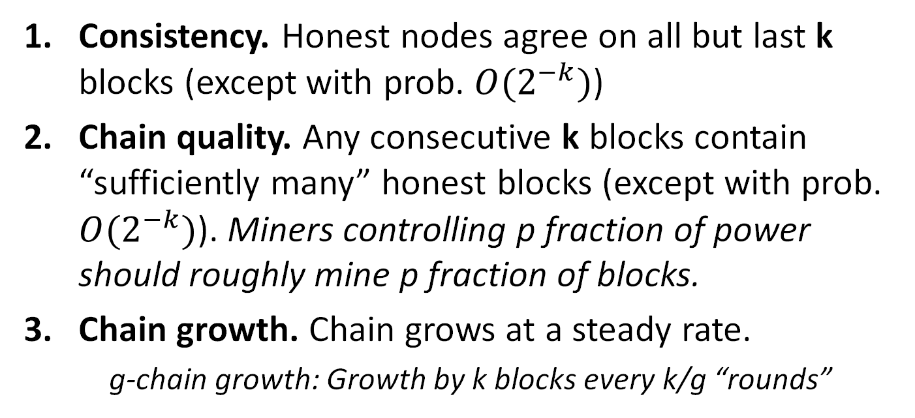
Nakamoto properties
Consistency. Honest nodes agree on all but last k blocks (except with prob. $O(2^{−k})$)
Chain quality. Any consecutive k blocks contain “sufficiently many” honest blocks (except with prob. $O(2^{−k})$). Miners controlling p fraction of power should roughly mine p fraction of blocks.
Chain growth. Chain grows at a steady rate.
    g-chain growth: Growth by k blocks every k/g “rounds”

Slide 4
Nakamoto Properties
Anonymous participation
Nodes can join/leave
  Very scalable
  Sleeping Beauty property
Leader not known beforehand
  Makes bribing harder
Up to ½ corruptions
Slow
  Even when everyone is honest
Resource intensive
  PoS based possible
Long forks possible
No guarantees under long delays

Slide 5
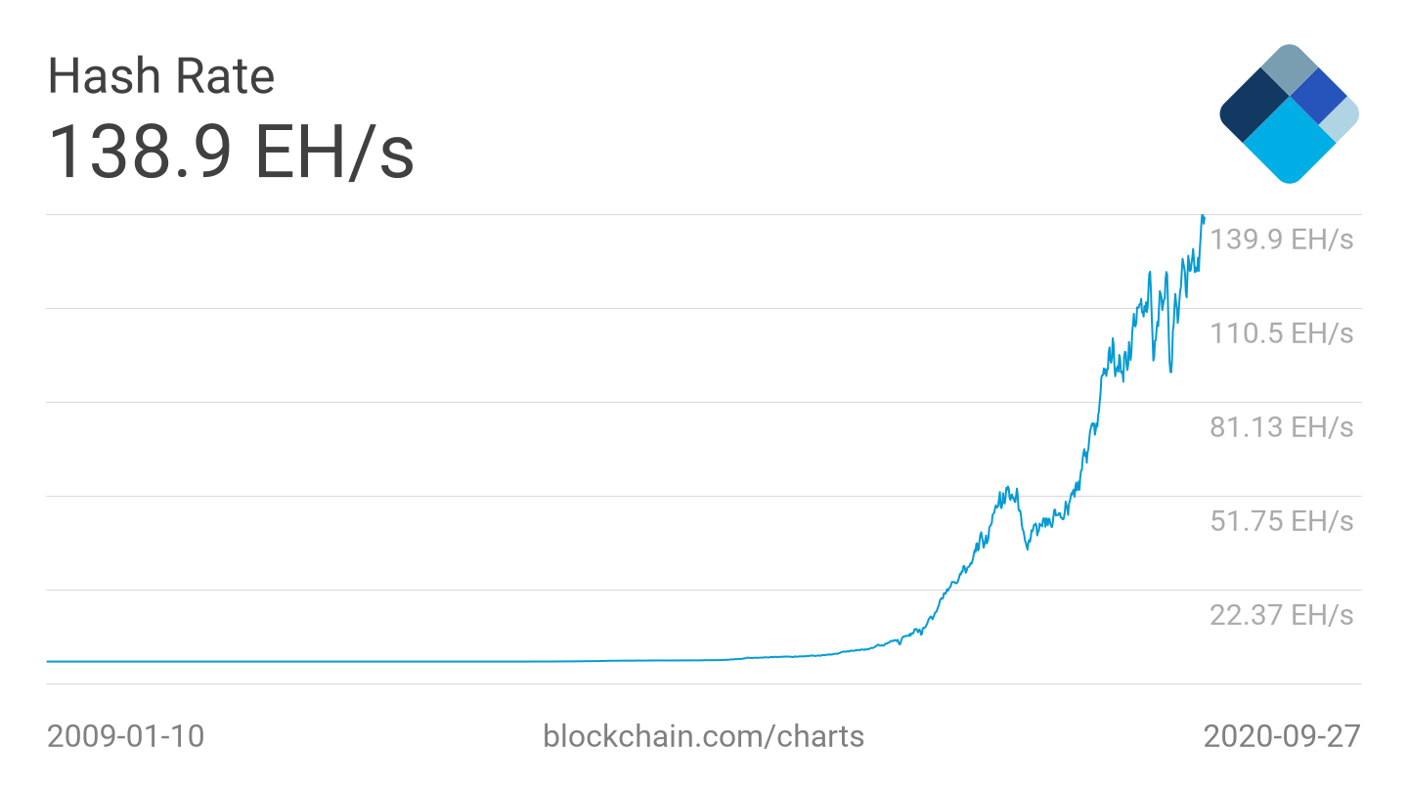
Difficulty Resets
Computation increases
But block time ~constant
Every two weeks difficulty reset based on prior two weeks
Based on time stamps
Slightly lagging
Miners accept heaviest chain

Slide 6
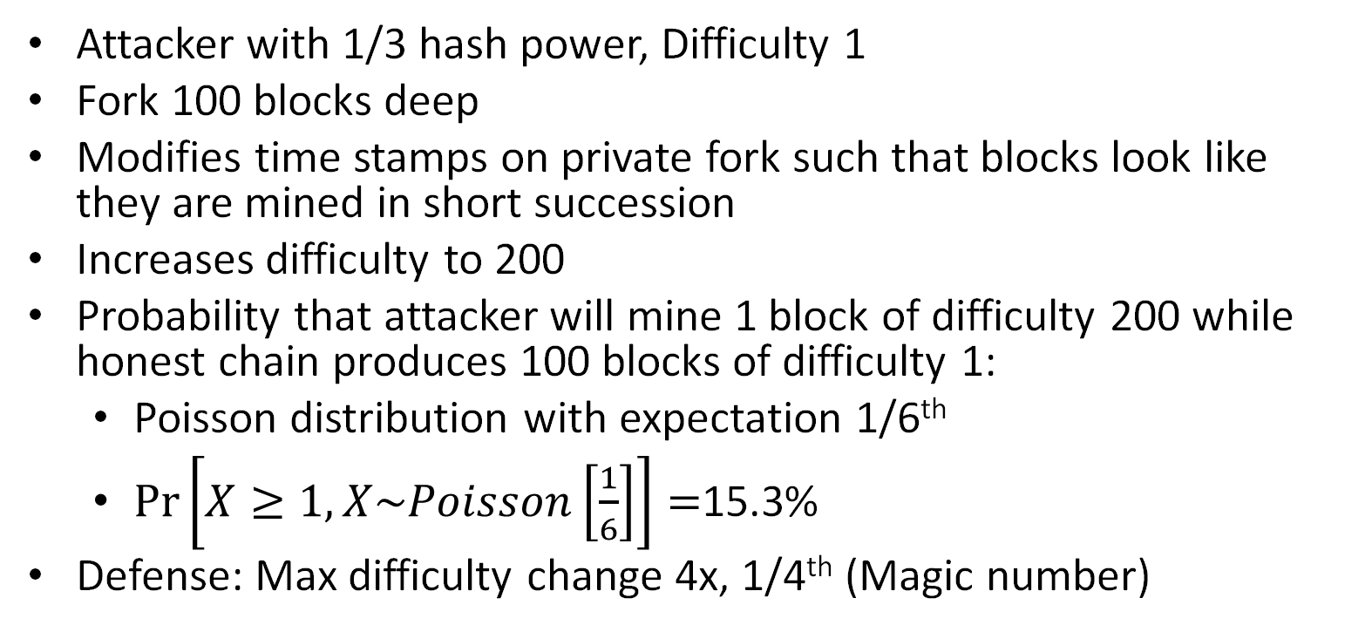
Difficulty Reset Attacks
Attacker with 1/3 hash power, Difficulty 1
Fork 100 blocks deep
Modifies time stamps on private fork such that blocks look like they are mined in short succession
Increases difficulty to 200
Probability that attacker will mine 1 block of difficulty 200 while honest chain produces 100 blocks of difficulty 1:
  Poisson distribution with expectation 1/6th
  $\operatorname{Pr}\left[X≥1,X\sim Poisson\left[\frac{1}{6}\right]\right]=$15.3%
Defense: Max difficulty change 4x, 1/4th (Magic number)

Slide 7

Changing the rules/Governance
Protocol upgrades
  New Transaction types (Add Smart Contracts)
  New Consensus (Switch from PoW to PoS)
  Increase Blocksize (1MB) Bitcoin/Bitcoin Cash
How do we reach consensus on these things

Slide 8
Soft/Hard Fork Activiation
Hard Fork
V1.0
V1.0
V2.0
V2.0
V2.0
Activated
V2.0
V2.0
V2.0
Soft Fork (Backwards compatible)
V 2.0
V 2.0
V 1.0
V2.0
V2.0
V 1.0

Slide 9
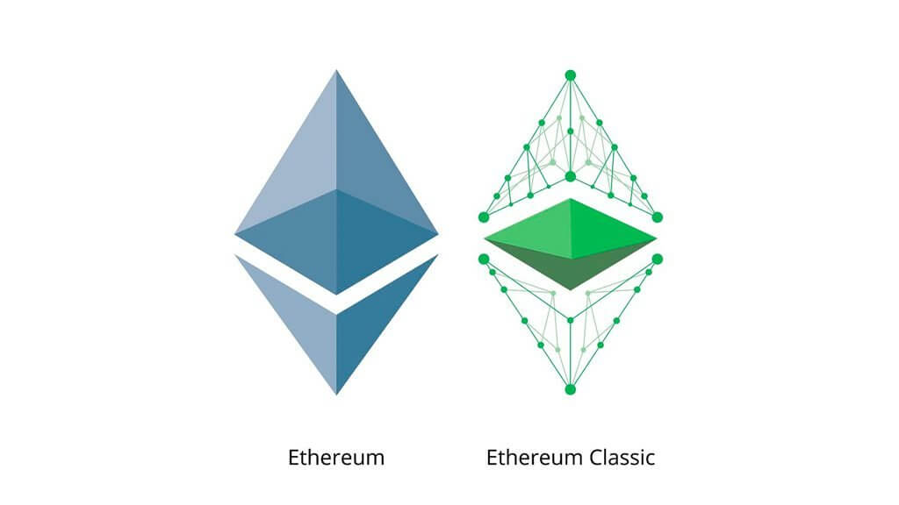
Hard Forks
Technically the simplest
New protocol version (new software)
Everyone upgrades
New protocol incompatible with old protocol
Everyone needs to upgrade
Ethereum/Zcash/Monero do this semi regularly
Contentious Hard Fork: Both versions exists
  Need to worry about replay attacks

Slide 10
Soft Forks
Rules become more restrictive
Disabling old OP_CODES
Further specifying signatures (ECDSA)
Old clients still work but their transactions may get rejected
If >50% upgrade then new rules enforced
Segregated Witness was a contentious soft fork

Slide 11
Case Study: Bitcoin vs Bitcoin Cash
Bitcoin Blocks are limited to 1MB
~Roughly 7 tx/s
Proposal to increase block size
Opinion 1: “Larger blocks increase network delay, decreases security, transactions should be moved off the chain.”
Opinion 2: “Bitcoin can support more transactions we should increase block size.”
Split in 2017: Every Bitcoin user got same amount of Bitcoin Cash (sum is less than sum of parts).

Slide 12
Case Study: Ethereum vs. Classic
Ethereum had a smart contract called DAO
Smart contract had a bug
July 2016, $50 Million USD of Ether stolen
Proposal to hard fork Ethereum and return funds
Stake vote was held
  87% in favor but only 5.5% participated
  4 days later Ethereum forked
  “Classic” is the old version including stolen funds
Ethereum Foundation owns trademark and branded Fork Ethereum
Later more divergence: Ethereum will move to PoS, Classic stay on PoW

Slide 13

Recap Byzantine Consensus
Fast
Partially Synchronous
No wasted energy
Known committee
  (must communicate)
Large committee
  Large communication
Predictable Leader
  Bribing 💸

Slide 14
Proof of Stake
Replace Sybill resistance of PoW with money
Staking pool
  💸
Stakes coins (through transaction)
Can’t use staked coins for anything else!
  💸
  💸
  💸
  💸
  💸
Incentives: Get’s rewards/fees. Can use punishments/slashing
Voting Power: Proportional to relative stake

Slide 15
Scaling Byzantine Consensus
Sub select a set of participants to run BC
Many stake weighted participants

Slide 16

Scaling Byzantine Consensus
Sub select a set of participants to run BC
What fraction of committee will be corrupted?

Slide 17
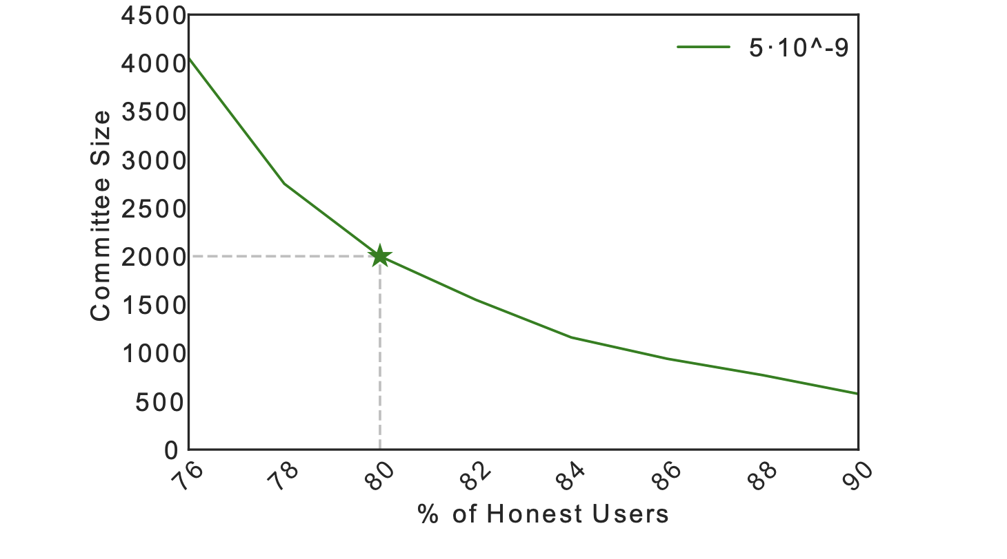
Scaling Byzantine Consensus
100s of nodes
>67% Honest
>1000s of nodes
80% Honest

Slide 18
Random Selection
How to choose committee?
Proposal:
Each staker computes H(block number,PK)
If H(block number,PK)< target
  Become part of committee for round
If BC succeeds add Block to chain
Target such that ~1000 nodes win
Broken! Attacker can choose PK such that they win

Slide 19

Randomness beacon
An ideal service that regularly publishes random value which no party can predict or manipulate
01010001 01101011 10101000 11110000

Slide 20
Random Selection with Beacon
How to choose committee?
Each Block wait for beacon randomness
Each staker computes H(block number beacon, PK)
If H(block number beacon,PK)< target
  Become part of committee for round
If BC succeeds add Block to chain
Beacon unpredictable so can’t choose PK
Even better: Compute deterministic (BLS) signature on Beacon and use as ticket (prevents others from seeing who won) VRF

Slide 21
Leader Selection
We can also make leader election random with a beacon!
Can make BC resilient vs. adversary that corrupts adaptively
(Bribing)
See Algorand reading

Slide 22
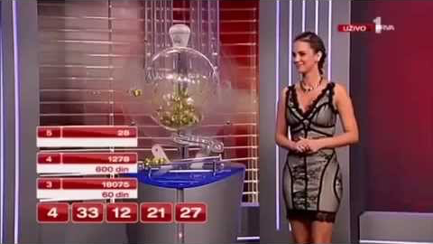
Lotteries
``Public displays”
can be corrupted
A beacon can be used to run a fair lottery

Slide 23
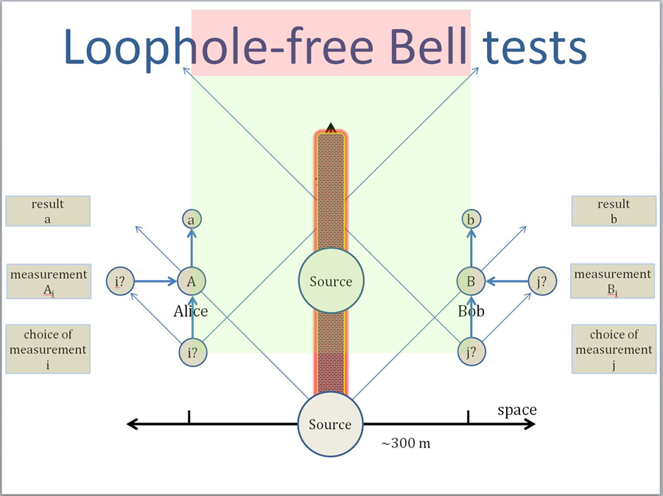
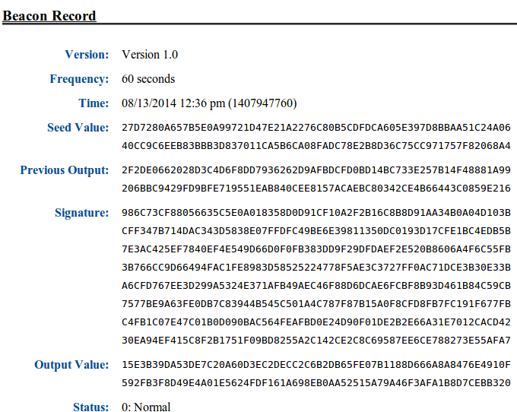
How to build a Beacon?
NIST (NSA) Beacon

Slide 24
Collect randomness approach
Alice
Bob
Claire
Zoe
Mildly synchronous
r_{a}
r_{b}
r_{c}
r_{z}
Blockchain
output beacon = Hash(r_{a} || r_{b} || ⋯ || r_{z} ) ∈ {0,1}²⁵⁶
Problem: Zoe controls the final seed !!
Notes:
VDFs solve the bias issue at the expense of synchrony
“Resurrect the most simple approach to multiparty randomness generation”

Slide 25
Commit and Reveal
Alice
Bob
Claire
Zoe
R1:
H(r_{a})
H(r_{b})
H(r_{c})
H(r_{z})
Mildly synchronous
R2:
r_{a}
r_{b}
r_{c}
r_{z}
Blockchain
output beacon = Hash(r_{a} || r_{b} || ⋯ || r_{z} ) ∈ {0,1}²⁵⁶
Problem: Beacon can be biased by not opening!!
K parties, k bits of influence
Notes:
VDFs solve the bias issue at the expense of synchrony
“Resurrect the most simple approach to multiparty randomness generation”

Slide 26
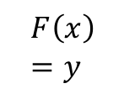


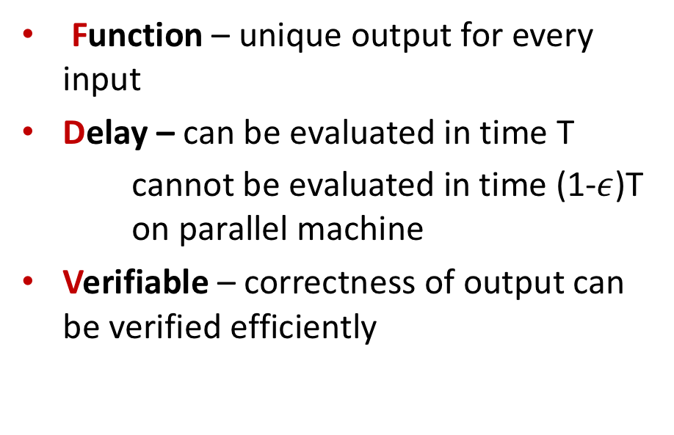
Verifiable Delay Function (VDF)
$$F$$
Function – unique output for every input
Delay – can be evaluated in time T
cannot be evaluated in time (1-$ε$)T on parallel machine
Verifiable – correctness of output can be verified efficiently
X
Y
$$F\left(x\right)=y$$
$$x, y, π$$
Verifier

Slide 27
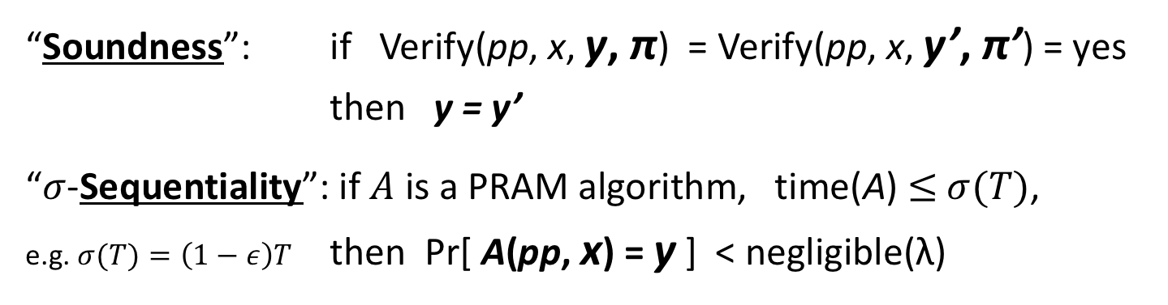
Security Properties (Informal)
Setup(λ, T) ⟶ public parameters pp
Eval(pp, x) ⟶ output y, proof π (requires T steps)
Verify(pp, x, y, π) ⟶ { yes, no }
“Soundness”: if Verify(pp, x, y, π) = Verify(pp, x, y’, π’) = yes
then y = y’
“$σ$-Sequentiality”: if $A$ is a PRAM algorithm, time(A) $≤$ $σ(T)$,
e.g. $σ(T)=\left(1−ε\right)T$ then Pr[ A(pp, x) = y ] < negligible(λ)
Notes:
T is required to be subexponential in lambda
sigma sequentiality is stated informally for now, describe formal game-based definition in several slides

Slide 28
Collect randomness approach
Alice
Bob
Claire
Zoe
Mildly synchronous
r_{a}
r_{b}
r_{c}
r_{z}
Blockchain
output beacon = Hash(r_{a} || r_{b} || ⋯ || r_{z} ) ∈ {0,1}²⁵⁶
Problem: Zoe controls the final seed !!
Notes:
VDFs solve the bias issue at the expense of synchrony
“Resurrect the most simple approach to multiparty randomness generation”

Slide 29
Solution: slow things down with a VDF [LW’15]
Alice
Bob
Claire
Zoe
r_{a}
r_{b}
r_{c}
r_{z}
Public Bulletin Board (blockchain)
Hash(r_{a} || r_{b} || ⋯ || r_{z} ) ∈ {0,1}²⁵⁶
VDF
H
beacon, π
Notes:
VDF is longer than time from ra to rz

Slide 30
Solution: slow things down with a VDF [LW’15]
VDF delay ≫ max-Δ-time(Alice ⟶ Zoe)
Uniqueness: ensures no ambiguity about output
Public Bulletin Board (blockchain)
Hash(r_{a} || r_{b} || ⋯ || r_{z} ) ∈ {0,1}²⁵⁶
VDF
H
beacon, π
Notes:
Hash function at the end ensures A cannot distinguish seed from random until after the time delay

Slide 31
VDF Beacon in a blockchain
Block i
Block i+1
Initializes VDF Beacon
Committee i+1
Committee i

Slide 32
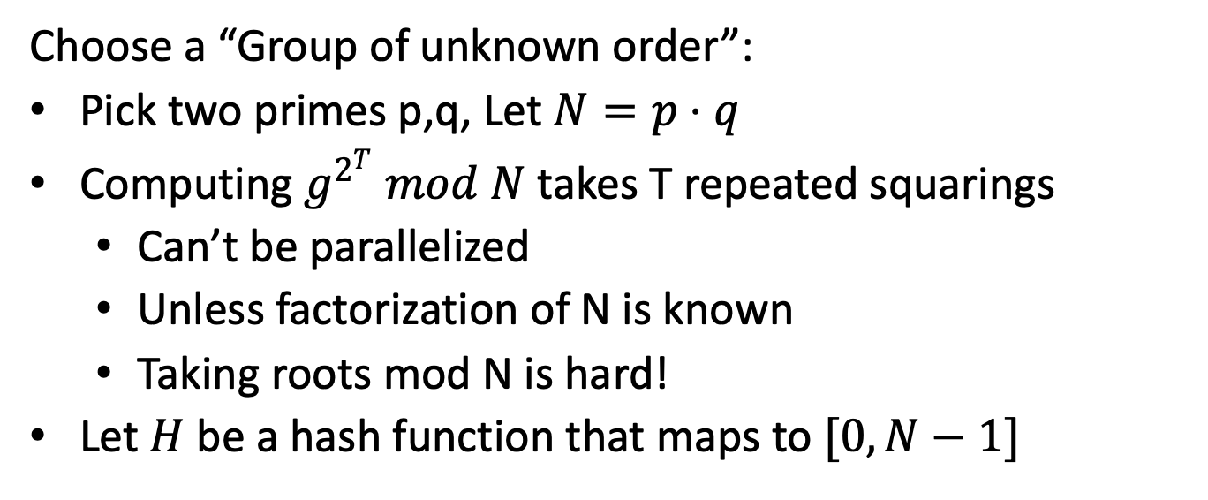
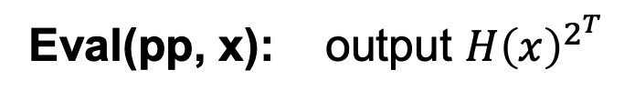
How to build a VDF
Choose a “Group of unknown order”:
Pick two primes p,q, Let $N=p⋅q$
Computing $g^{2^{T}} mod N$ takes T repeated squarings
  Can’t be parallelized
  Unless factorization of N is known
  Taking roots mod N is hard!
Let $H$ be a hash function that maps to $[0,N−1]$
Eval(pp, x): output $H{\left(x\right)}^{2^{T}}$
How to verify?

Slide 33
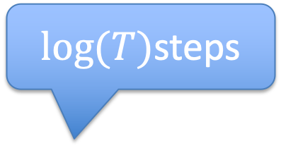
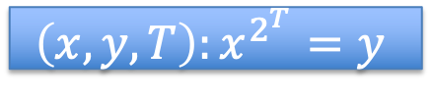
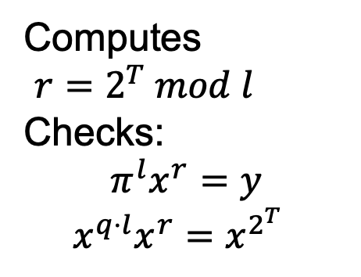


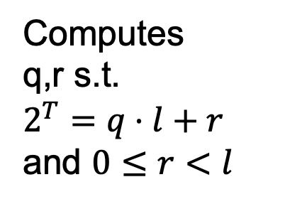

VDF Proof [Wesolowski’18]
$$\left(x,y,T\right):x^{2^{T}}=y$$
y
Random $λ$ bit prime l
$\log{(T)}$steps
Computes
q,r s.t.
$2^{T}=q⋅l+r$ and $0≤r<l$
Computes
$r=2^{T} mod l$
Checks:
$$π^{l}x^{r}=y$$
$$x^{q⋅l}x^{r}=x^{2^{T}}$$
$$π=x^{q}$$

Slide 34
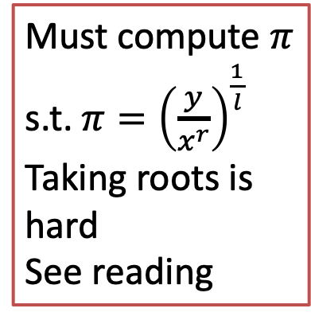
Security intuition
$$\left(x,y,T\right):x^{2^{T}}=y$$
Must compute $π$
s.t. $π={\left(\frac{y}{x^{r}}\right)}^{\frac{1}{l}}$
Taking roots is hard
See reading
y
Random $λ$ bit prime l
Computes
q,r s.t.
$2^{T}=q⋅l+r$ and $0≤r<l$
Computes
$r=2^{T} mod l$
Checks:
$$π^{l}x^{r}=y$$
$$x^{q⋅l}x^{r}=x^{2^{T}}$$
$$π=x^{q}$$

Slide 35

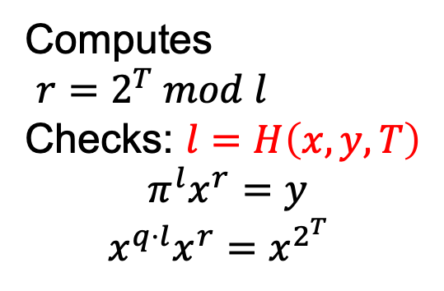

VDF Proof [Wesolowski’18]
$$\left(x,y,T\right):x^{2^{T}}=y$$
y
$$l=H\left(x,y,T\right)∈Primes$$
Computes
q,r s.t.
$2^{T}=q⋅l+r$ and $0≤r<l$
Computes
$r=2^{T} mod l$
Checks: $l=H\left(x,y,T\right)$
$$π^{l}x^{r}=y$$
$$x^{q⋅l}x^{r}=x^{2^{T}}$$
$$π=x^{q},l$$

Slide 36
END OF LECTURE
Next lecture:
Ethereum and Smart Contracts

