Slide 1
Ethereum: mechanics
CS251 Fall 2020
(cs251.stanford.edu)
Dan Boneh
Note: HW#2 is posted on the course web site. Due Oct. 12.

Slide 2
Limitations of Bitcoin
Recall: UTXO contains (hash of) ScriptPK
simple script: indicates conditions when UTXO can be spent
Limitations:
Difficult to maintain state in multi-stage contracts
Difficult to enforce global rules on assets
A simple example: rate limiting. My wallet manages 100 UTXOs.
Desired policy: can only transfer 2BTC per day out of my wallet
Notes:
a UTXO being spent cannot tell how many of my other UTXOs were spent during that day.

Slide 3
An example: NameCoin
Domain name system on the blockchain: [google.com ⇾ IP addr]
Need support for three operations:
Name.new(OwnerAddr, DomainName): intent to register
Name.update(DomainName, newVal, newOwner, OwnerSig)
Name.lookup(DomainName)
Note: also need to ensure no front-running on Name.new()

Slide 4
A broken implementation
Name.new() and Name.upate() create a UTXO with ScriptPK:
DUP HASH256 <OwnerAddr> EQVERIFY CHECKSIG
VERIFY <NameCoin> <DomainName> <IPaddr> <1>
only owner can “spend” this UTXO to update domain data
Contract: (should be enforced by miners)
if domain google.com is registered,
no one else can register that domain
Problem: this contract cannot be enforced using Bitcoin script

Slide 5

What to do?
NameCoin: fork of Bitcoin that implements this contract
(see also the handshake project)
Can we build a blockchain that natively supports generic contracts like this?
⇒ Ethereum

Slide 6

Ethereum: enables many applications
About 3000 Ethereum Decentralized Apps (DAPPs)
New coins: ERC-20 interface to DAPP
DeFi: exchanges, lending, stablecoins, derivatives, etc.
Insurance
Games: assets managed on chain (e.g. CryptoKitties)
Managing distinguished assets (ERC-821)
stateofthedapps.com, dapp.review

Slide 7
Bitcoin as a state transition system
world state
updated world state
UTXO₁
UTXO₂
⋮
UTXO₁
UTXO₃
⋮
input
…
…
Tx: UTXO₂ ⇾ UTXO₃
Bitcoin rules:
F_{bitcoin} : S × I ⇾ S
S: set of all possible world states, s₀ ∈ S genesis state
I: set of all possible inputs

Slide 8
Ethereum as a state transition system
Much richer state transition functions
⇒ one transition executes an entire program

Slide 9
Running a program on a blockchain (DAPP)
… blockchain …
Tx1
Tx2
state₂
…
state₀
state₁
program code
create a DAPP
Layer 2:
compute layer (executed by miners)
Layer 1:
consensus layer

Slide 10
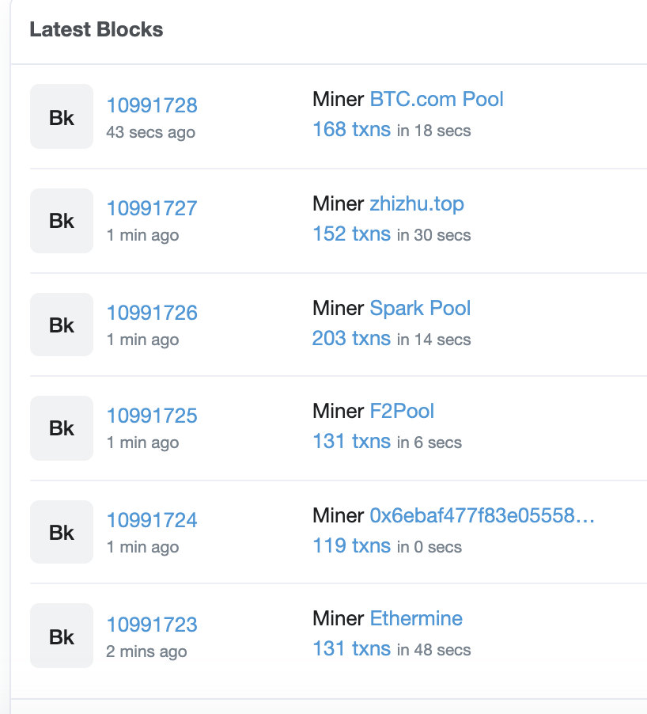
The Ethereum system
Layer 1: PoW consensus. Block reward = 2 ETH + Tx fees (gas)
avg. block rate = 15 seconds.
(variant of Nakamoto)
about 150 Tx per block.

Slide 11
Ethereum Layer 1.5: compute layer
World state: set of accounts identified by 160-bit address.
Two types of accounts:
owned accounts: controlled by ECDSA signing key pair (PK,SK).
SK known only to account owner
(2) contracts: controlled by code.
code set at account creation time, does not change

Slide 12
Data associated with an account
Account data Owned Contracts
address (computed): H(PK) H(CreatorAddr, CreatorNonce)
code: ⊥ CodeHash
storage root (state): ⊥ StorageRoot
balance (in Wei): balance balance (10¹⁸ Wei = 1 ETH)
nonce: nonce nonce
(#Tx sent) + (#accounts created): anti-replay mechanism

Slide 13
Account state: persistent storage
Every contract has an associated storage array S[]:
S[0], S[1], … , S[2²⁵⁶-1]: each cell holds 32 bytes, init to 0.
Account storage root: Merkle Patricia Tree hash of S[]
  Cannot compute full Merkle tree hash: 2²⁵⁶ leaves
0
0, a
S[000] = a
S[010] = b
S[011] = c
S[110] = d
time to compute
root hash:
≤ 2×|S|
0
0
⊥, b
root
1
1
10, d
1
⊥, c
|S| = # non-zero cells
Notes:
Store suffix in nodes.

Slide 14
State transitions: Tx and messages
Transactions: signed data by initiator
To: 32-byte address of target (0 ⇾ create new account)
From, Signature: initiator address and signature on Tx
Value: # Wei being sent with Tx
gasPrice, gasLimit: Tx fees (later)
if To = 0: create new contract code = (init, body)
if To ≠ 0: data (what function to call & arguments)
nonce: must match current nonce of sender (prevents Tx replay)
Notes:
nonce must match current nonce of sender in sender’s account data. When Tx processed successfully, nonce in sender’s account data is incremented by 1.

Slide 15
State transitions: Tx and messages
Transaction types:
owned ⇾ owned: transfer ETH between users
owned ⇾ contract: call contract with ETH & data

Slide 16
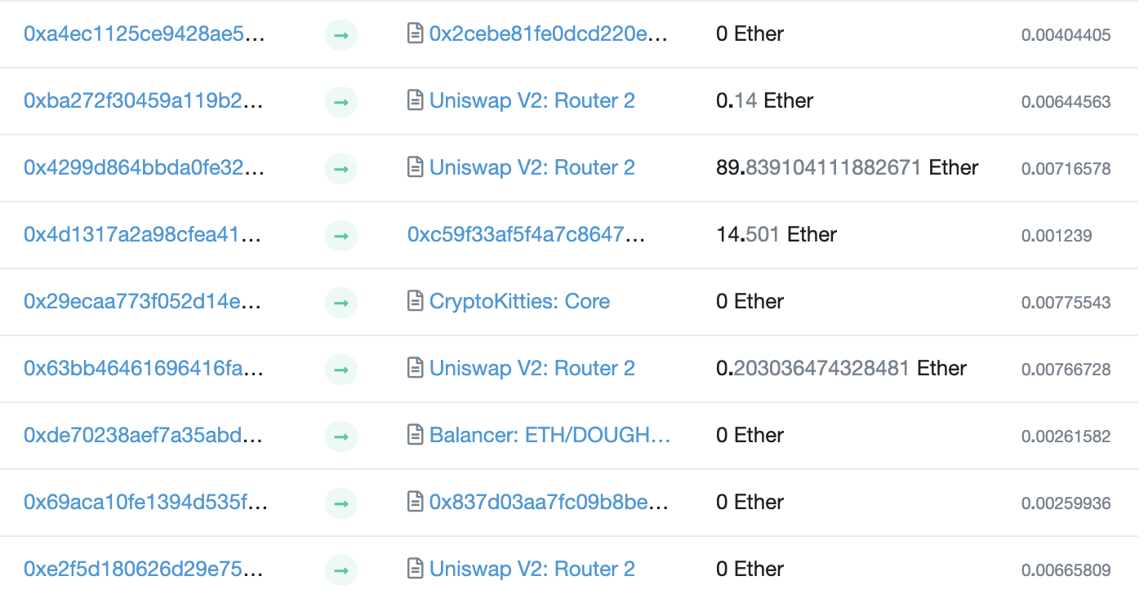
Example (block #10993504)
From
To
msg.value
Tx fee (ETH)
Notes:
Some Tx go to contracts, others go to owned addresses

Slide 17
Messages: virtual Tx initiated by a contract
Same as Tx, but no signature (contract has no signing key)
contract ⇾ owned: contract sends funds to user
contract ⇾ contract: one program calls another (and sends funds)
One Tx from user: can lead to many Tx processed. Composability!
Tx from owned addr ⇾ contract ⇾ another contract
another contract ⇾ different owned

Slide 18
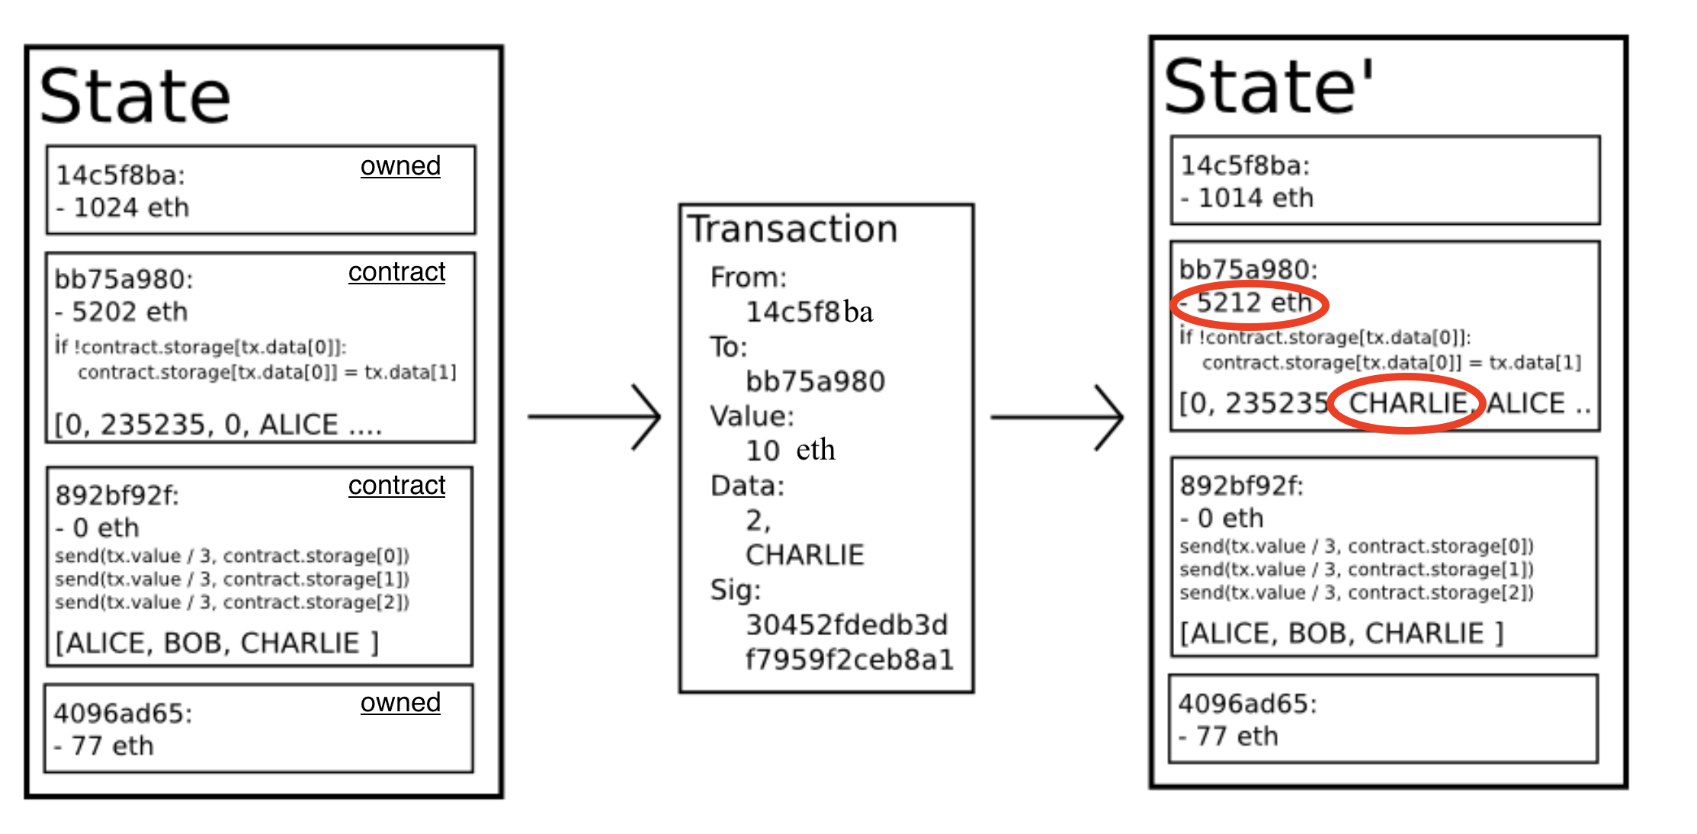
Example Tx
world state (four accounts)

Slide 19
An Ethereum Block
Miners collect Txs from users ⇒ leader creates a block of n Tx
Miner does:
    for i=1,…,n: execute state change of Tx_{i}
    (can change state of >n accounts)
    record updated world state in block
Other miners re-execute all Tx to verify block
Miners should only build on a valid block
Miners are not paid for verifying block (note: verifier’s dilemma)

Slide 20
Block header data (simplified)
consensus data: parent hash, difficulty, PoW solution, etc.
address of gas beneficiary: where Tx fees will go
world state root: updated world state
Merkle Patricia Tree hash of all accounts in the system
(4) Tx root: Merkle hash of all Tx processed in block
(5) Tx receipt root: Merkle hash of log messages generated in block
(5) Gas used: tells verifier how much work to verify block

Slide 21
The Ethereum blockchain: abstractly
prev hash
prev hash
…
…
accts.
accts.
updated
world
state
Tx
log
messages
updated
world
state
Tx
log
messages

Slide 22
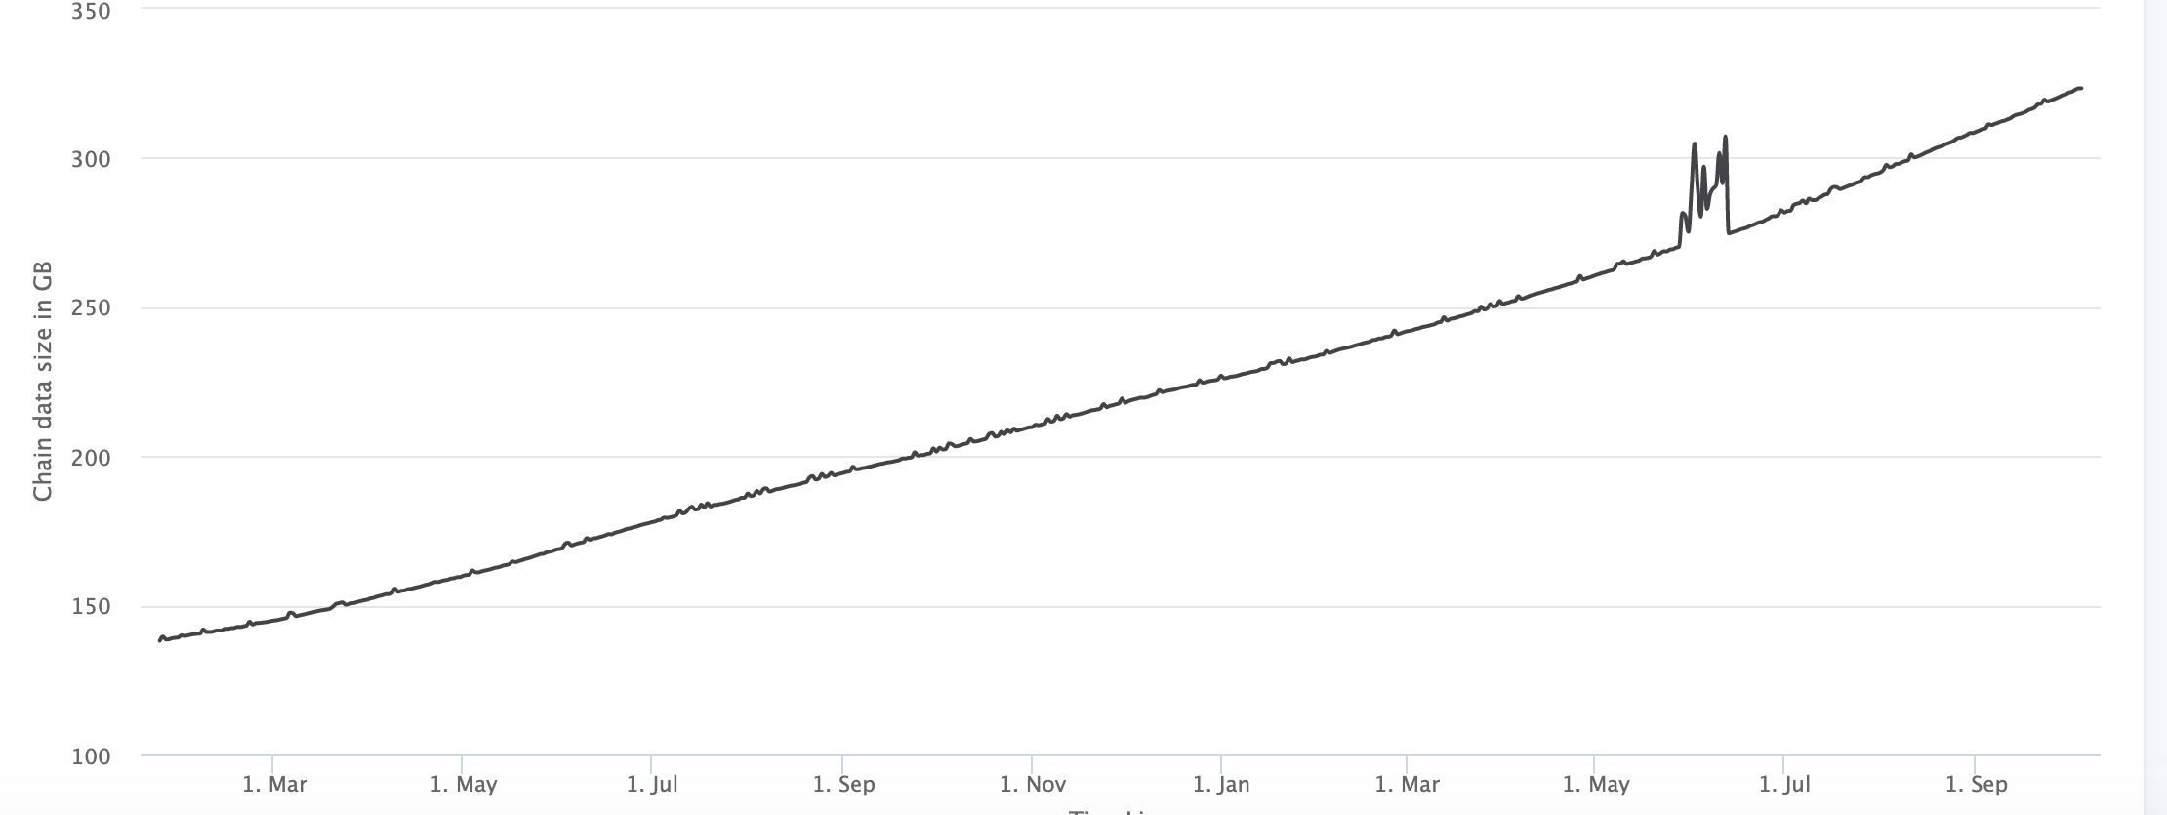
Amount of memory to run a node (in GB)
323GB
ETH total blockchain size: 5.2 TB (Oct. 2020)

Slide 23
An example contract: NameCoin
contract nameCoin { // Solidity code (next lecture)
struct nameEntry {
address owner; // address of domain owner
bytes32 value; // IP address
}
// array of all registered domains
mapping (bytes32 => nameEntry) data;

Slide 24
An example contract: NameCoin
function nameNew(bytes32 name) {
// registration costs is 100 Wei
if (data[name] == 0 && msg.value >= 100) {
data[name].owner = msg.sender // record domain owner
emit Register(msg.sender, name) // log event
}}
Code ensures that no one can take over a registered name

Slide 25
An example contract: NameCoin
function nameUpdate(
bytes32 name, bytes32 newValue, address newOwner) {
// check if message is from domain owner,
// and update cost of 10 Wei is paid
if (data[name].owner == msg.sender && msg.value >= 10) {
data[name].value = newValue; // record new value
data[name].owner = newOwner; // record new owner
}}}

Slide 26
An example contract: NameCoin
function nameLookup(bytes32 name) {
return data[name];
}
} // end of contract

Slide 27
EVM mechanics: execution environment
Write code in Solidity (or another front-end language)
⇒ compile to EVM bytecode
(recent projects use WASM or BPF bytecode)
⇒ miners use the EVM to execute contract bytecode
in response to a Tx

Slide 28
The EVM
Stack machine (like Bitcoin) but with JUMP
max stack depth = 1024
program aborts if stack size exceeded; miner keeps gas
contract can create or call another contract
In addition: two types of zero initialized memory
Persistent storage (on blockchain): SLOAD, SSTORE (expensive)
Volatile memory (for single Tx): MLOAD, MSTORE (cheap)
LOG0(data): write data to log

Slide 29
Gas prices: examples
SSTORE addr (32 bytes), value (32 bytes)
zero ⇾ non-zero: 20,000 gas
non-zero ⇾ non-zero: 5,000 gas
non-zero ⇾ zero: 15,000 gas refund
SUICIDE: kill current contract. 24,000 gas refund
Refund is given for reducing size of blockchain state

Slide 30
Gas calculation
Tx fees (gas) prevents submitting Tx that runs for many steps
Every EVM instruction costs gas:
    Tx specifies gasPrice: conversion: gas ⇾ Wei
    gasLimit: max gas for Tx

Slide 31
Gas calculation
Tx specifies gasPrice: conversion gas ⇾ Wei
    gasLimit: max gas for Tx
if gasLimit×gasPrice > msg.sender.balance: abort
deduct gasLimit×gasPrice from msg.sender.balance
set Gas = gasLimit
execute Rx: deduct gas from Gas for each instruction
if (Gas < 0): abort, miner keeps gasLimit×gasPrice
(5) Refund Gas×gasPrice to msg.sender.balance
Notes:
gas for each instruction defined by a hard coded table.

Slide 32
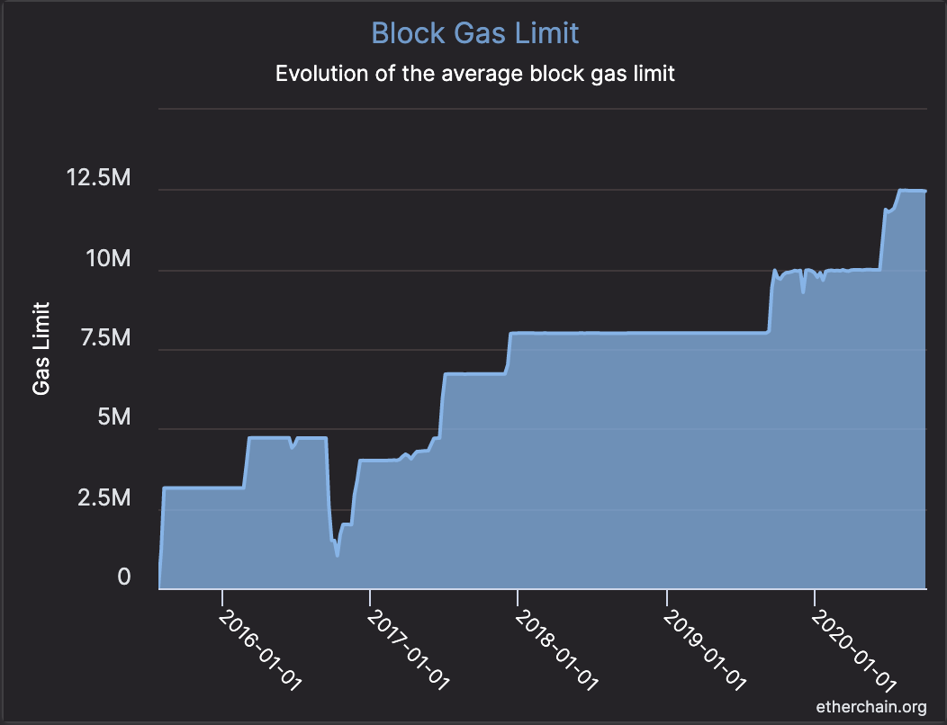
Transactions are becoming more complex
GasLimit is increasing over time ⇒ each Tx takes more instructions to execute

Slide 33
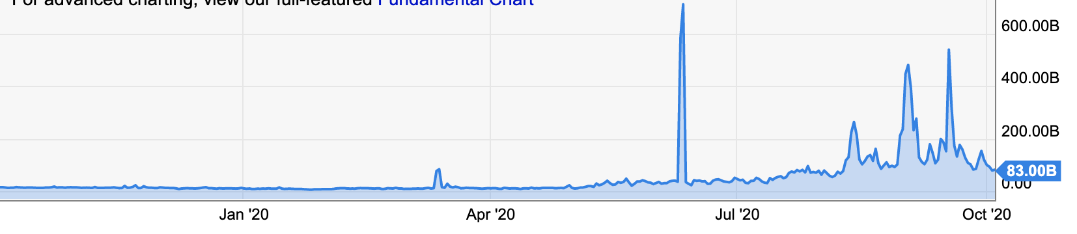
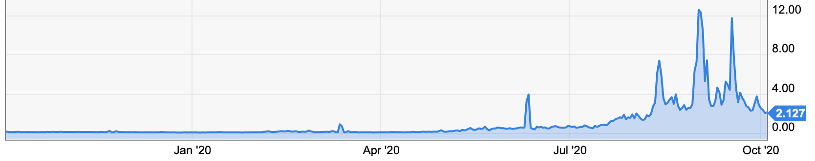
Gas prices: spike during congestion
GasPrice in Gwei:
83B Gwei = 83×10⁻⁹ ETH
Average Tx fee in USD

Slide 34
END OF LECTURE
Next lecture: writing Solidity contracts

