Slide 1
Solidity
CS251 Fall 2020
(cs251.stanford.edu)
Dan Boneh

Slide 2
Recap
World state: set of accounts identified by 160-bit address.
Two types of accounts:
owned accounts: address = H(PK)
(2) contracts: address = H(CreatorAddr, CreatorNonce)

Slide 3
Recap: Transactions
To: 32-byte address (0 ⇾ create new account)
From: 32-byte address
Value: # Wei being sent with Tx
gasPrice, gasLimit: Tx fees (later)
data: what contract function to call & arguments
if To = 0: create new contract code = (init, body)
[signature]: if Tx initiated by an owned account
Notes:
nonce must match current nonce of sender in sender’s account data. When Tx processed successfully, nonce in sender’s account data is incremented by 1.

Slide 4
Recap: Blocks
Miners collect Tx from users:
⇒ run them sequentially on current world state
⇒ new block contains updated world state and Tx list and log msgs

Slide 5
The Ethereum blockchain: abstractly
prev hash
prev hash
…
…
accts.
accts.
updated world state
Tx
log messages
updated world state
Tx
log messages

Slide 6
EVM mechanics: execution environment
Write code in Solidity (or another front-end language)
⇒ compile to EVM bytecode
(recent projects use WASM or BPF bytecode)
⇒ miners use the EVM to execute contract bytecode in response to a Tx

Slide 7
The EVM
Stack machine (like Bitcoin) but with JUMP
max stack depth = 1024
program aborts if stack size exceeded; miner keeps gas
contract can create or call another contract
In addition: two types of zero initialized memory
Persistent storage (on blockchain): SLOAD, SSTORE (expensive)
Volatile memory (for single Tx): MLOAD, MSTORE (cheap)
LOG0(data) instruction: write data to log

Slide 8
Gas prices: examples
SSTORE addr (32 bytes), value (32 bytes)
zero ⇾ non-zero: 20,000 gas
non-zero ⇾ non-zero: 5,000 gas
non-zero ⇾ zero: 15,000 gas refund
SUICIDE: kill current contract. 24,000 gas refund
Refund is given for reducing size of blockchain state

Slide 9
Gas calculation
Tx fees (gas) prevents submitting Tx that runs for many steps
Every EVM instruction costs gas:
Tx specifies gasPrice: conversion: gas ⇾ Wei
gasLimit: max gas for Tx

Slide 10
Gas calculation
Tx specifies gasPrice: conversion gas ⇾ Wei
gasLimit: max gas for Tx
if gasLimit×gasPrice > msg.sender.balance: abort
deduct gasLimit×gasPrice from msg.sender.balance
set Gas = gasLimit
execute Tx: deduct gas from Gas for each instruction
if (Gas < 0): abort, miner keeps gasLimit×gasPrice
(5) Refund Gas×gasPrice to msg.sender.balance
Notes:
gas for each instruction defined by a hard coded table.
Max refund in (5) is gasLimit times gasPrice

Slide 11
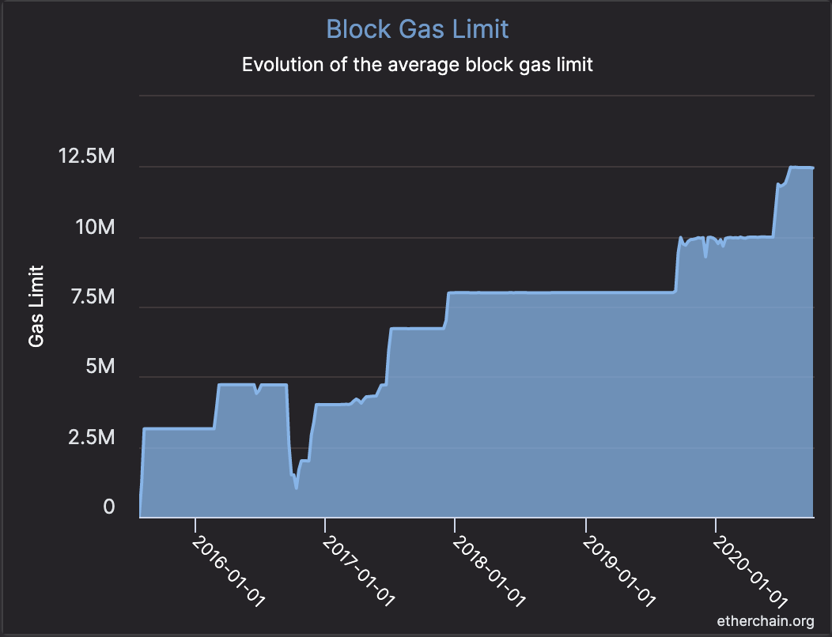
Transactions are becoming more complex
GasLimit is increasing over time ⇒ each Tx takes more instructions to execute

Slide 12
Gas prices: spike during congestion
GasPrice in Gwei: 83 Gwei = 83×10⁻⁹ ETH
Average Tx fee in USD

Slide 13
Solidity
docs: https://solidity.readthedocs.io/en/v0.7.2/
IDE: https://remix-ide.readthedocs.io/en/latest/#

Slide 14
Contract structure
contract IERC20Token { function transfer(address _to, uint256 _value) external returns (bool);
function totalSupply() external view returns (uint256);
…
}
contract ERC20Token is IERC20Token { // inheritance
address owner;
constructor() public { owner = msg.sender; }
function transfer(address _to, uint256 _value) external returns (bool) {
… implentation …
} }

Slide 15
Value types
uint256
address (bytes20)
_address.balance, _address.send(value), _address.transfer(value)
call: send Tx to another contract
bool success = _address.call(data).value(amount).gas(amount);
delegatecall: load code from another contract into current context
bytes32
bool
Notes:
send(): returns false on failure. transfer() raises exception on failure.

Slide 16
Reference types
struct Person {
uint128 age;
uint128 balance;
address addr;
}
Person[10] public people;
structs
arrays
bytes
strings
mappings:
Declaration: mapping (address => unit256) balances;
Assignment: balances[addr] = value;

Slide 17
Globally available variables
block: .blockhash, .coinbase, .difficulty, .gaslimit, .number, .timestamp
gasLeft()
msg: .data, .sender, .sig, .value
tx: .gasprice, .origin
abi: encode, encodePacked, encodeWithSelector, encodeWithSignature
Keccak256(), sha256(), sha3()
require, assert e.g.: require(msg.value > 100, “insufficient funds sent”)
A ⇾ B ⇾ C ⇾ D:
at D: msg.sender = C
tx.origin = A

Slide 18
Function visibilities
external: function can only be called from outside contract. Arguments read from calldata
public: function can be called externally and internally. Arguments copied from calldata to memory
private: only visible inside contract
internal: only visible in this contract and contracts deriving from it
view: only read storage (no writes to storage)
pure: does not touch storage
function f(uint a) private pure returns (uint b) { return a + 1; }

Slide 19
Using imports
contract SafeMath {
function safeAdd(uint256 a, uint256 b)
internal pure returns (uint256)
{
uint256 c = a + b;
require(c >= a, “UINT256_OVERFLOW");
return c;
}
}
Inheritance
contract A is SafeMath {}
uint256 a = safeAdd(b, c);
SafeMath code is compiled into the A contract
Libraries
contract A { using SafeMath for uint256; }
uint256 a = b.safeAdd(c);
Notes:
SafeMath can be declared as a library: Library SafeMath { } (instead of a contract)
Libraries are called using DELEGATECALL

Slide 20
ERC20 tokens
https://github.com/ethereum/EIPs/blob/master/EIPS/eip-20.md
A standard API for fungible tokens that provides basic functionality to transfer tokens or allow the tokens to be spent by a third party.
An ERC20 token is itself a smart contract that contains its own ledger of balances.
A standard interface allows other smart contracts to interact with every ERC20 tokens, rather than using special logic for each token.

Slide 21
ERC20 token interface
function transfer(address _to, uint256 _value) external returns (bool);
function transferFrom(address _from, address _to, uint256 _value) external returns (bool);
function approve(address _spender, uint256 _value) external returns (bool);
function totalSupply() external view returns (uint256);
function balanceOf(address _owner) external view returns (uint256);
function allowance(address _owner, address _spender) external view returns (uint256);
Notes:
transfer: transfer from Tx sender.
transferFrom: transfer from some other account. Function will check permissions.
approve: allow _spender to spend _value from Tx sender’s account
totalSupply: total coins in all accounts
allowance: how much can _spender spend from _owner’s acccount?

Slide 22
How are ERC20 tokens transferred?
contract ERC20Token is IERC20Token {
mapping (address => uint256) internal balances;
function transfer(address _to, uint256 _value) external returns (bool) {
require(balances[msg.sender] >= _value, "ERC20_INSUFFICIENT_BALANCE");
require(balances[_to] + _value >= balances[_to], "UINT256_OVERFLOW” );
balances[msg.sender] −= _value;
balances[_to] += _value;
emit Transfer(msg.sender, _to, _value); // write log message
return true;
}
}
Notes:
All coins initially belong to owner, then owner transfers coins to others using transfer().

Slide 23
ABI encoding and decoding
Every function has a 4 byte selector that is calculated as the first 4 bytes of the hash of the function signature.
In the case of `transfer`, this looks like bytes4(keccak256(“transfer(address,uint256)”);
The function arguments are then ABI encoded into a single byte array and concatenated with the function selector. ABI encoding simple types means left padding each argument to 32 bytes.
This data is then sent to the address of the contract, which is able to decode the arguments and execute the code.
Functions can also be implemented within the fallback function.

Slide 24
Calling other contracts
Addresses can be cast to contract types.
address _token;
IERC20Token tokenContract = IERC20Token(_token);
ERC20Token tokenContract = ERC20Token(_token);
When calling a function on an external contract, Solidity will automatically handle ABI encoding, copying to memory, and copying return values.
tokenContract.transfer(_to, _value);

Slide 25
Gas cost considerations
Everything costs gas, including processes that are happening under the hood (ABI decoding, copying variables to memory, etc).
Considerations in reducing gas costs:
How often to we expect a certain function to be called? Is the bottleneck the cost of deploying the contract or the cost of each individual function call?
Are the variables being used in calldata, the stack, memory, or storage?

Slide 26
Stack variables
Stack variables are generally the cheapest to use and can be used for any simple types (anything that is <= 32 bytes).
uint256 a = 123;
All simple types are represented as bytes32 at the EVM level.
Only 16 stack variables can exist within a single scope.

Slide 27
Calldata
Calldata is a read-only byte array.
Every byte of a transaction’s calldata costs gas (68 gas per non-zero byte, 4 gas per zero byte).
All else equal, a function with more arguments (and larger calldata) will cost more gas.
It is cheaper to load variables directly from calldata, rather than copying them to memory.
For the most part, this can be accomplished by marking a function as `external`.

Slide 28
Memory
Memory is a byte array.
Complex types (anything > 32 bytes such as structs, arrays, and strings) must be stored in memory or in storage.
string memory name = “Alice”;
Memory is cheap, but the cost of memory grows quadratically.

Slide 29
Storage
Using storage is very expensive and should be used sparingly.
Writing to storage is most expensive. Reading from storage is cheaper, but still relatively expensive.
mappings and state variables are always in storage.
Some gas is refunded when storage is deleted or set to 0
Trick for saving has: variables < 32 bytes can be packed into 32 byte slots.

Slide 30
Event logs
Event logs are a cheap way of storing data that does not need to be accessed by any contracts.
Events are stored in transaction receipts, rather than in storage.

Slide 31
Security considerations
Are we checking math calculations for overflows and underflows?
What assertions should be made about function inputs, return values, and contract state?
Who is allowed to call each function?
Are we making any assumptions about the functionality of external contracts that are being called?

Slide 32
Re-entrency bugs

Slide 33
contract Bank{
mapping(address=>uint) userBalances;
function getUserBalance(address user) constant public returns(uint) {
return userBalances[user]; }
function addToBalance() public payable {
userBalances[msg.sender] = userBalances[msg.sender] + msg.value; }
// user withdraws funds
function withdrawBalance() public {
uint amountToWithdraw = userBalances[msg.sender];
// send funds to caller ... vulnerable!
if (msg.sender.call().value(amountToWithdraw) == false) { throw; }
userBalances[msg.sender] = 0;
} }

Slide 34
contract Attacker {
uint numIterations;
Bank bank;
function Attacker(address _bankAddress) { // constructor
bank = Bank(_bankAddress);
numIterations = 10;
if (bank.value(75).addToBalance() == false) { throw; } // Deposit 75 Wei
if (bank.withdrawBalance() == false) { throw; } // Trigger attack
} }
function () { // the fallback function
if (numIterations > 0) {
numIterations --; // make sure Tx does not run out of gas
if (bank.withdrawBalance() == false) { throw; }
} } } }

Slide 35
Why is this an attack?
Attacker ⇾ Bank.addToBalance(75)
Attacker ⇾ Bank.withdrawBalance ⇾
Attacker.fallback ⇾ Bank.withdrawBalance ⇾
Attacker.fallback ⇾ Bank.withdrawBalance ⇾ …
withdraw 75 Wei at each recursive step

Slide 36
How to fix?
function withdrawBalance() public {
uint amountToWithdraw = userBalances[msg.sender];
userBalances[msg.sender] = 0;
if (msg.sender.call.value(amountToWithdraw)() == false) {
userBalances[msg.sender] = amountToWithdraw;
throw;
}
}

Slide 37
END OF LECTURE
Next lecture: crypto economics

